Slide 1



The Soft X-ray Imager on THESEUS
Paul O’Brien
(University of Leicester)
on behalf of the THESEUS SXI collaboration
http://www.isdc.unige.ch/theseus/

Slide 2
THESEUS Core Science is based on two pillars:
  probe the physical properties of the early Universe, by discovering and exploiting the population of high redshift GRBs.
  provide an unprecedented deep monitoring of the soft X-ray transient Universe, providing a fundamental contribution to multi-messenger and time domain astrophysics in the early 2030s (synergy with aLIGO/aVirgo, eLISA, ET, Km3NET and EM facilities e.g., LSST, E-ELT, SKA, CTA, ATHENA).
THESEUS Observatory Science includes:
  study of thousands of faint to bright X-ray sources by exploiting the unique simultaneous availability of broad band X-ray and NIR observations
  provide a flexible follow-up observatory for fast transient events with multi-wavelength ToO capabilities and guest-observer programmes.
http://www.isdc.unige.ch/theseus/

Slide 3
What do we need from the SXI?
Discovery instrument in the 0.3 – 5 keV band
Large instantaneous field of view for GRB detection and the X-ray survey
Good sensitivity: ~10⁻¹⁰ erg cm⁻² s⁻¹ in 100sec, ~2 x 10^{—11} in 1500sec
PSF to provide <2 arcmin localisation
The “usual” soft X-ray imaging systems do not provide the field of view
Scintillator or coded-mask devices do not observe below a few keV
A scintillator device does not provide the sensitivity or localisation accuracy
Our required combination of sky area and soft X-ray sensitivity requires an intrinsically wide-field, focusing X-ray optic – the so-called ‘Lobster-eye’

Slide 4
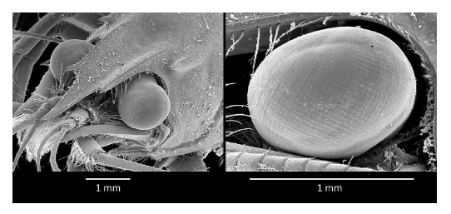
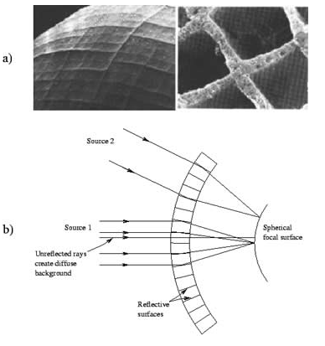
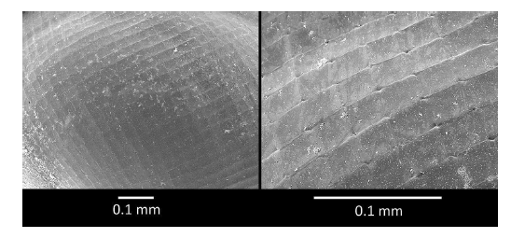
Lobster-eye Wide-field Vision
No single optical axis
X-ray option originally described by Angel (1979)
Notes:
http://www.ourislamicbooks.com/invit1/eye-of-the-lobster.html

Slide 5
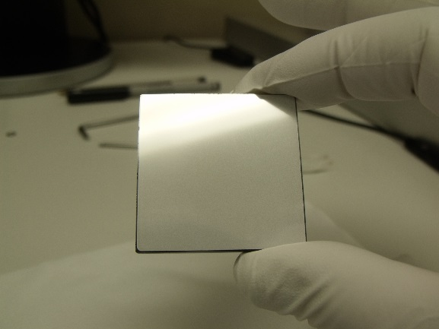

Micro Pore Optics
Glass plate – thickness L=2.4 mm
Square pores size 40 μm, so L/d=60 (provides optimum performance)
Slumped to spherical form R_{c}=2F = 600mm for THESEUS

Slide 6
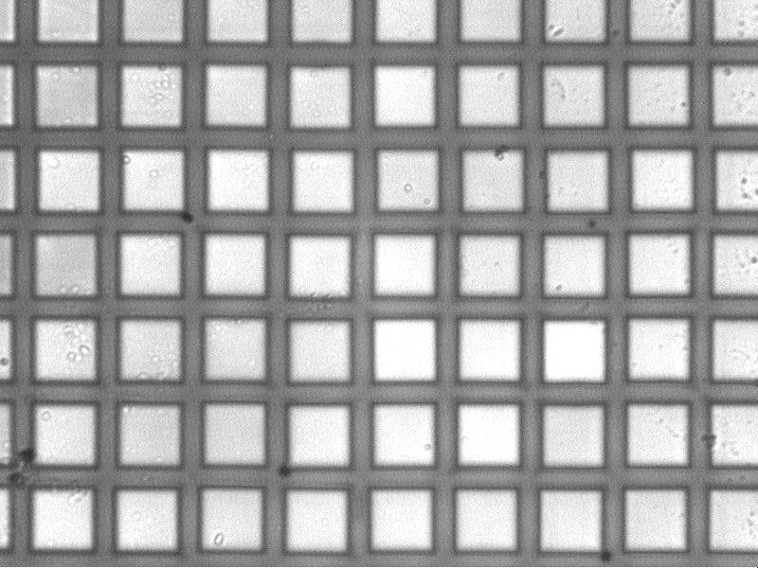
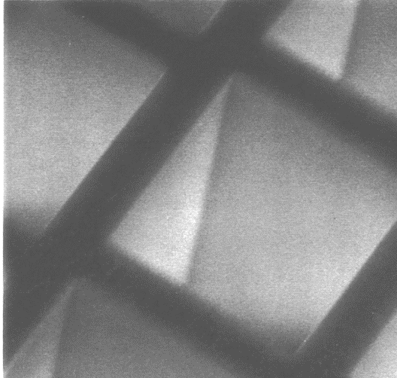
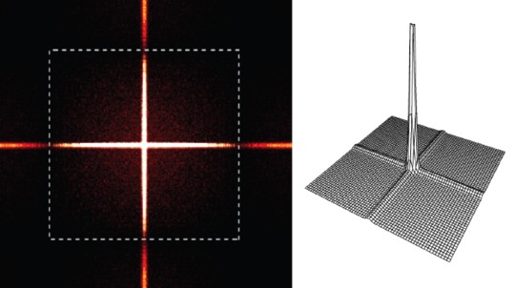
Operation of an MPO telescope
Incident X-rays
Diffuse
background
Double reflection (2-axes, true focus)
Single reflection (1 axis, line focus)

Slide 7
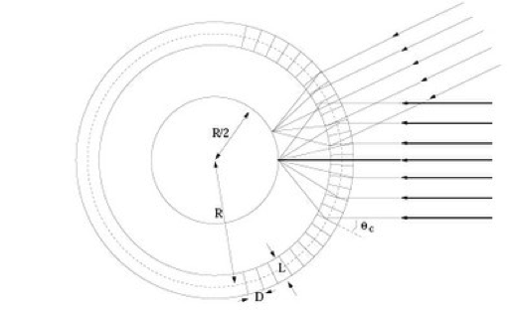
Detectors vs optics: Basic Geometry
A consequence of the geometry is that the
detector geometrical area is ¼ the optic
geometrical area. [expanded in practice to avoid
vignetting at edges]
Wide FOV → Big Detector Plane
Cooling possible issue with CCDs but greatly
lessened by using CMOS
FOV goes closely as linear with focal length
Effective area goes as focal length²
Equal areas
SVOM breadboard, UoL

Slide 8
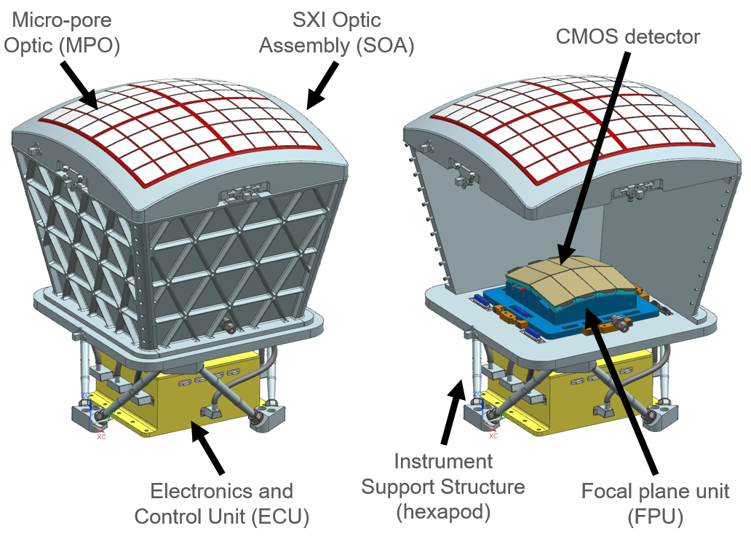
THESEUS Soft X-ray Imager (SXI)
2 identical modules observing in the 0.3-5 keV band
Each uses an 8x8 array of square pore MPOs
2 module FoV ~0.5 sr total (with small overlap)
Each uses 8 large format CMOS detectors (Te2v)
CMOS each 8x4cm² with 30-40 micron pixels
Each module has a mass ~40kg and is ~0.5m across

Slide 9


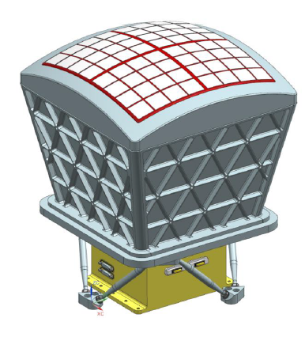






SXI Consortium
Instrument GSE
AIT
Calibration
Optics:
AIT
Frame
EDIV
Thermal control
PI
Software
Instrument S/W pipeline
Trigger algorithm
Software contributions
Science data centre
Structure:
Telescope tube
Hexapod
Focal plane
AIT
Structure
CMOS characterisation
Electronics control unit:
FEE
E-box
Data handling unit:
DHU
BEE (thermal control, HK)
Harnesses
UK, Spain, Belgium, Germany, Czech Republic, Netherlands, Ireland (+Poland & Switzerland)

Slide 10
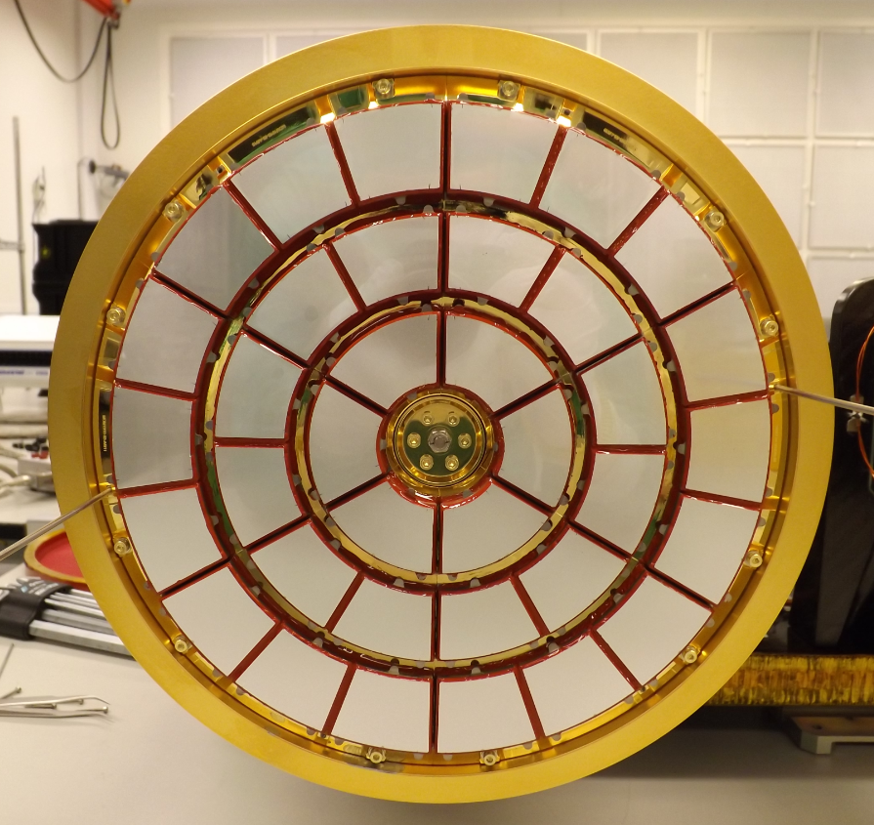
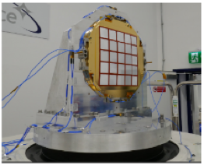
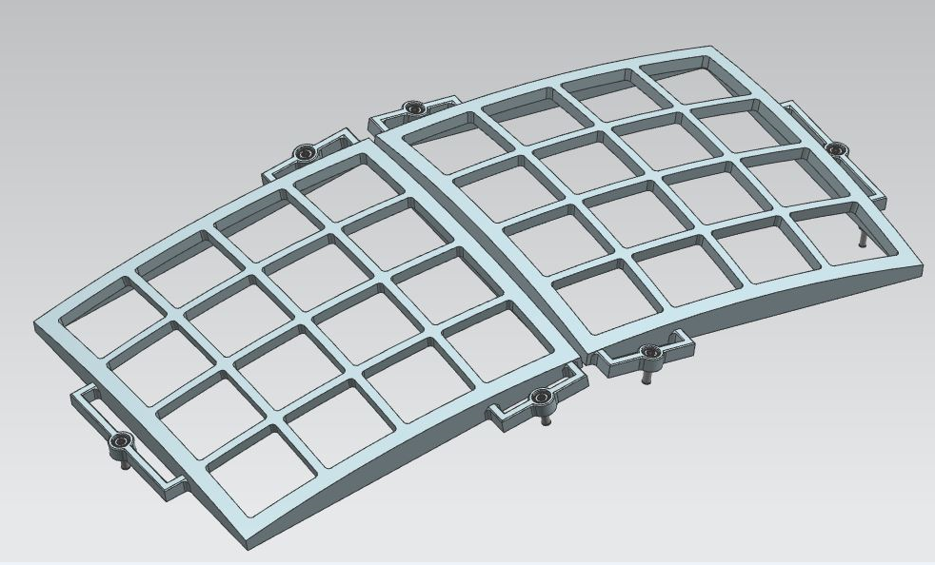
Optics heritage
Optic
  MIXS optic (Wolter type 2), 2m RoC - BepiColombo launched November 2018
  SVOM optic 5x5 MPOs, 2m RoC Lobster – FM built, launch 2022
  SMILE/SXI optic 8x4 MPOs, 600mm RoC, plates tested, launch 2024
  Theseus/SXI optic 2x[8x8] MPOs, 600mm RoC
MIXS-T
SVOM
SMILE/SXI

Slide 11
CMOS Detectors
Per module:
  8 detectors, 2 x 4, tilted to follow the curved focal surface
  Each detector active imaging area: 4cm x 8cm
Current dead space estimate:
  3 side buttable
  Non sensitive space = 860um on the sides, 270um on top
  Package non sensitive space (additional) = 50um on all sides
CIS-family Phase A ESA TDE (OU/Te2V) developing deep depleted, 30-40um pixels, plus a ESA TDA (OU, UL, RAL, MSSL) to characterise

Slide 12
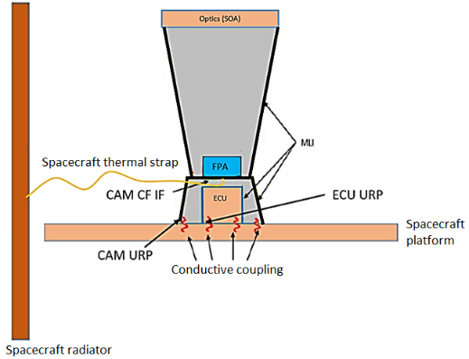
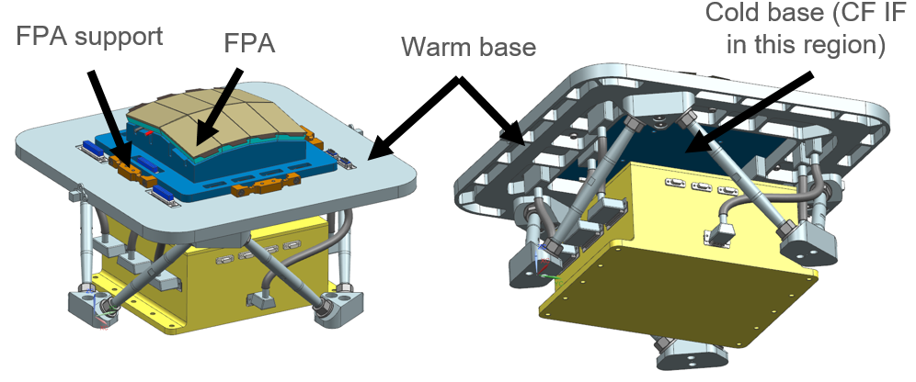
Thermal control of the SXI
The MPOs and detectors both have sky-facing thin Al layers acting as a light block.
The MPOs will operate at +20-30°C, and the CMOS detectors at <= -30°C. The former achieved through PID controlled heaters on the optic frame, while the latter is achieved via a spacecraft provided Cold Finger (CF) and good thermal coupling between the FPA cold base (blue) and the warm base (part of the instrument support structure).

Slide 13
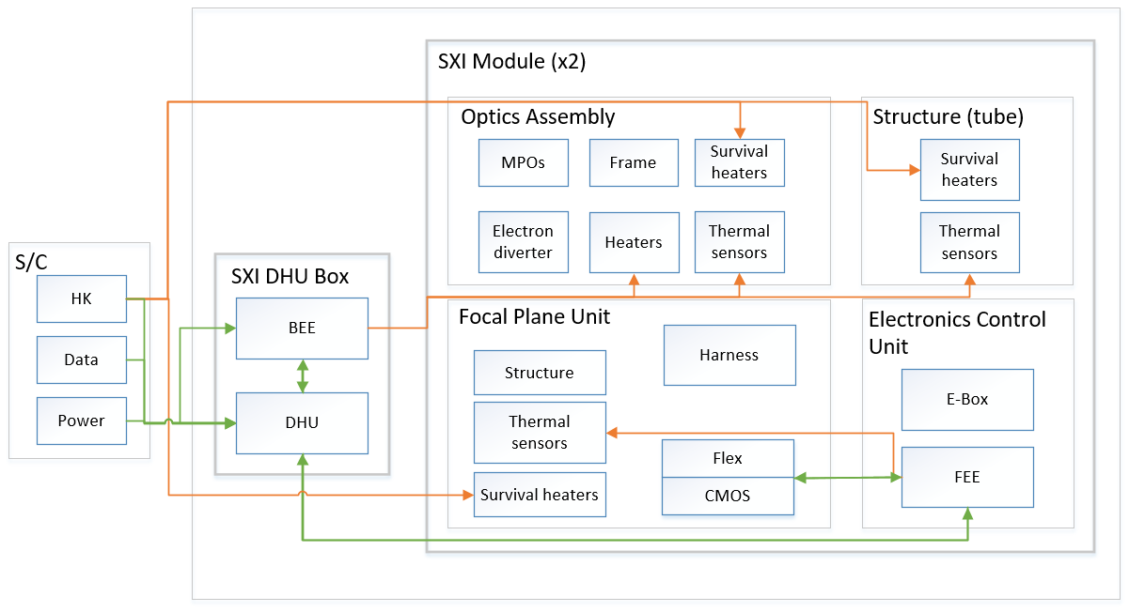
SXI functional block diagram
The front-end electronics (FEE) provide focal plane control/data acquisition, while the back-end electronics (BEE) provide thermal control and housekeeping. The FEE PCBs and a power board are housed within an Electronics and Control Unit (ECU) for each module, linked by spacewire to the DHU.
The BEE are located inside the SXI Data Handling Unit (DHU) and provide overall thermal control as well as handling of the housekeeping data. The SXI DHU provides the data interface to the spacecraft platform.

Slide 14
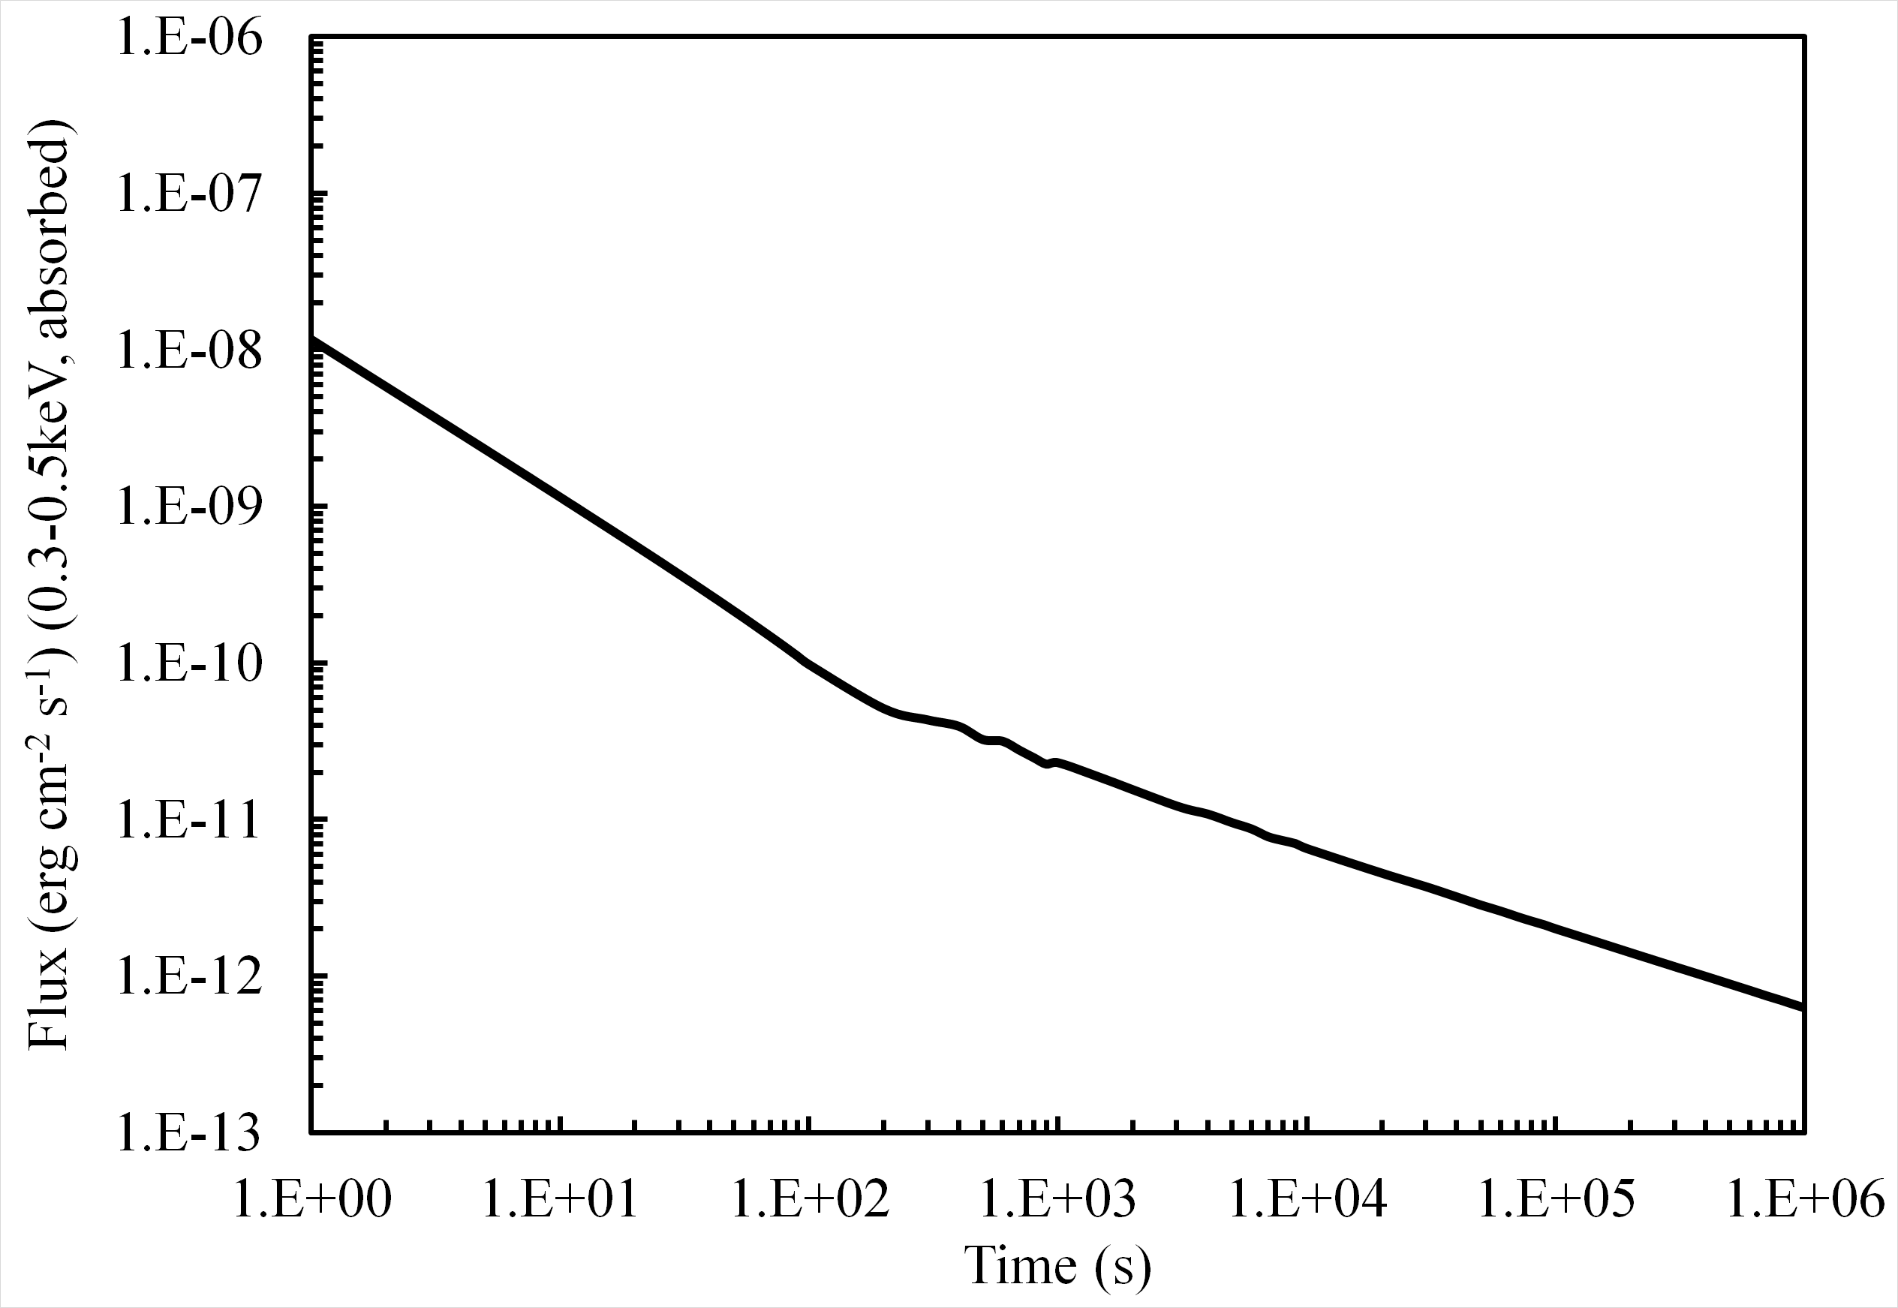
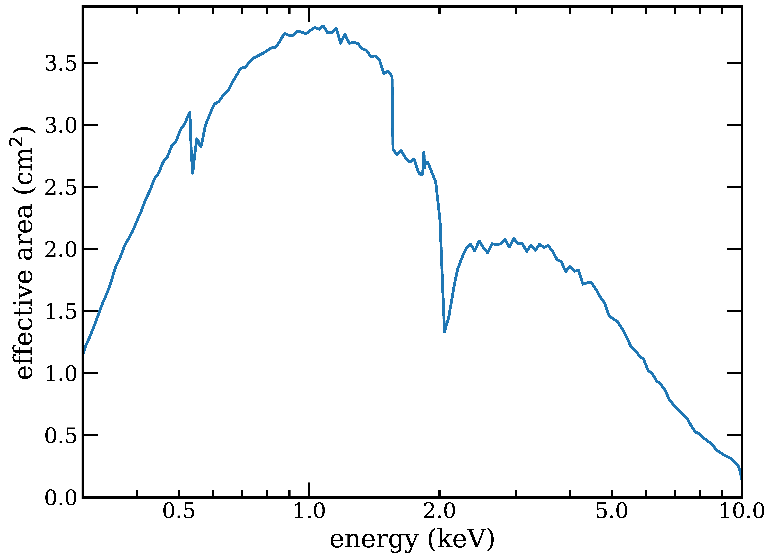
SXI operation
The SXI detectors are clocked out every 100ms, photons are graded in the FEE and the photon stream (with grade, energy and pixel locations) is passed to the DHU within which runs the on-board trigger system to search for transients. All photons are telemetered to ground.
The instrument trigger system operates on a variety of timescales, and optimizes the fraction of the PSF (and hence effective area) as a function of time to maximize S/N. Above shows the trigger sensitivity for a GRB-like spectrum using two PSF fractions (left) along with the total (optics+detector+filters) effective area (right).

Slide 15
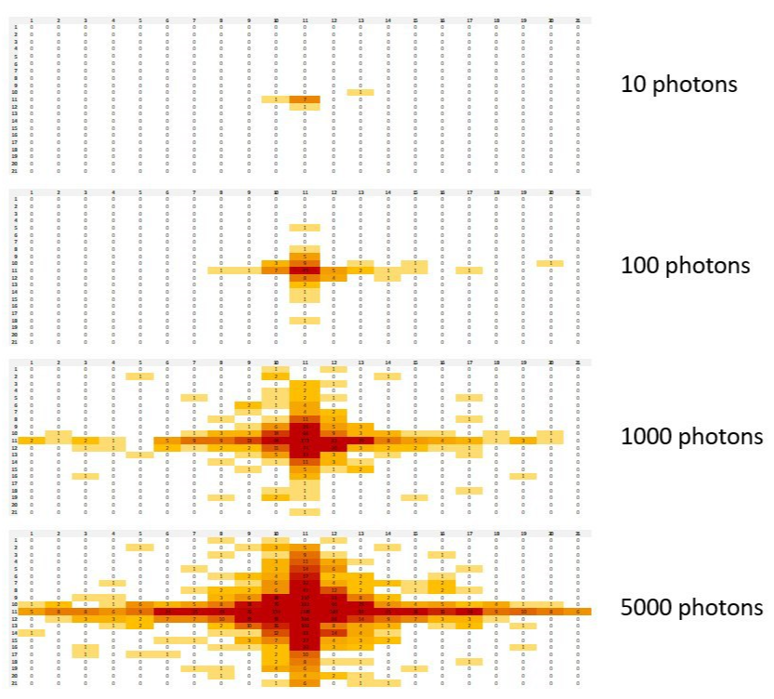
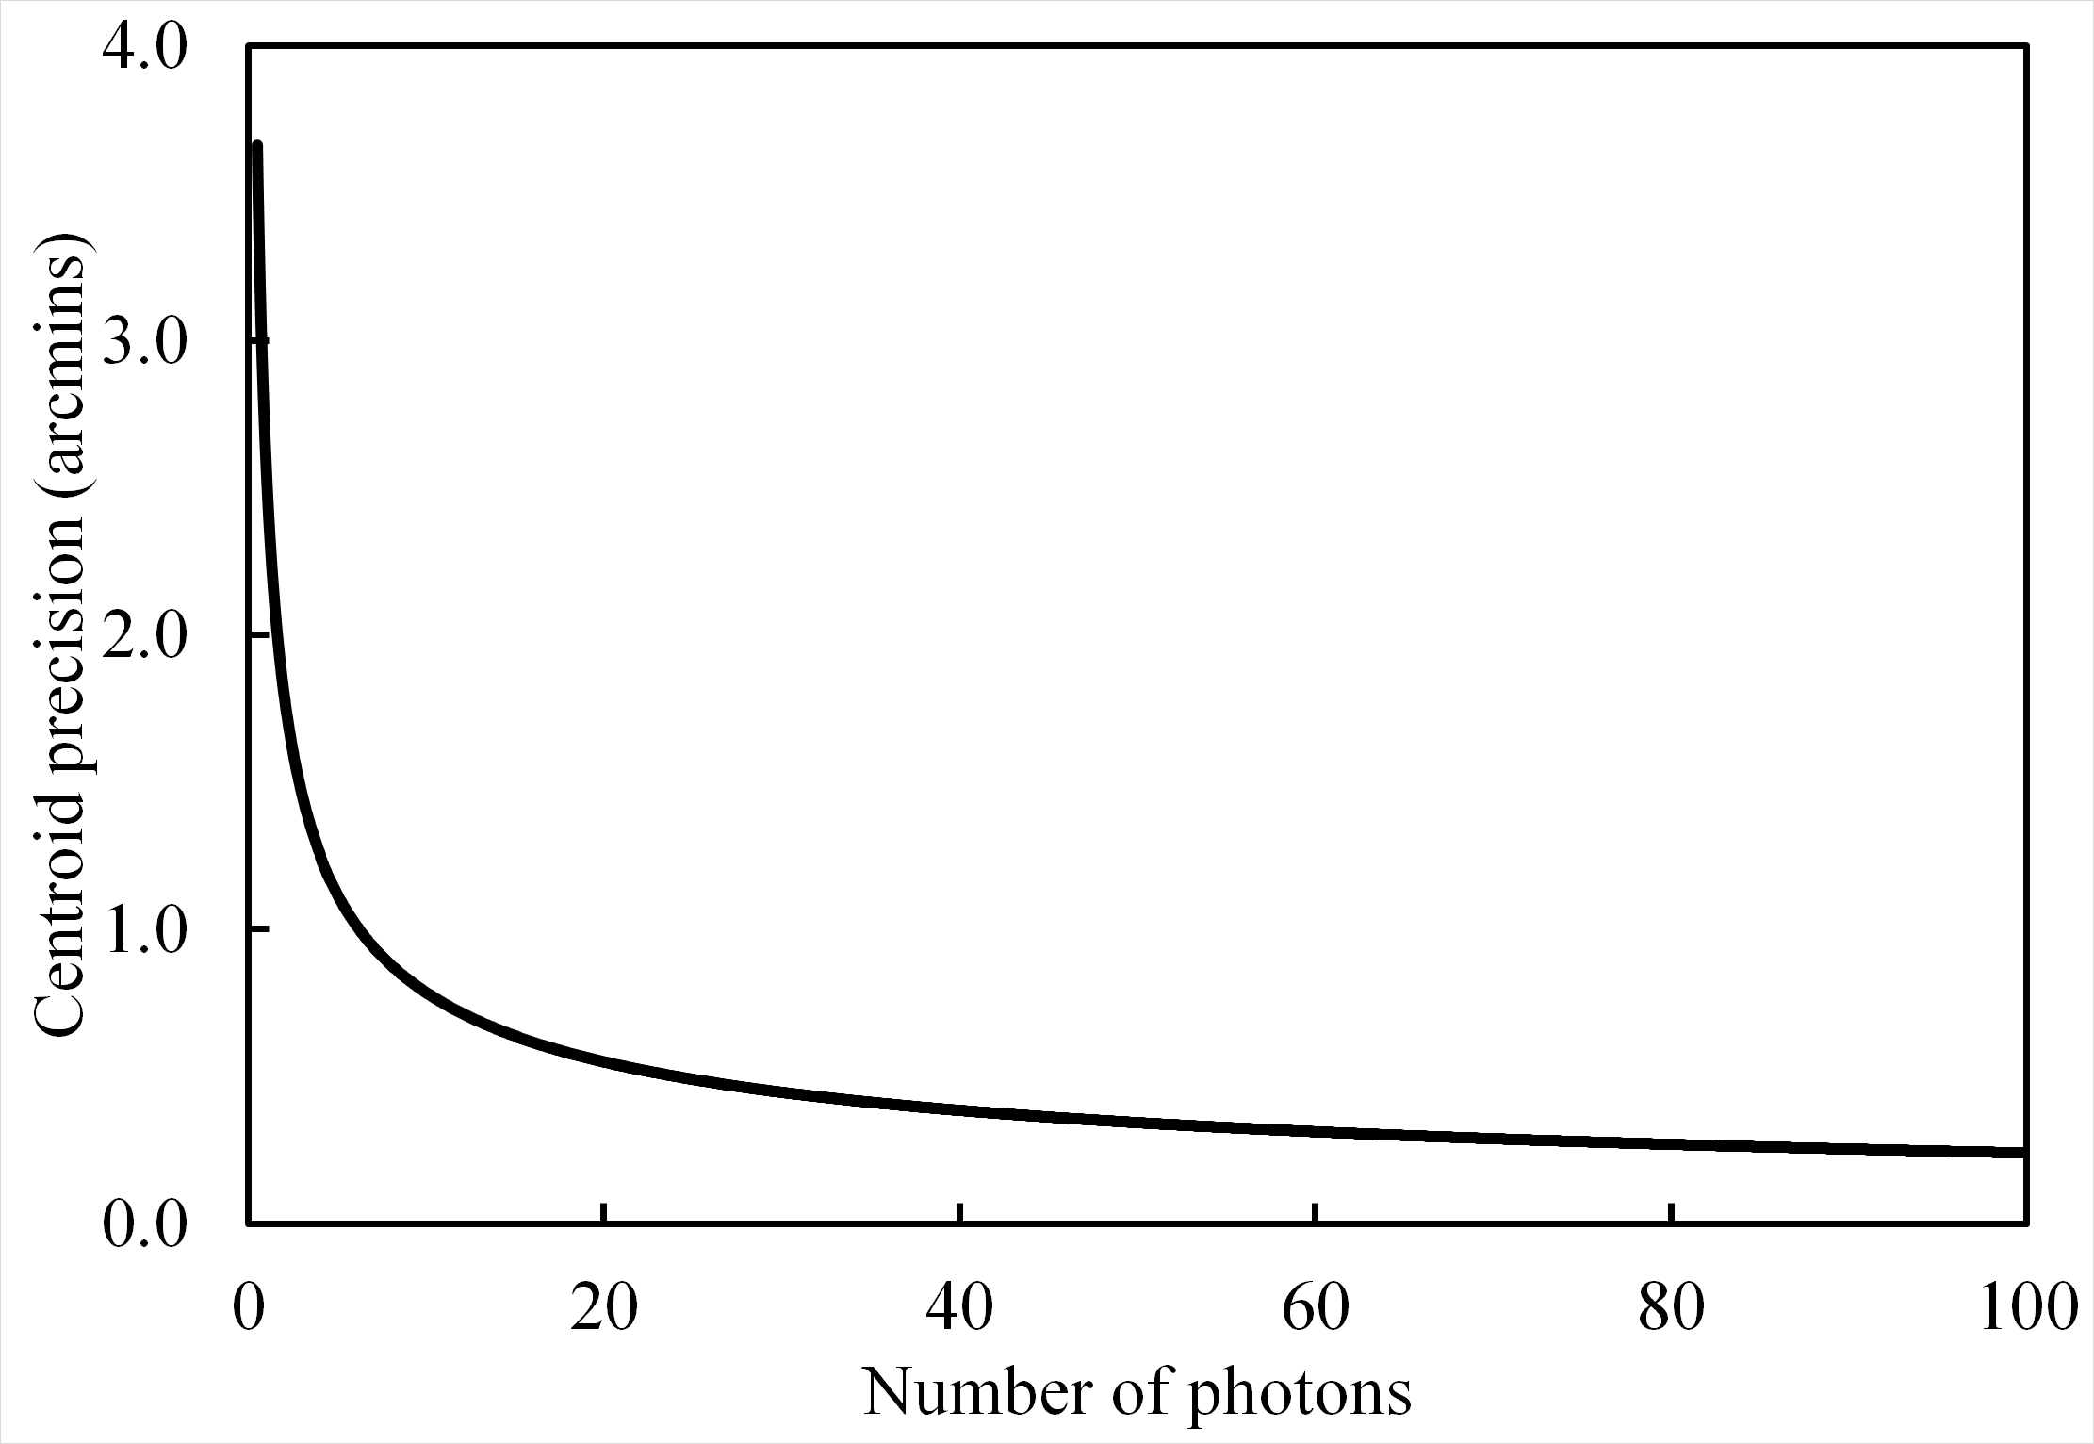
SXI Astrometric Accuracy
Event simulator
Accounts for sky background, CMOS detector background, PSF, hot pixels, centroiding algorithm, and thermal stability
Detailed analysis ongoing
Used to test trigger algorithm
Also used to determine effect of hot pixels

Slide 16
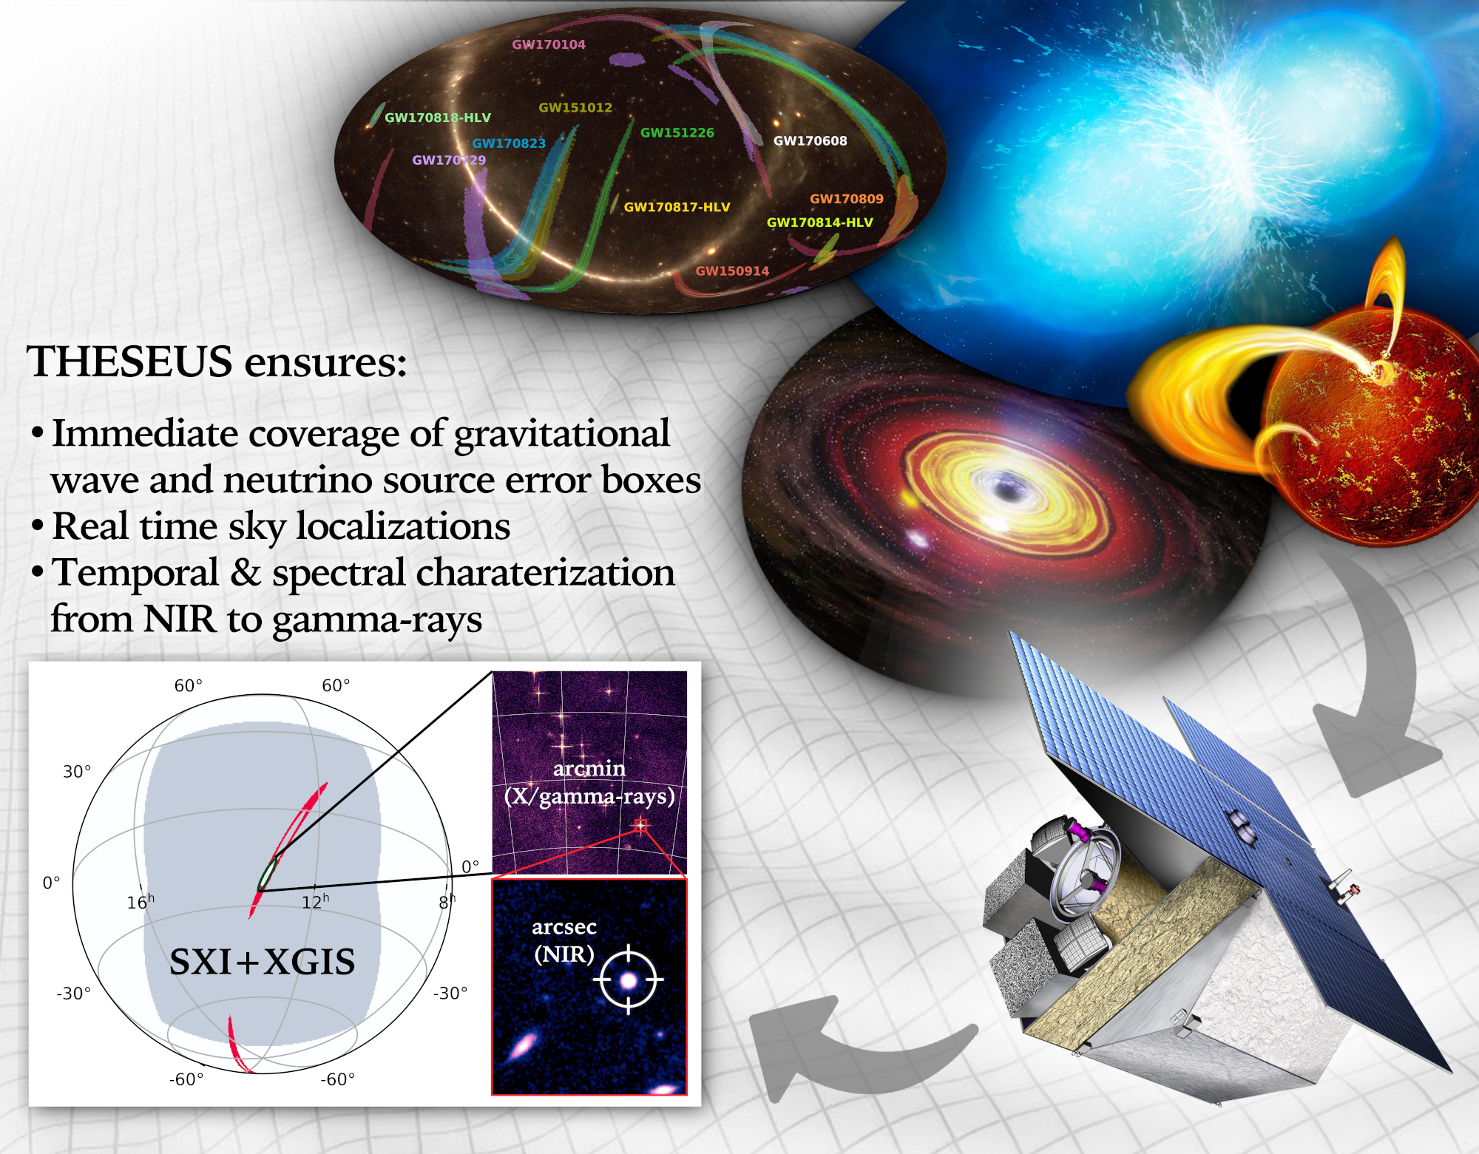
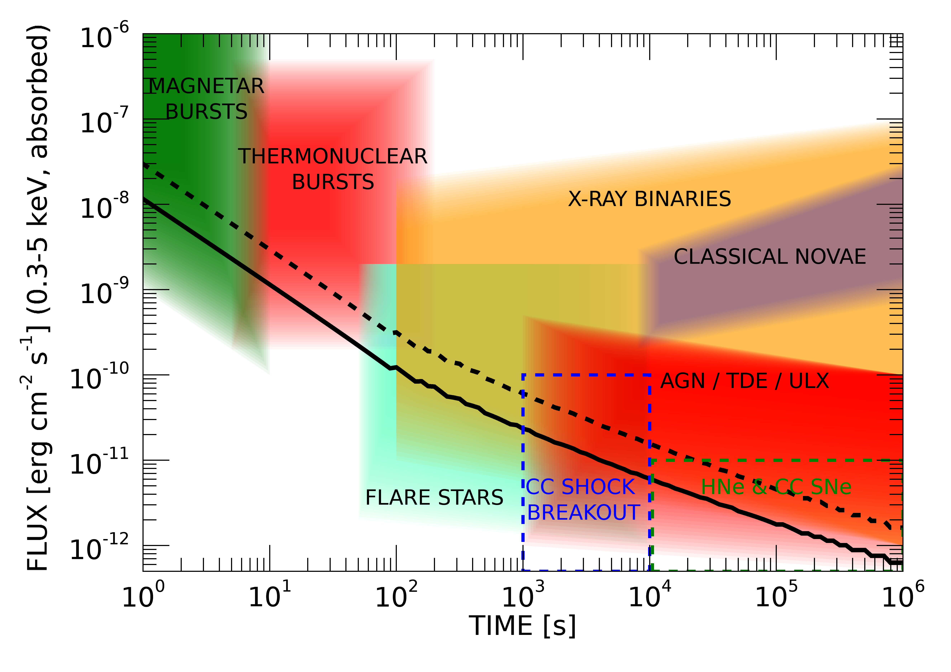
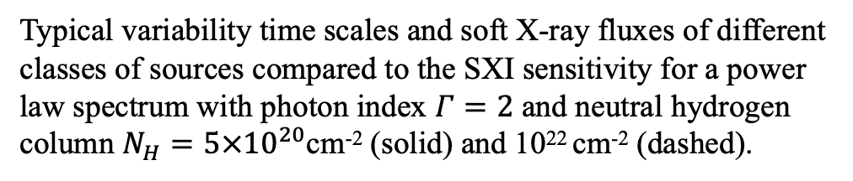
SXI sky survey
Typical variability time scales and soft X-ray fluxes of different classes of sources compared to the SXI sensitivity for a power law spectrum with photon index $Γ=2$ and neutral hydrogen column $N_{H}=5×{10}^{20}$cm⁻² (solid) and 10²² cm⁻² (dashed).

Slide 17
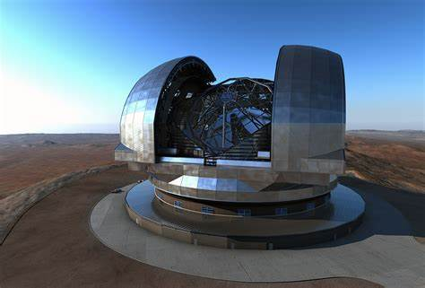
Surveys and synergy
Bright survey: daily (or faster) monitoring of few dozen targets
Medium survey: ~weekly monitoring of hundreds-thousands of targets
Faint survey: flaring survey of entire sample
With the SXI we do not need to decide sampling rate ahead of time – SXI observes and provides on-board triggers, but also telemeters all photons to ground
Almost all future facilities have time domain studies in their science case (e.g. ELT, SKA, CTA, Athena, ET…) so excellent opportunities for synergy

Slide 18
Thank you

