Slide 1
Tracing the metal-enrichment in the early universe with THESEUS
Lise Christensen
Niels Bohr Institute
University of Copenhagen
THESEUS conference, 24 Mar, 2021

Slide 2
Science driver
Explore GRBs in the first 1 Gyr lifetime of the Universe
Detect 40-50 GRBs at z > 6 over 3.5 years mission lifetime
Star formation rate history at z > 6 - 12
Intergalactic medium reionization epoch
Faint end star-forming galaxy population
Trace early chemical enrichment and signatures of Pop-III stars
(See also presentation by Tanvir, Vergani, Le Floc’h)

Slide 3
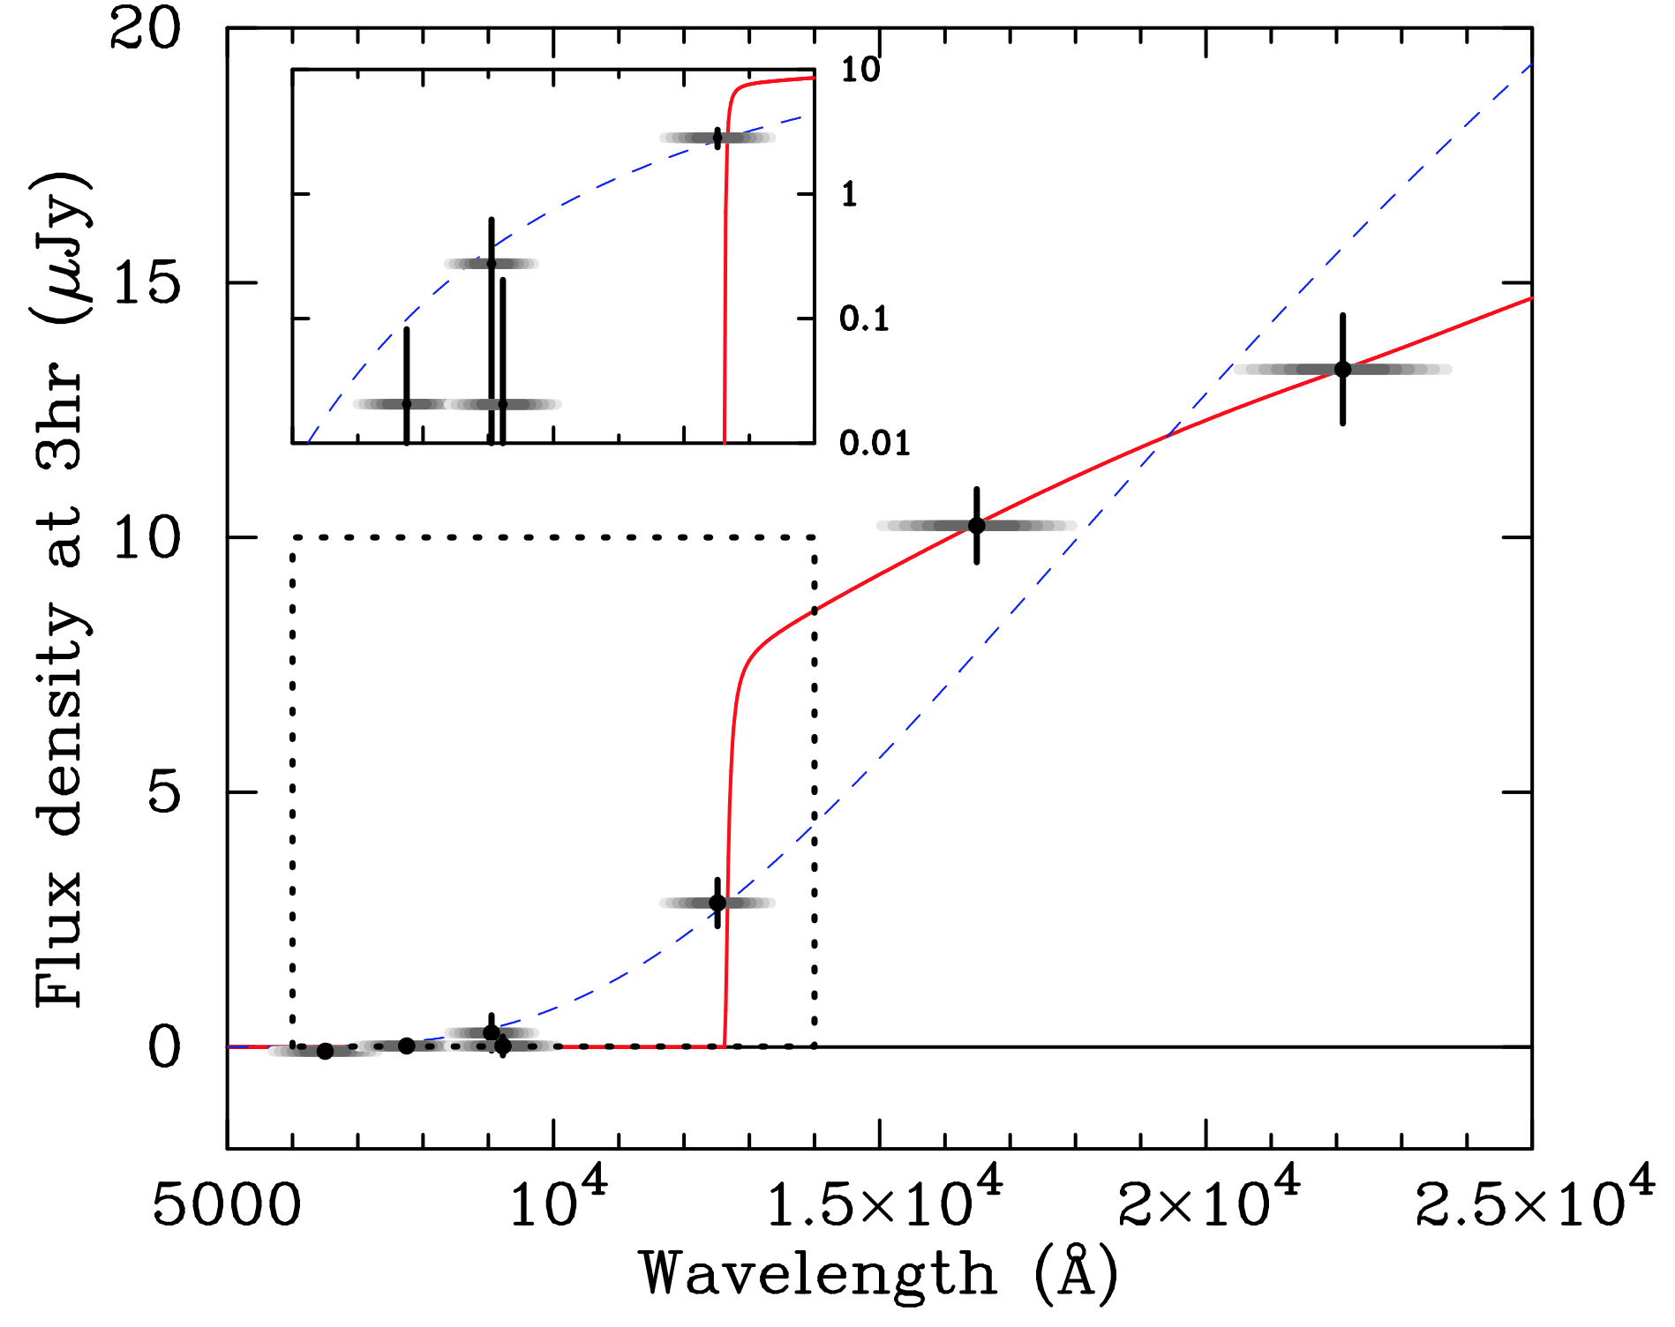
Identifying high-z GRB events
GRBs are the most powerful explosions in the Universe
Long-GRBs associated with SN Type Ib/c
Beacons to probe the high-z universe
Locate star-forming galaxies
Detectable out to the highest redshifts
E.g. GRB 090429B at z ~ 9.4 (Cucchiara et al. 2009)
THESEUS will identify high-z events at Δz < 10 %
(see talk by Le Floc’h)
22.80 ± 0.16 21.41 ± 0.05 21.12 ± 0.04 22.42 ± 0.16
~ 2.5 hours after trigger

Slide 4
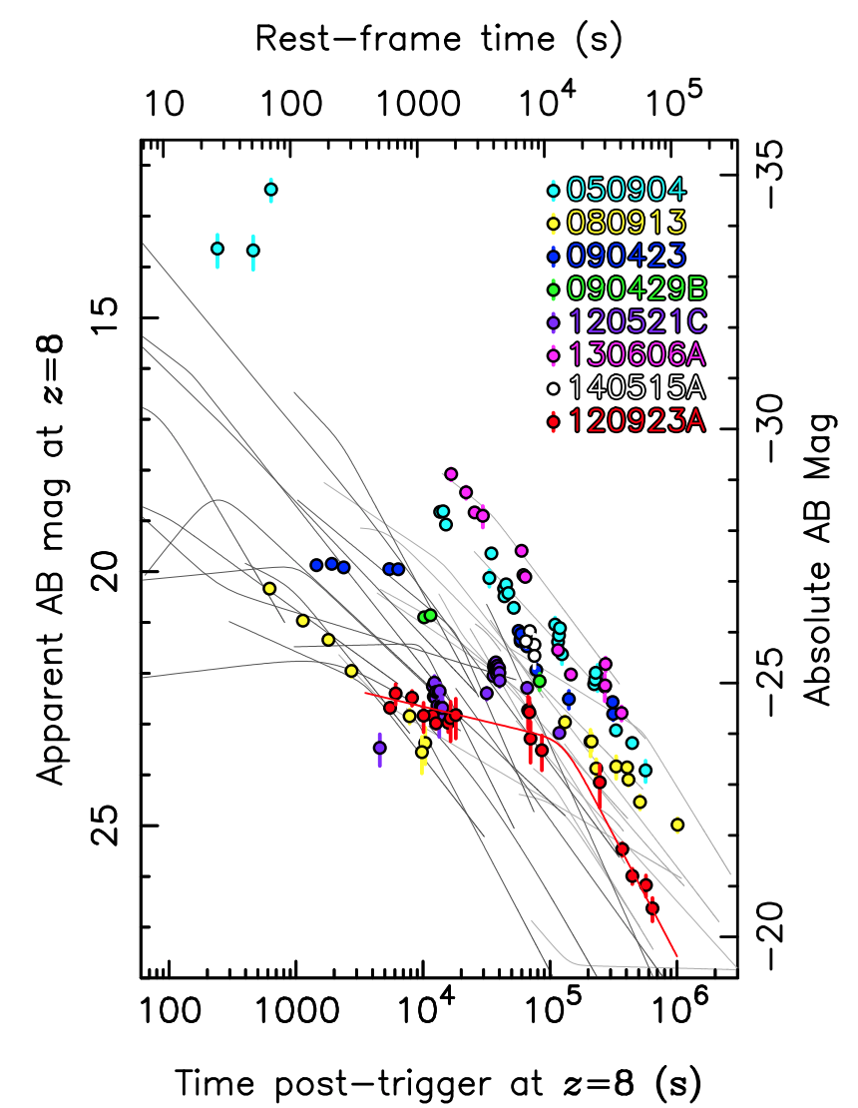
Infrared afterglow light curves at z=8
z>5 GRBs:
THESEUS infrared telescope (IRT) limiting magnitudes
Spectroscopy mode, R=400
H_{AB} = 17.5 mag ( 3σ )
t_{exp} = 1800 s
-> Spec-z < 1% uncertainty
5 filter IYZJH photometry
H_{AB} = 21.8 mag ( 5σ )
150 s / filter
Photo-z < 10% uncertainty
Tanvir+2018
Notes:
Examples of z>6 detections.
Important to be *fast*: Theseus imaging sequence : 12.5 min + reaction time < 10 min for 50% of events.

Slide 5
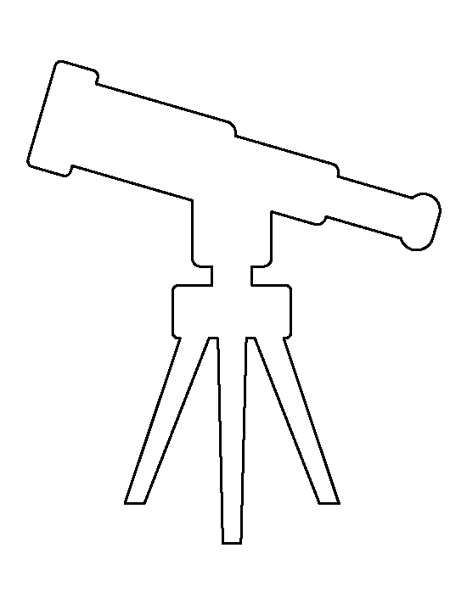
Detecting metal enrichment
Quasar
Galaxy
Circumgalactic
material
GRB
HII, HI, metals,
dust, molecules
Cold, neutral gas clouds
IGM
Notes:
Various ways to investigate high-z galaxies

Slide 6
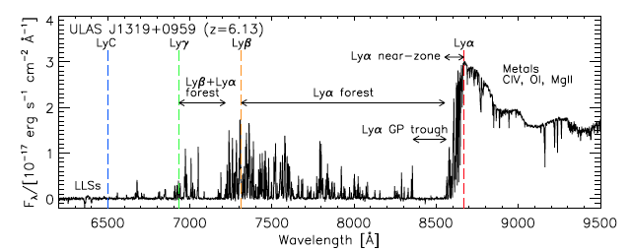
GRB and quasar spectra to measure the high-z Universe
Quasars:
Neutral fraction <x_{HI}> and N(HI) sensitive to models
Continuum and Lyα emission-line profile
Proximity zones
Broad absorption lines (BAL) frequent at high-z
Rare beyond z > 7
Simple power-law spectral slopes
No host luminosity dependence
No overdense regions
Need R > 5000 NIR spectra to disentangle contribution of HI absorption in host and
neutral IGM
Quasar: ULAS J1319+0959 z=6.13 (Becker+2015)
Metals :
Si, O, C, Fe
Lyα forest
GRBs:
GRB 130606 z= 5.913 (Chornok+13; Hartoog+15)
LyC
Lyγ
Lyβ
Lyα

Slide 7
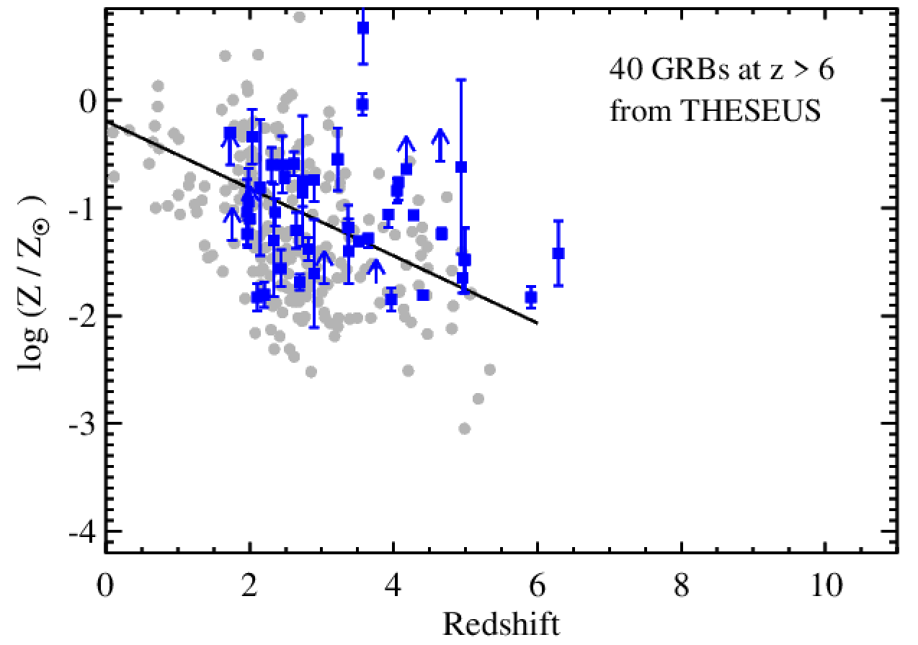
Quasar-DLA and GRB metallicities
Both cases: absorption lines provide accurate metallicites
Independent on host galaxy luminosity, and metallicity diagnostics
?
High-z GRBs: Bolmer+19
Hartoog+15, Sparre+15
Quasars: Rafelski+2014,
Neeleman+13, Jorgenson+13,
Quiret+16, De Cia+18
Notes:
QSOs – decreasing metallicity trend
GRBs – constant metallicity ?

Slide 8
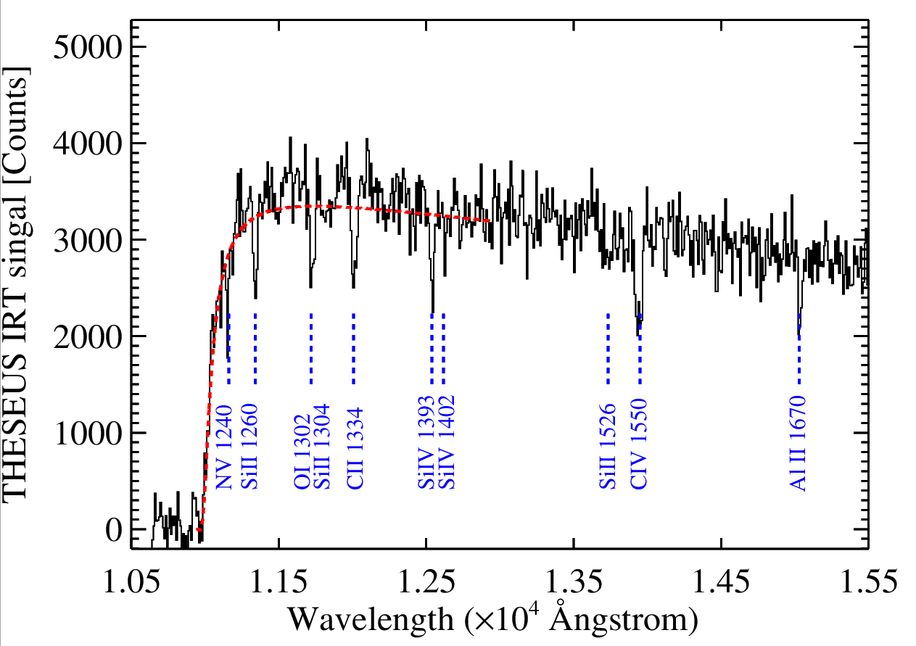
Simulated GRB spectra with THESEUS IRT
Simulated example GRB
z = 8.0
Log N(HI) = 21.2
Metallicity (Z) = 1 % solar
Common metal absorption lines
IRT setup
0.8 < λ < 1.6 micron
Resolution = λ/Δλ ∼ 400
Magnitude H_{AB} = 16
t_{exp} =1800 s -> S/N ~13
THESEUS assessment study report
(Yellow-book)
IRT Simulation by D. Goetz

Slide 9
Simulated GRB spectra with THESEUS IRT
Recovered parameters from IRT spectra
Accurate redshift ( Δz < 1 % at 6 < z < 11 ) from spectral break when S/N > 3
Determine log N(HI) within 0.2 dex uncertainty when S/N > 10
Detecting metal absorption lines feasible with:
log Z ≥ –2 when S/N > 10
log Z ≥ –3 when S/N > 20
log Z= -3 : Can have a pop III progenitor ( Campisi+2011)
Critical metallicity for Pop III
Probability contours of 100, 75, 25%
Notes:
Campisi : even when inferred metallicity is -3, then local pockets of pristine gas can exist.

Slide 10
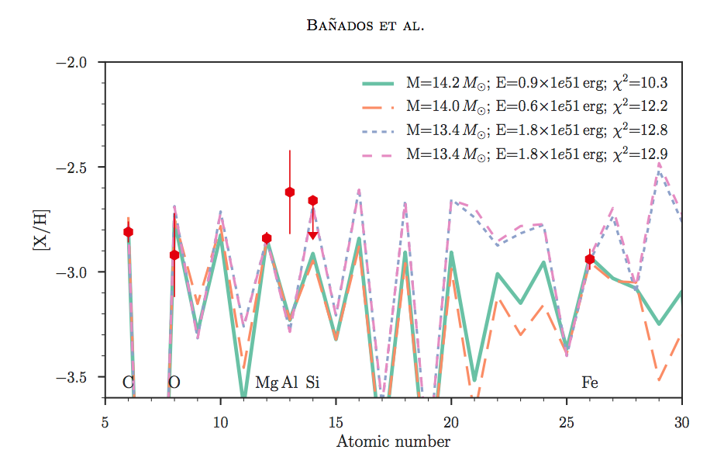
Pop III metallicity signatures
How can we recognize a Pop III progenitor ?
Ultra-long GRBs (Yoon+16)
Low metallicity: [O/H] < -3
Peculiar abundance patterns from [Si/C], [C/O], [Al/O], [Fe/O]
Enrichment depends on explosion energy and progenitor mass
(Heger & Woosley+10, Welsh+19)
Bañados + 2019
Ne
S
Ar
Ca
Cr
Ti
Co
Zn
Ni
F
P
V
Na
Mn
Cl
K
Sc
Cu
Notes:
[Si/C] < -1. , [ C/O] < -0.5 rough numbers!
Fe 1608 OK for ELT NIR spectrum… but faint!

Slide 11
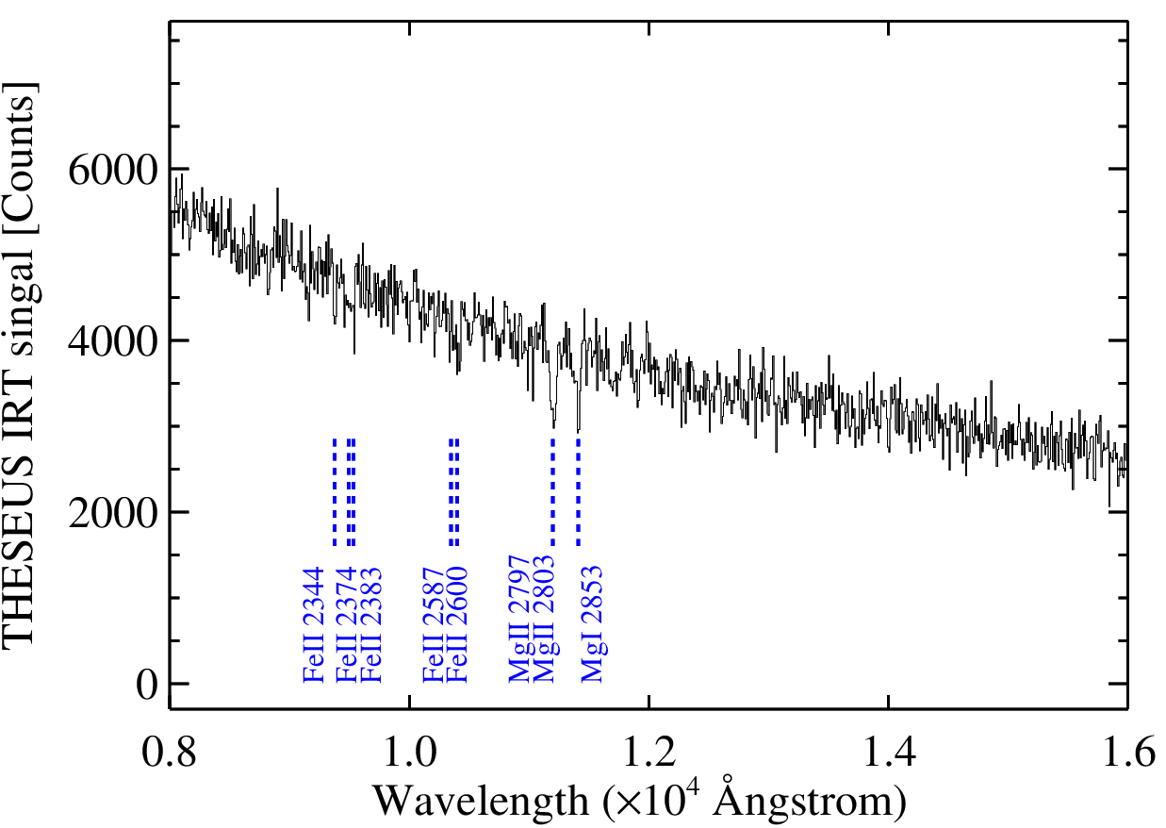
Simulated low-z GRB with THESEUS IRT
Low-redshift GRB redshift identification
Sets of Fe II, Mg II absorption lines
Feasible at z > 2
At z< 2, needs either Ca II H,K or NaD lines for spectroscopic -z
z =3 GRB,
1 % solar metallicity
Notes:
At z < 2, it will be challenging to detect absorption lines.

Slide 12
Reddened GRB with THESEUS IRT
Reddening :
Highly reddened GRB 140506A at z = 0.899, H_{AB} = 20.9 at Δt = 58 hours
Rare rest-frame UV absorption and extinction curve: Either strong 2175 Å bump, or multiple scatterings on dust grains (Fynbo et al. 2014)
X-shooter spectrum, GRB 140506A

Slide 13
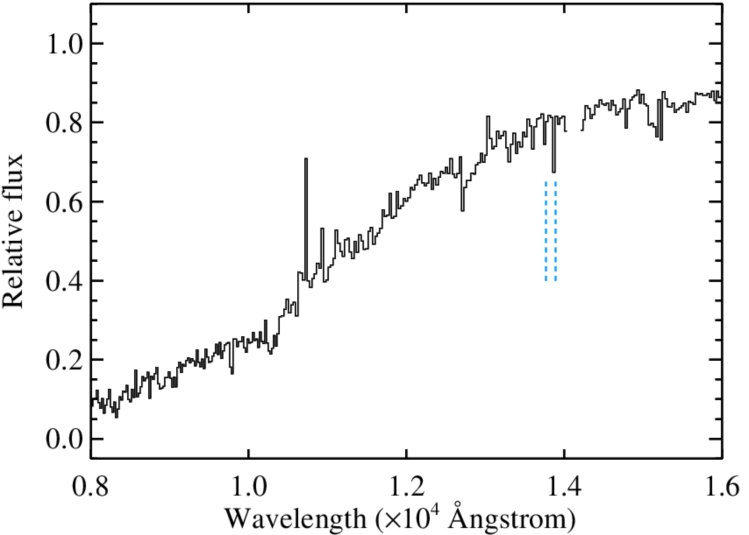
Reddened GRB with THESEUS IRT
Reddening :
Highly reddened GRB 140506A at z = 0.899, H_{AB} = 20.9 at Δt = 58 hours
Rare rest-frame UV absorption and extinction curve: Either strong 2175 Å bump, or multiple scatterings on dust grains (Fynbo et al. 2014)
THESEUS IRT spectrum
Redshifted to z = 2.5
X-shooter spectrum, GRB 140506A
Ca II H,K

Slide 14
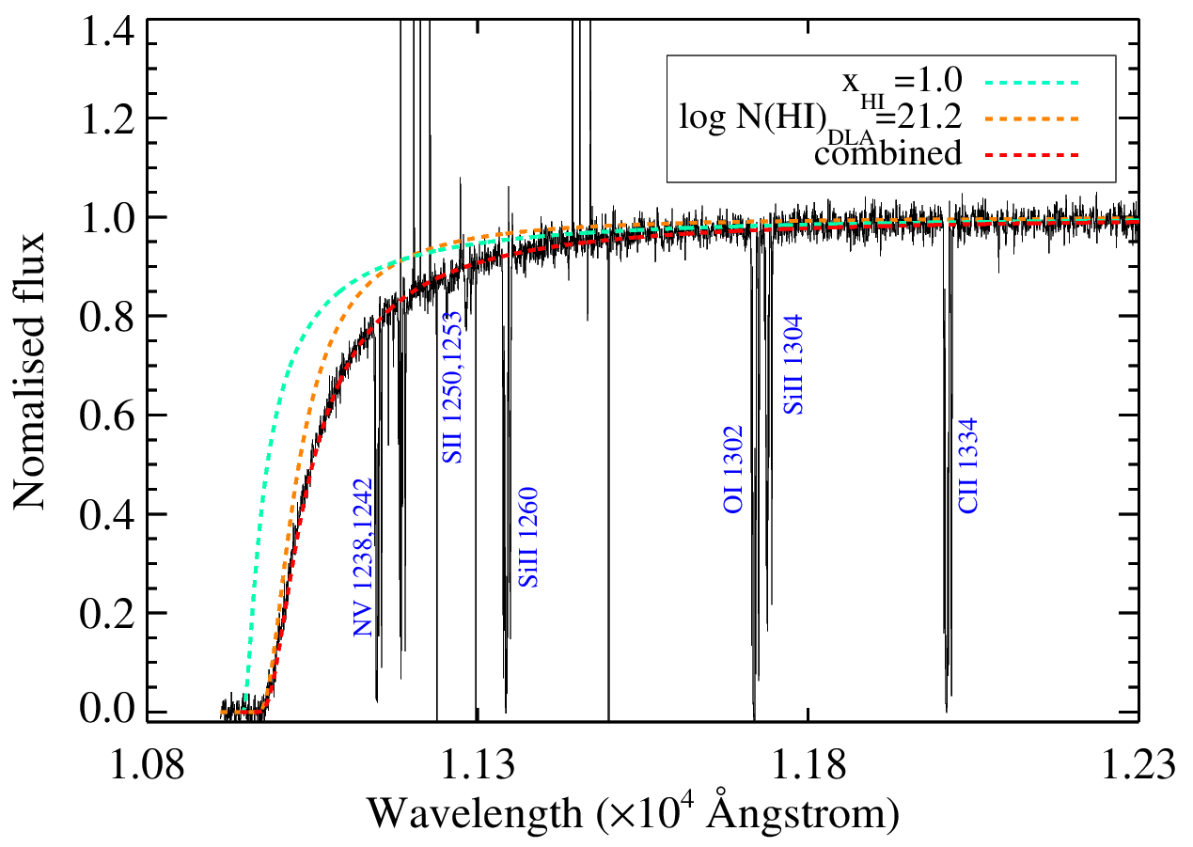
Simulated ELT spectra of high-z GRBs
Example ELT spectrum incl. telluric emission and absorption and model corrections
z = 8, metallicity Z = 1% solar, neutral IGM fraction x_{HI} = 1
t_{exp}=1800 s, J_{AB} = 20 mag ( Δt ~0.5 day post burst), R=10,000 gives S/N ~ 30-40
Disentangle host N(HI) and neutral fraction IGM
Accurate metallicities
Metal lines detected at log Z > -5
THESEUS assessment study report
(Yellow-book)

Slide 15
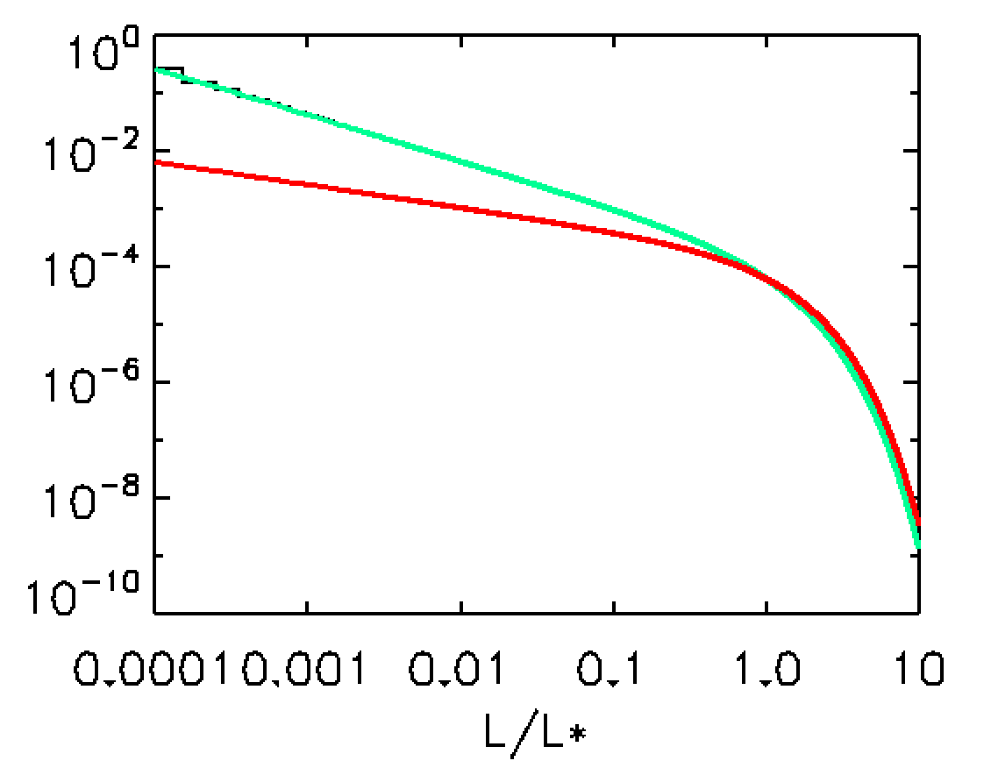
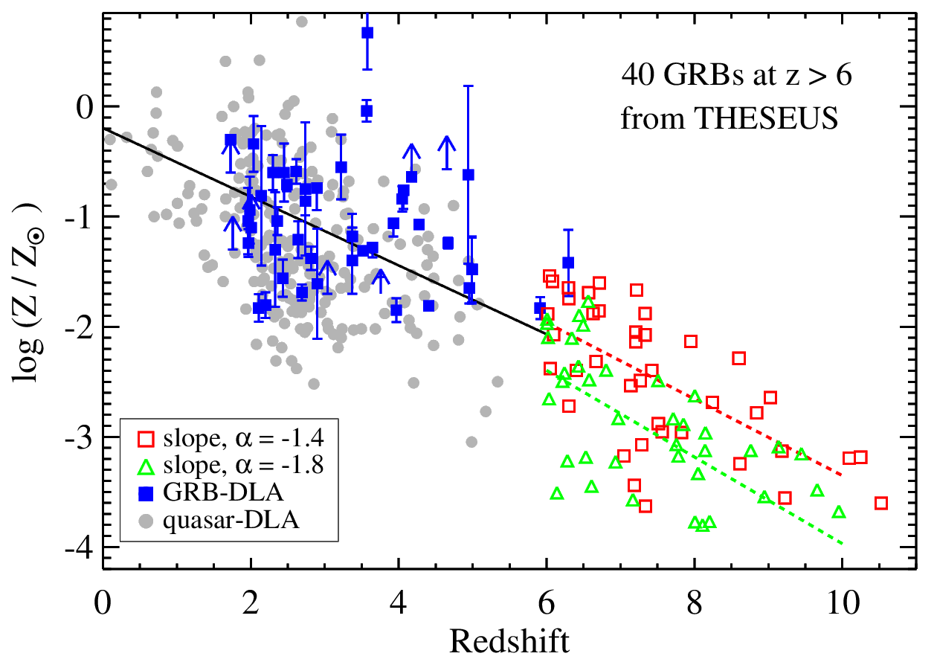
GRB (and quasar-absorber) metallicities
Predicting metallicities at z>6
quasar-DLA
GRB-DLA
THESEUS simulation
α = -1.8
α = -1.4
Galaxy luminosity functions
with varying faint-end slopes
THESEUS assessment study report (Yellow-book)

Slide 16
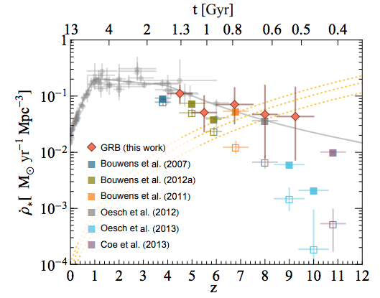
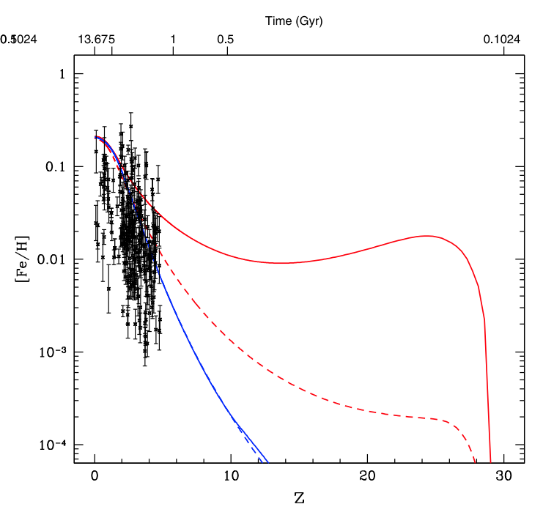
GRBs tracing star-forming galaxies
Consequence for metallicity evolution
THESEUS will explore this region
GRB ρ_{SFR} model
from Kistler+13
Kistler+2013
Halo – galaxy ρ_{SFR} model
Behroozi & Silk ‘15
UV luminosity
function - ρ_{SFR}
Vangioni+15

Slide 17
THESEUS probing the high-z Universe
THESEUS will provide unique probes of the high-redshift Universe
Rapid, autonomous follow-up of high-z events:
Redshift 6 < z < 11 : recovered at Δz < 1% uncertainty when S/N >3
Metal-absorption lines detected at z > 2 (better than Δz ~ 0.5 % uncertainty)
log N(HI) Range 19 < log N(HI) < 23 recovered at +/-0.2 dex with S/N ~10
Dust – or high-z GRB? Distinguishable via IRT spectral slope, or IRT imaging colours
Distinguish high-priority, essential events
Follow-up synergy, THESEUS will provide critical triggers:
Reionization of the IGM: GRBs better tracers than quasars
<x_{HI}>: Accurate measurements need R > 5000 + high S/N, ELT spectra
Metallicity : THESEUS IRT can detect lines at log Z > -3
accurate metallicities or Pop-III signatures with ELT spectra
-- low-z WHIM triggers for ATHENA XIFU

