Slide 1
GALI - The gamma-ray burst localizing instrument
A novel gamma-ray detector configuration
Roi Rahin* Department of Physics, Technion For the GALI collaboration
*Ramon fellow by the Israeli Ministry of Science and Technology.

Slide 2
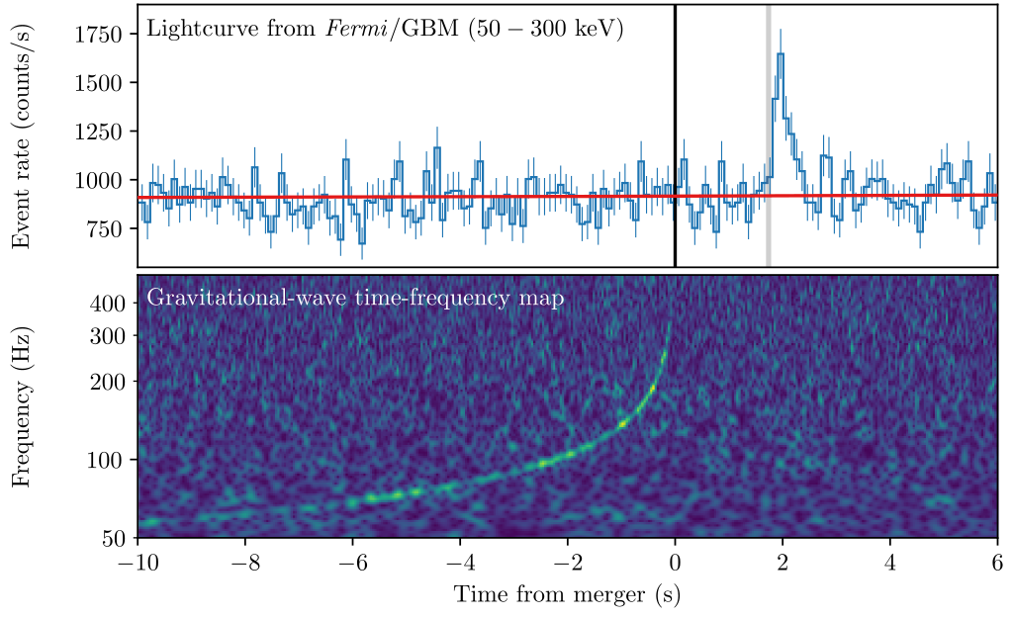
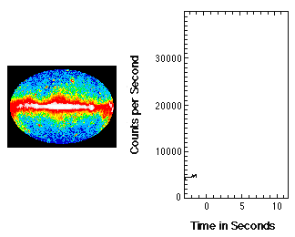
Background - Gamma ray bursts
Soft γ-ray spectrum (several keV to several MeV)
Isotropic across the sky
Transient, typically up to ~100 seconds
Associated with Supernovae and Neutron star mergers

Slide 3
Background - soft gamma ray detectors
γ-rays are Typically detected using either scintillator crystals or specialised semi-conductors such as CZT (Cadmium zinc telluride).
Scintillators | CZT
Omni-directional - detection efficiency is direction independent | Detection mainly for face on interaction
Low energy resolution (≳10%) | High energy resolution (<2.5%)
Interaction produces visible light | Direct detection
Wide energy range <10 keV to several MeV | Limited energy range up to ~150 keV or 20-700 keV
Best known example: Fermi GBM | Best known example: Swift BAT

Slide 4
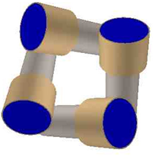
The problem - Directionality
In scintillator crystals, all directional information is lost during the detection.
CZT detectors can use a coded-mask for directionality (Swift-BAT), but the FOV is limited and sensitivity is reduced by the mask.
Directionality in scintillators is typically achieved using relative counts

Slide 5
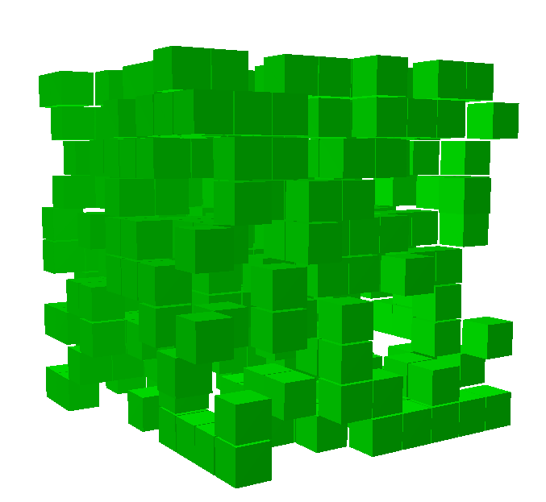
New concept - GALI
A compact configuration causes angle dependant mutual occultations between detectors
Enabled by coupling scintillators to SiPM

Slide 6
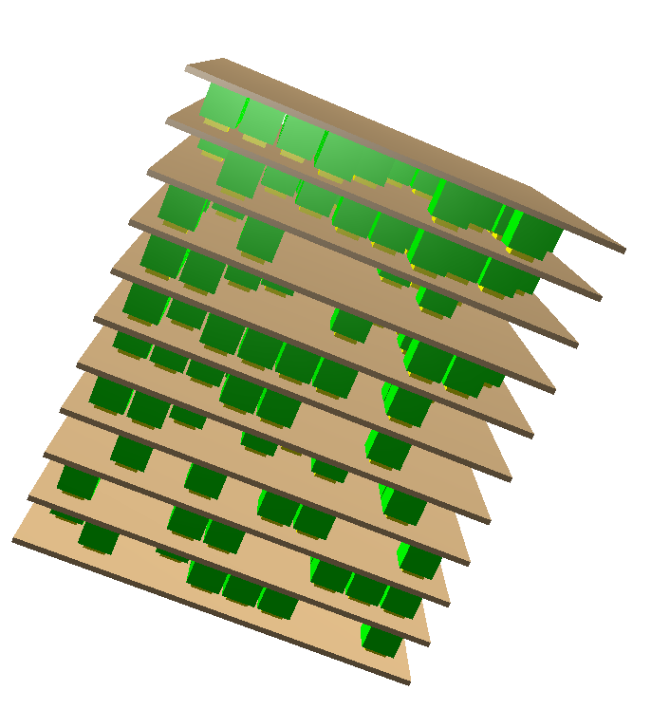
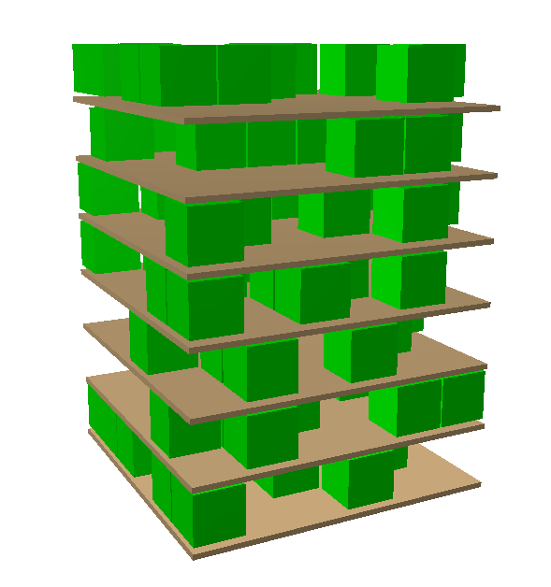
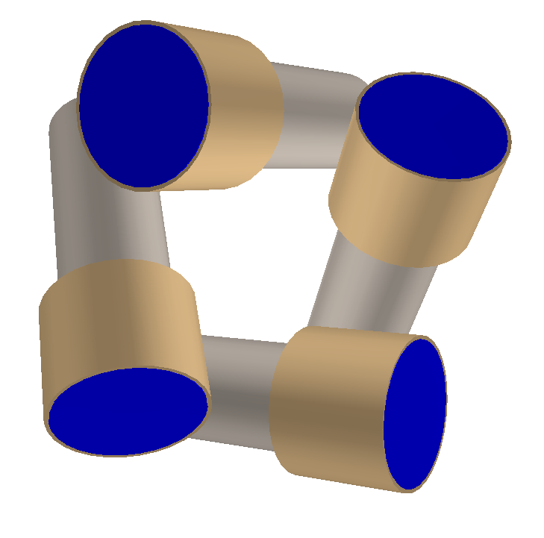
Simulations
Simulations performed using MEGAlib simulation software (based on Root and geant4).
Comparison of several simulated configurations
350 small scintillators 9x9x9 mm cubes
90 scintillators
9x9x9 mm cubes
4 cylindrical scintillators (3’’ diameter, 1’’ thickness)

Slide 7
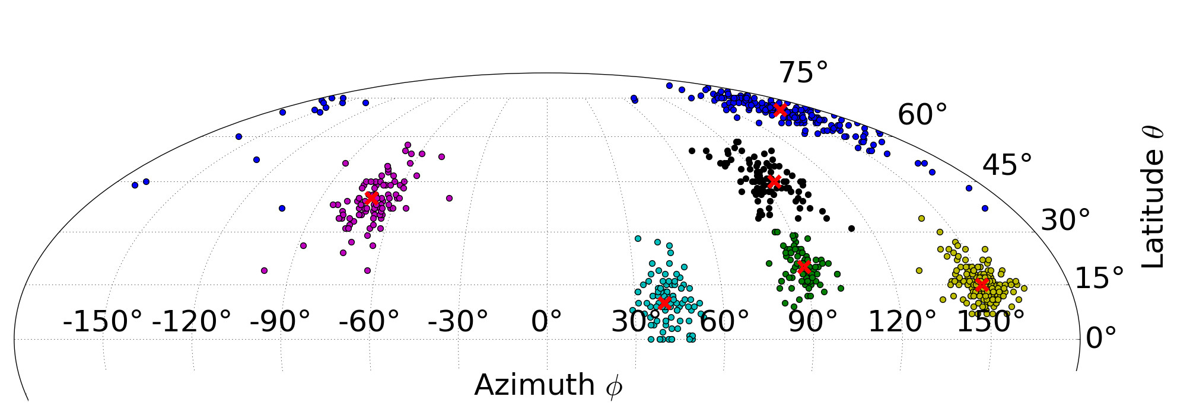
Simulations - results
Flux of 10 ph cm⁻² s⁻¹ 10-1000 keV ( 1 second duration)
13.1° average error
6.5° average error

Slide 8
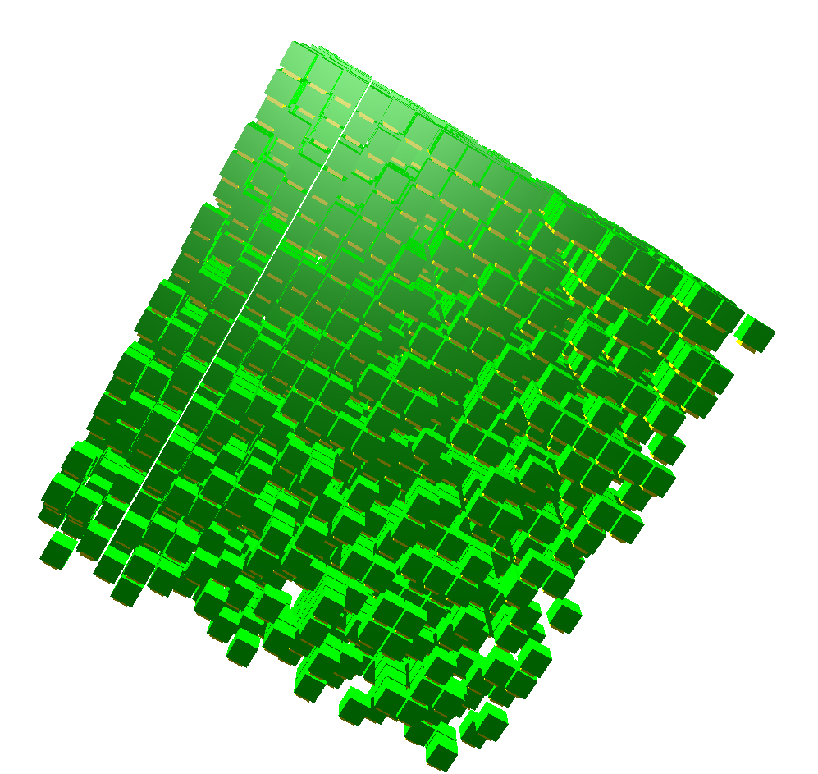
Simulations - results
1.9° average error
350 scintillators
0.5° average error
2800 scintillators

Slide 9
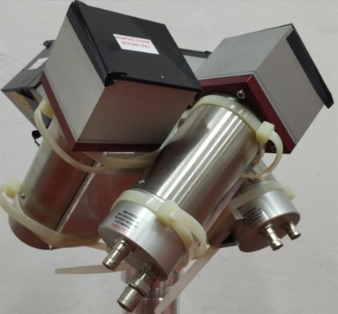
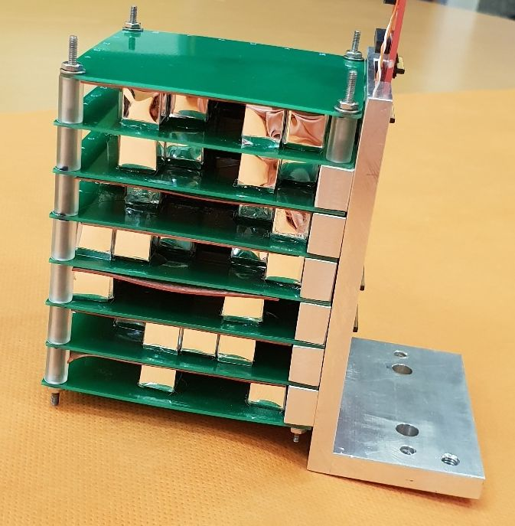
Laboratory Experiments
Performed using the ²⁴¹Am 60 keV line (no background).
2 configurations
2.5’’x2.5’’x1’’ NaI scintillators. 4 in total, titled 45° relative to zenith
90 CsI scintillators
9x9x9 mm cubes

Slide 10
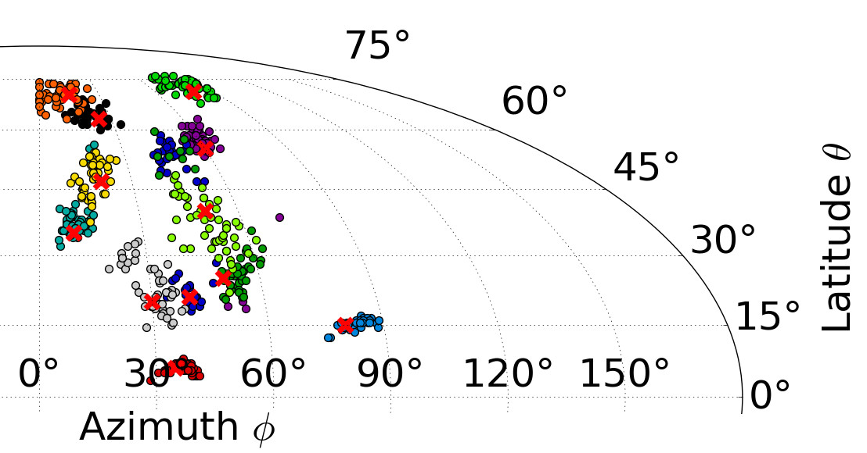
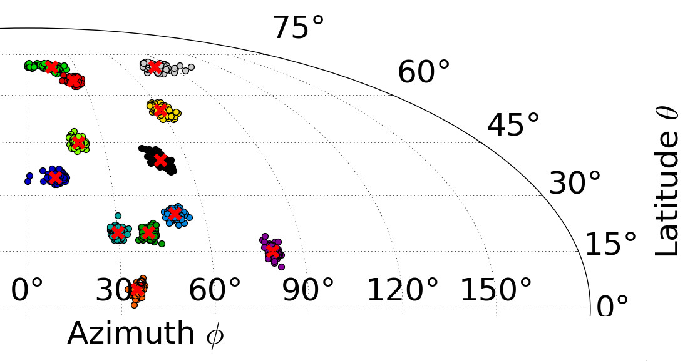
Experimental results
Fluence ~25 ph cm⁻² total

Slide 11
Additional points
Lowering exposure time in the experiment shows that even for ~1 ph cm⁻² localization is still possible (average error was ~10°)
Calibrating directionality using the simulations (required for flight) still produces good accuracy
Localization accuracy (deg.) worsens by ~50%, probably because of the simulation assumes identical scintillators
Remaining issues: Using SiPM in a space environment.
See talk on CAMELOT

Slide 12
Summary
The GALI concept* of mutual occultation of numerous scintillators is a scalable concept for γ-ray burst detectors applicable to small (cubesats) and large satellites such as Theseus, as well as constellations.
We’ve demonstrated both in experiment and simulations that the GALI concept has far superior localization accuracy to traditional methods.
An ISS experiment is currently being designed, aiming for the AX-1 mission
Published in the SPIE proceedings See at: https://arxiv.org/abs/2102.12373

