Slide 1

A numerical jet model for the prompt emission of gamma-ray bursts
Ruben Farinelli
INAF-IASF Bologna

Slide 2
Motivation for a model development
THEORY AND NUMERICAL SIMULATIONS
Studies for mission designs (e.g. THESEUS) and expected results using as realistic as possible jet emission models
Searching for the origin of intrinsic GRB relations (e.g. Amati relation)
DATA ANALYSIS
A large number of models has been proposed for the GRB prompt emission but none has been implemented e,g. for the XSPEC package
The only one is GRBCOMP (Titarchuk et al. 2012) which is however sub-relativistic and essentially isotropic at least up to E_{peak} of the EF(E) spectrum

Slide 3
Model physical and geometrical inputs
JET KINEMATICS AND GEOMETRY
Relativistic velocity defined by Γ
Cone half-angle θ_{jet}
Top jet radius r_{jet}
Inclination to the observer θ_{obs}
JET RADIATION AS SINGLE-PULSE APPROXIMATION
At some time δ(t-t ₀) a radiation pulse is emitted in the star frame
In the jet comoving- frame the local intensity is defined by some function I_{jet}(E_{jet}, k_{jet})

Slide 4
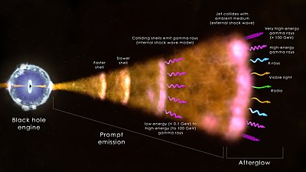
Model physical and geometrical inputs

Slide 5
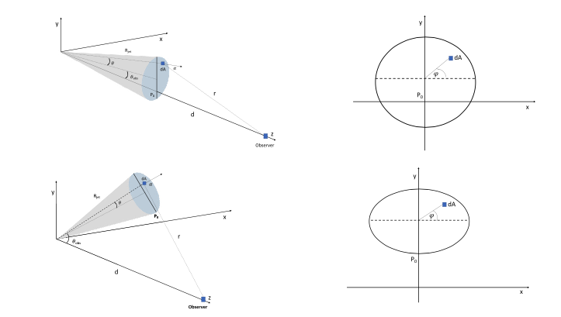
Model geometry

Slide 6





Top-hat jet coordinates
y
P
α
P
x
r_{jet}
r
γ
ω
O
d
z

Slide 7



For numerical purposes as r_{jet} << d it is convenient
to expand all quantities in Taylor series over (r_{jet}/d)
y
P
α
x
r_{jet}
r
γ
ω
O
d
z

Slide 8
The specific intensity is assumed to be isotropic in the jet frame
y
The specific intensities are related by the Lorentz transformations
dA
α
x
r_{jet}
r
γ
ω
O
d
z

Slide 9
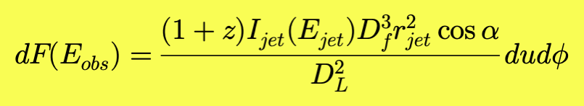
Flux coming from the area dA
y
Term accounting for projected
area
dA
α
x
r_{jet}
r
γ
ω
O
d
z

Slide 10
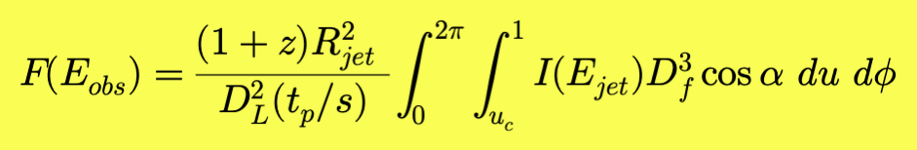
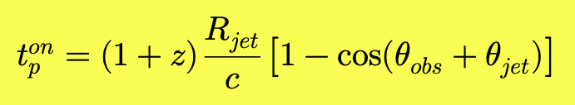
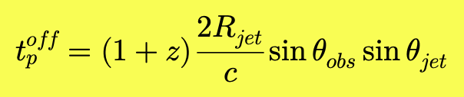
Total flux from top-hat surface
y
dA
α
x
r
γ
ω
O
d
z

Slide 11
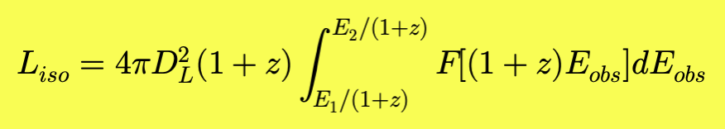
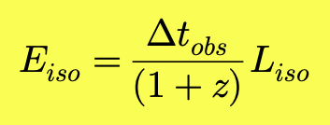
Isotropic equivalent luminosity and fluence

Slide 12
Comoving frame emissivity: broken powerlaw
K=10²⁷ erg cm⁻² s⁻¹ keV-1 ster⁻¹
The change of slope occurs between the values E1 and E2 such that:
At values E≲E1 and E≳E2 the model is approximately a simple power law with index p₁ and p₂ respectively.
The two power laws are smoothly joined at values E1<E<E2, hence the Δ parameter sets the “smoothness” of the slope change.

Slide 13
Additional comoving frame emissivity laws
CUT-OFF POWERLAW
K=10²⁷ erg cm⁻² s⁻¹ keV⁻¹ ster⁻¹
BLACKBODY
K=5x10²² erg cm⁻² s⁻¹ keV⁻¹ ster⁻¹

Slide 14
Jet surface brightness
Θ_{obs} =5°
Θ_{jet} =10 °
Γ=50
Γ=20
Θ_{obs} =15°
Γ=20
Γ=50

Slide 15
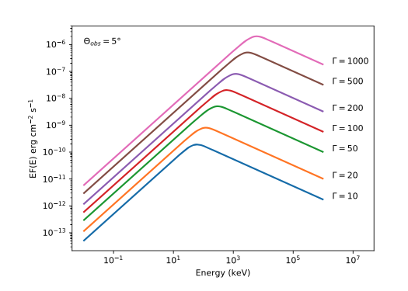
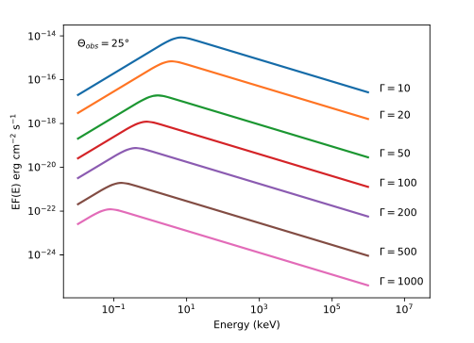
Different values of the jet Lorentz factor
Θ_{obs} < Θ_{jet}
[EP, F(E)] increase with Γ
Θ_{obs} > Θ_{jet}
[EP, F(E)] decrease with Γ

Slide 16
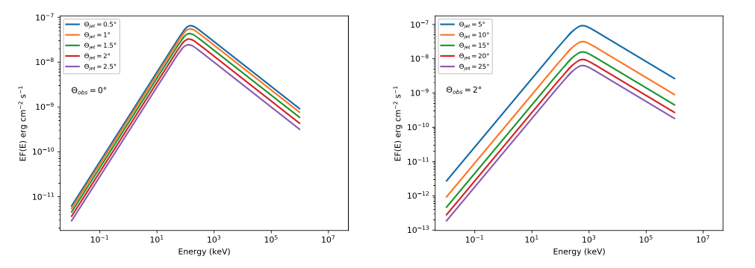
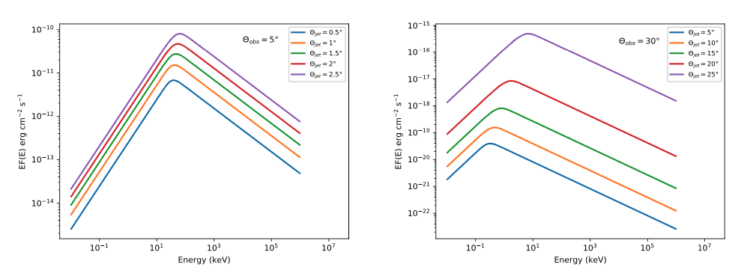
On-axis Θ_{obs} < Θ_{jet}
Γ=20 Θ_{jet} < 1/ Γ
Γ=100 Θ_{jet} >> 1/ Γ
Off-axis Θ_{obs} > Θ_{jet}
Γ=20 Θ_{jet} < 1/ Γ
Γ=100 Θ_{jet} >> 1/ Γ

Slide 17
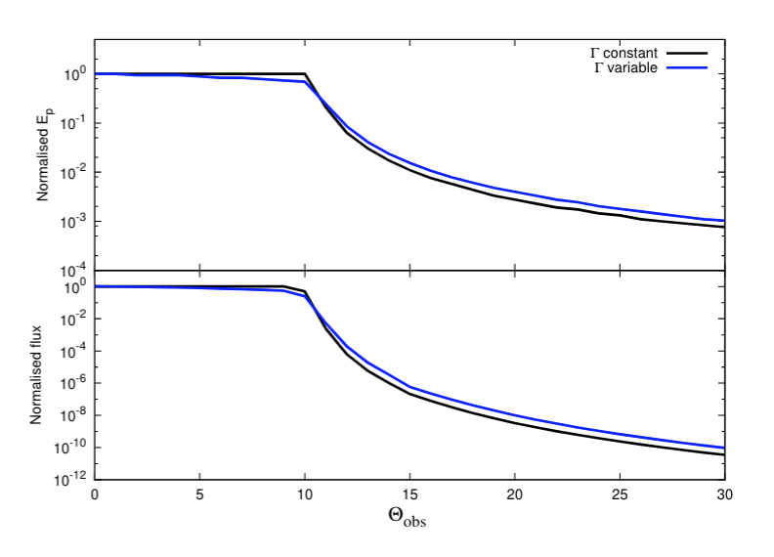
The observer’s viewing angle dependence
Values normalized to the case θ_{obs}=0∘

Slide 18
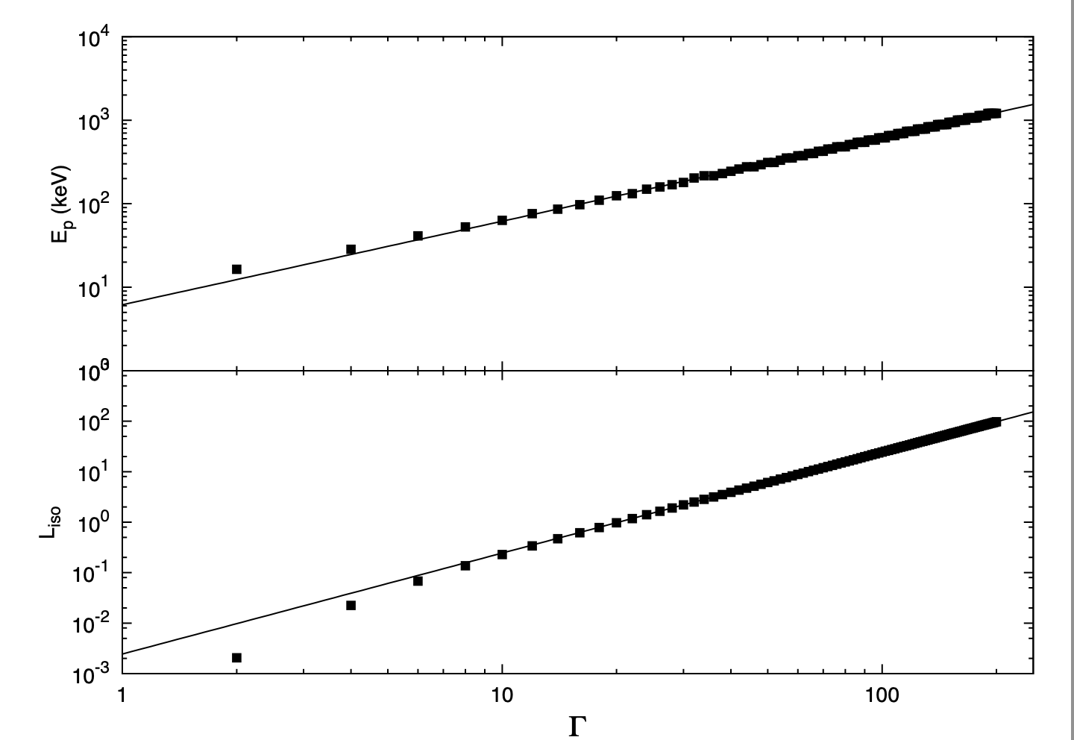
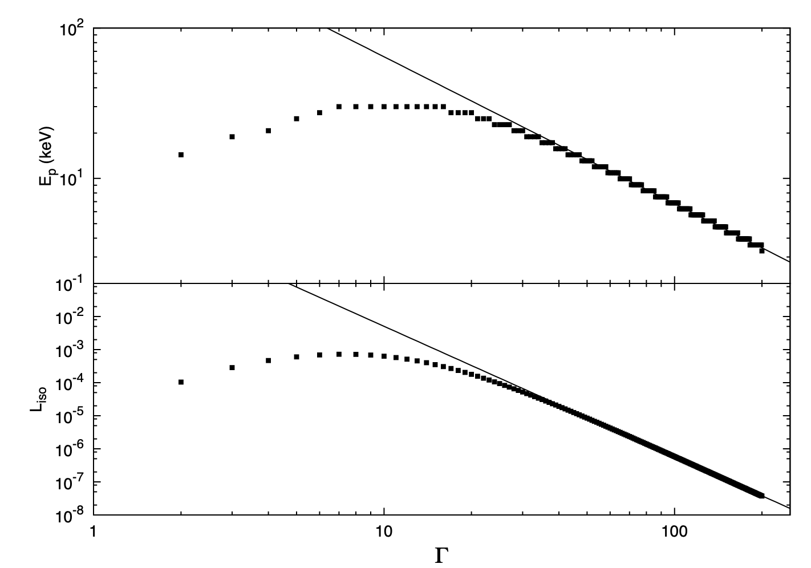
The key role of the observer’s viewing angle
E_{p} ∝ Γ
E_{p} ∝ Γ⁻¹
L_{iso} ∝ Γ²
L_{iso} ∝ Γ⁻⁴
ON-AXIS CASE
Θ_{obs} = 5
OFF-AXIS CASE
Θ_{obs} = 15
E_{p} ∝ (L_{iso})^{0.5}
E_{p} ∝( L_{iso})^{0.25}
Two clear and distinct law which comes from purely relativistic kinematics effects

Slide 19
The Amati relation
The data dispersion is related to instrinsic dispersion of the comoving-frame parameters (i.e., E₀, p₁, p₂ , Norm, for a broken-powerlaw)
Do the outliers are off-axis events ?

Slide 20
Theory vs observations
Γ sampled from a Gaussian distribution N(100,50)
Θ_{jet} = uniform distribution [5∘-20 ∘]
Θ_{obs} = uniform distribution over [Cos0 ∘ -Cos Θ_{jet} ] for on-axis
and [Cos Θ_{jet} - Cos (Θ_{jet} + 20 ∘)] for off-axis
E₀= N(5, 2), p₁=N (0, 0.5), p₂=N (1.5, 0.5), K_{SBPL} = N(150,50)
R₁₂ =1

Slide 21
Theory vs observations
Slope for off-axis is half than that for on-axis events
The position of some well know outliers in the E_{p}-E_{iso} plane is consistent with that of simulated off-axis events
Γ as main parameter driving the Amati Relation

Slide 22
Model applications
Being viewing-angle dependent, it can be used to estimate the rate of GRB detection for Theseus simulations as well as the flux by playing with the model parameters
X-ray spectral fitting of GRB with model release
for Xspec package

Slide 23
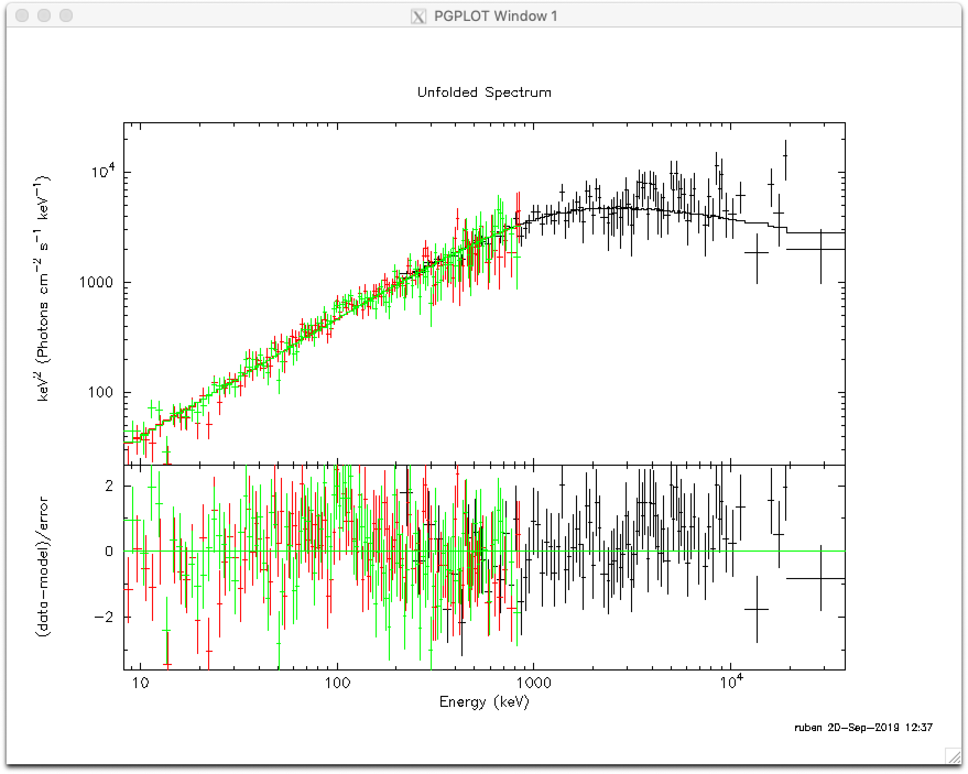
Model applications: GRB110721
Best-fit parameters
Γ=495 (> 187)
p₁=-1.01^{-0.26} _{+0.77}
δ=1.22^{+0.17} _{-0.26}
_{Low Ecut=9.67}^{+2.32} _{– 2.39}
Norm=3.97^{+5.45}_{-1.86}
𝟀2/dof=310/300
Fixed parameters
Θ_{jet} = 10∘
Θ_{obs} = 5∘
p₂=1.3
E₀=25 keV
z=1 (not known)
Model needs a low-energy rollover
(expabs in XSPEC)

Slide 24
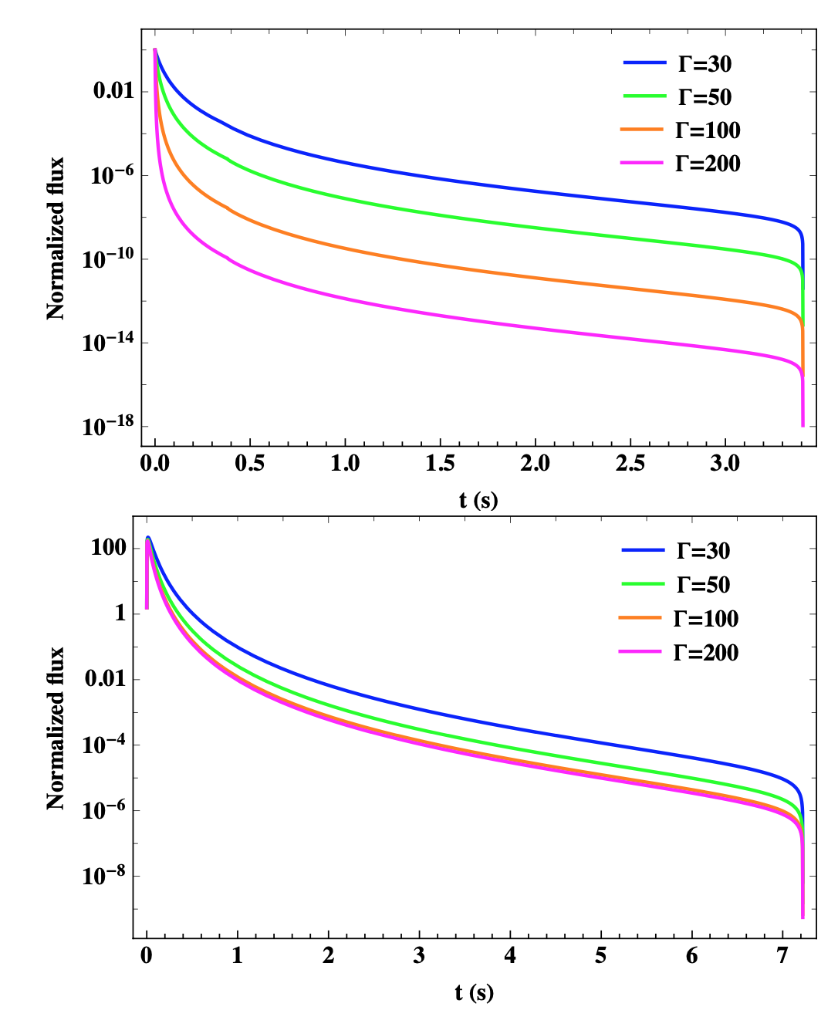
Temporal domain
The radiation curvature effects produces specific pulses in the observer’s frame
R_{jet} = 10¹² cm Θ_{obs} = 10∘
On-axis Θ_{obs} = 5∘
Off-axis Θ_{obs} = 12∘

Slide 25
Temporal domain
More complex light curves can be obtained by the Green’s function convolutional method
Two possible scenarios
A single jet evolving with time
A series of colliding shells (internal shock model) where each collision produces a pulse of lenght dictated by radiative time
time-scale
All the mathematical details will be given in a elsewhere paper

Slide 26
Model references
Description and applications
Farinelli et al. 2021, MNRAS, 501, 5723
Source code for XSPEC, waiting to be part of the next
Heasarc release
https://github.com/HEASARC/xspec_localmodels
(model name: GRBJET)

