Slide 1
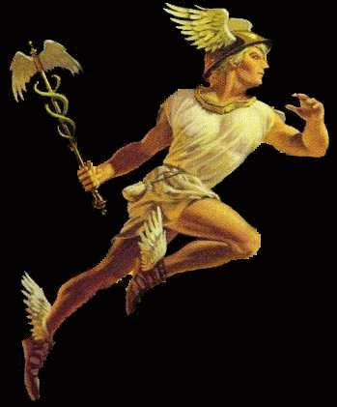





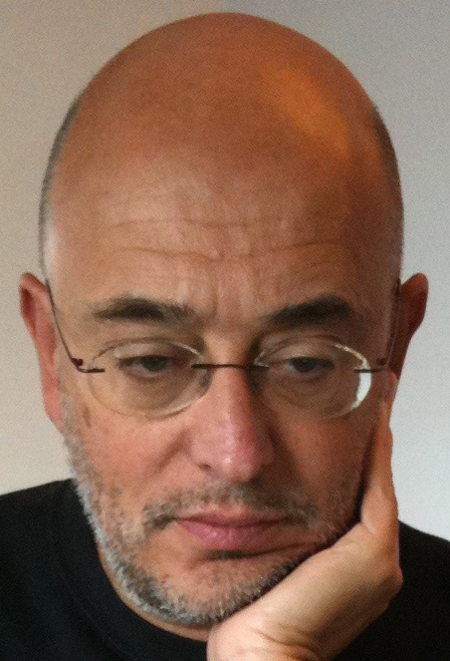
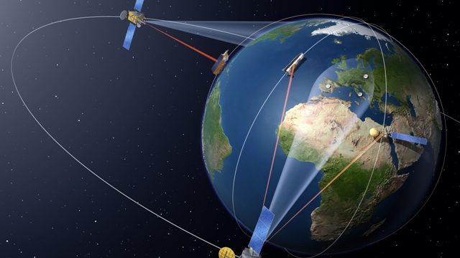

GrailQuest
Gamma-ray Astronomy International Laboratory for Quantum Exploration of Space-Time
& HERMES
High Energy Rapid Modular Ensamble of Satellites
Hunting for Gravitational Wave Electromagnetic Counterparts
Probing Space-Time Quantum Foam
HERMES
GrailQuest
Luciano Burderi - University of Cagliari
  Tiziana Di Salvo, Andrea Sanna, Fabrizio Fiore, Alessandro Riggio
  On behalf of the HERMES and GrailQuest Collaborations
GrailQuest
Please, visit our websites:
http://hermes.dsf.unica.it
www.hermes-sp.eu

Slide 2
Two compelling (astro)-physical problems for the next decades
Development of Multi-Messenger astronomy (EM counterparts of GW events)
Is physical space(time) granular or continuous? (Zeno’s paradoxes, existence of a “fundamental minimal length” in some string theories, atoms of space, particles vs. fields, …)
Distributed Astronomy is the key!

Slide 3
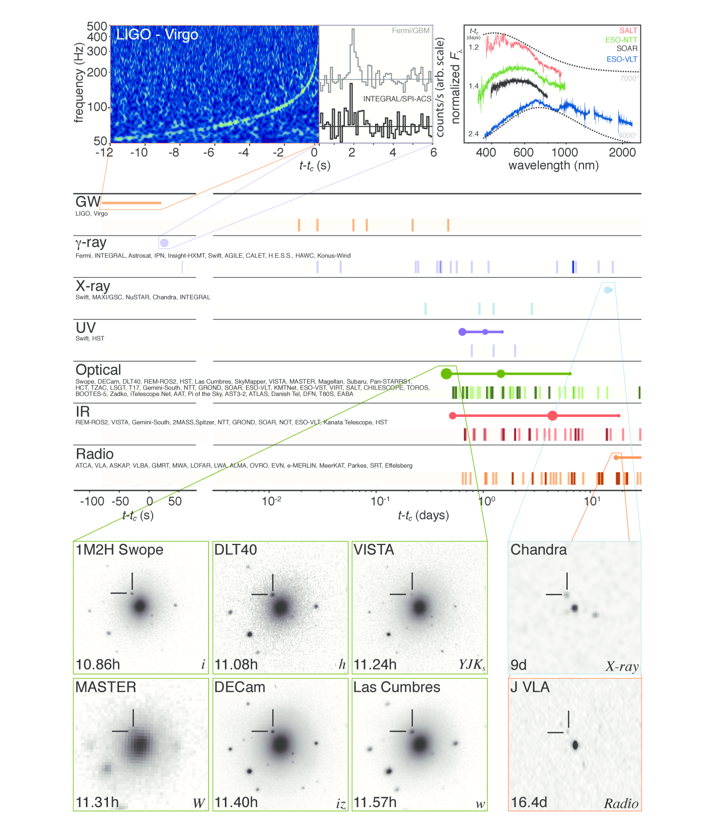
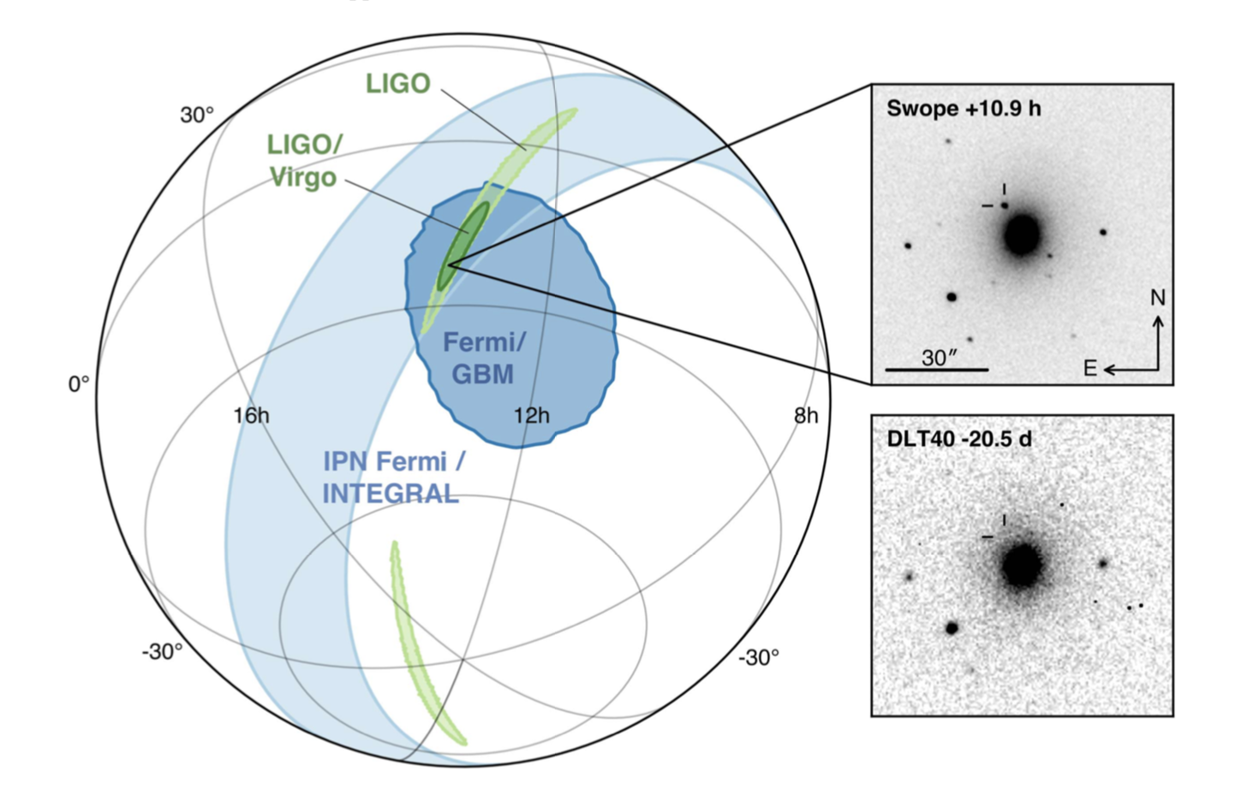
The birth of Multi−Messenger Astronomy
GW170817
NS-NS merging
Host galaxy NGC 4993
~ 40 Mpc
70 observatories

Slide 4
The Multi−Messenger Astronomy Paradox I
2025+ LIGO/VIRGO/KAGRA/LIGO-INDIA will detect GW170817 within ~ 300 Mpc with localisation accuracy ~10 deg²
FERMI GBM would not have been able to detect GRB 170817A at D > 60 Mpc

Slide 5
The Multi−Messenger Astronomy Paradox II
One of he most thrilling research field in Science:
the whole field based on ONE discovery: GRB 170817A - GW170817 connection
Fact ♯ 1:
within 2025 LIGO − Virgo − KAGRA − Einstein Telescope GW antennas will provide detectability of NS−NS mergers events like GW170817 within ≅ 300 Mpc
Localization accuracies:
100 square deg (LIGO − Virgo)
10 square deg (LIGO − Virgo − KAGRA)
Fact ♯ 2:
GBM would not have been able to detect an event 60% fainter than GRB 170817A.
Kilonova events seen at angles ≥ 25 degrees are undetectable by GBM for distances ≥ 60 Mpc.
Fact ♯ 1 + Fact ♯ 2 ➔ No EM counterpart detected, no party!
(quoting George Clooney)
We need a All-sky Monitor at least 10÷100×GBM Area for letting Multi−Messenger Astronomy to develop from infancy to maturity!

Slide 6
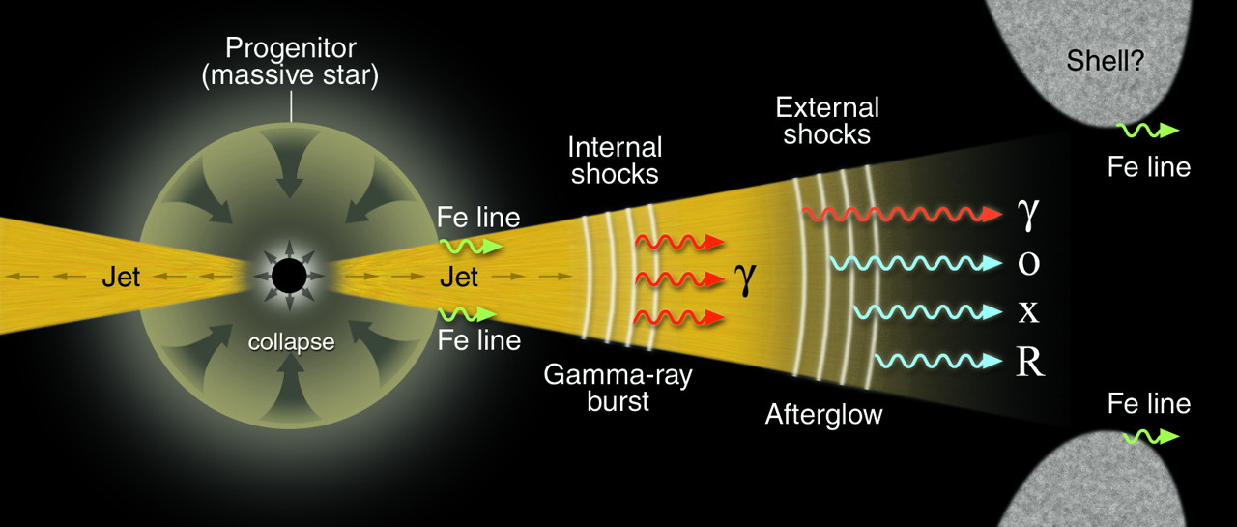
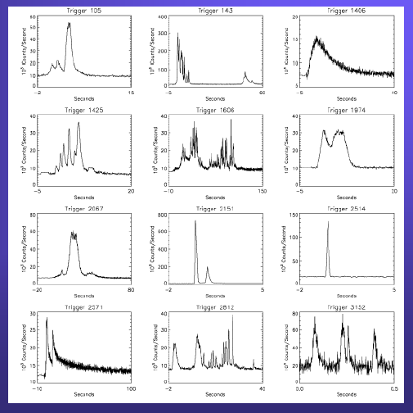
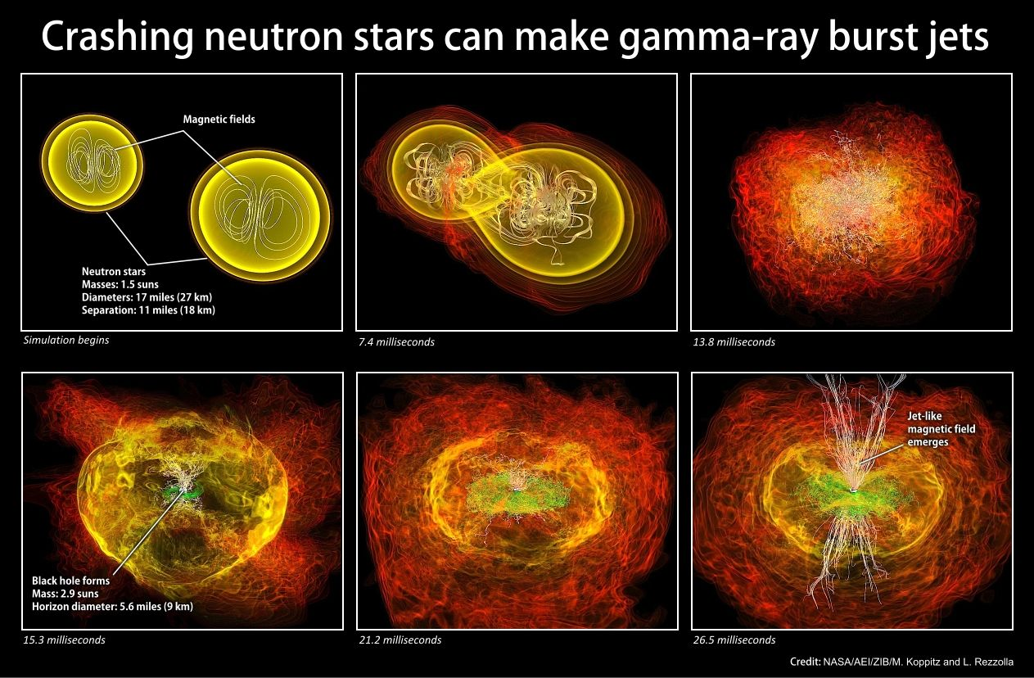
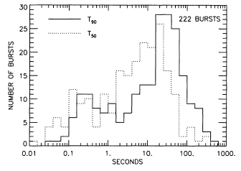
Long GRB:
BH collapse of a massive star
GRB
progenitors
Short GRB:
NS−NS binary
system coalescence
(emission of GW)
short
long

Slide 7
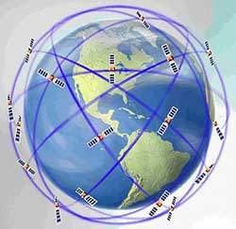
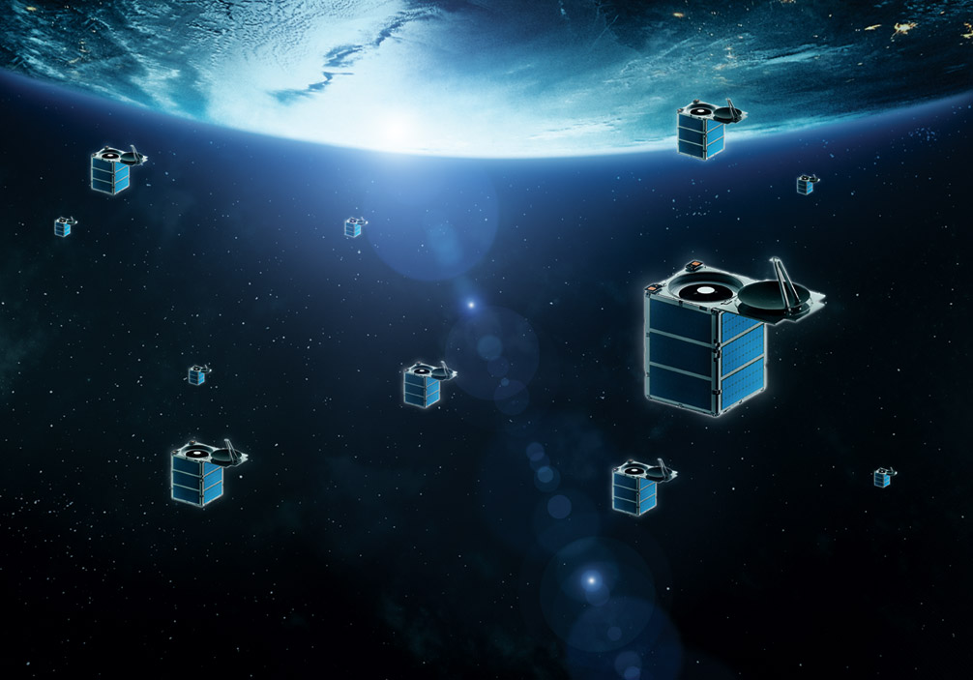
GrailQuest & HERMES in a nutshell
Aims:
all Sky Monitor for fast and accurate detection
of the position of bright, transient, high-energy events
and All Sky Monitor of known bright sources (timing):
GRBs
GW events
high-energy counterparts of Fast Radio Bursts
flares from Magnetars
GrailQuest (only)
first dedicated experiment in Quantum Gravity
How:
temporal triangulation of signals detected by a swarm of LEO nano/micro/small satellites equipped with:
keV-Mev scintillators,
sub μs time resolution
temporal triangulation
Pros:
modularity,
limited cost,
quick developement

Slide 8
Monte-Carlo simulations of a true long GRB
Template (1ms resolution) of a long GRB ( derived from GRB130502327 observed by Fermi GBM)
Δt = 40 s; φ_{GRB}= 6.5 phot/s/cm²; φ_{BCK}= 2.8 phot/s/cm²; variability ≈ 5 ms;
(Long and Short GRB with millisecond time variability, 40% of bright)
zoom of 10 ms of template centered at the main peak
(≈ 5 ms width)

Slide 9
Accuracy in delays from cross−correlation analysis
Accuracy in determining delays
from a bright long GRB with
Δt = 40 s;
φ_{GRB}= 6.5 phot/s/cm²;
φ_{BCK}= 2.8 phot/s/cm²;
variability timescale ≈ 5 ms;
1000 pair of Monte-Carlo simulations
for detectors of different effective
areas A
Best fit formula:
σ_{DELAYS} ≈ σ_{ToA} = 3.3 μs × (A/1 m²)^{−0.58}

Slide 10
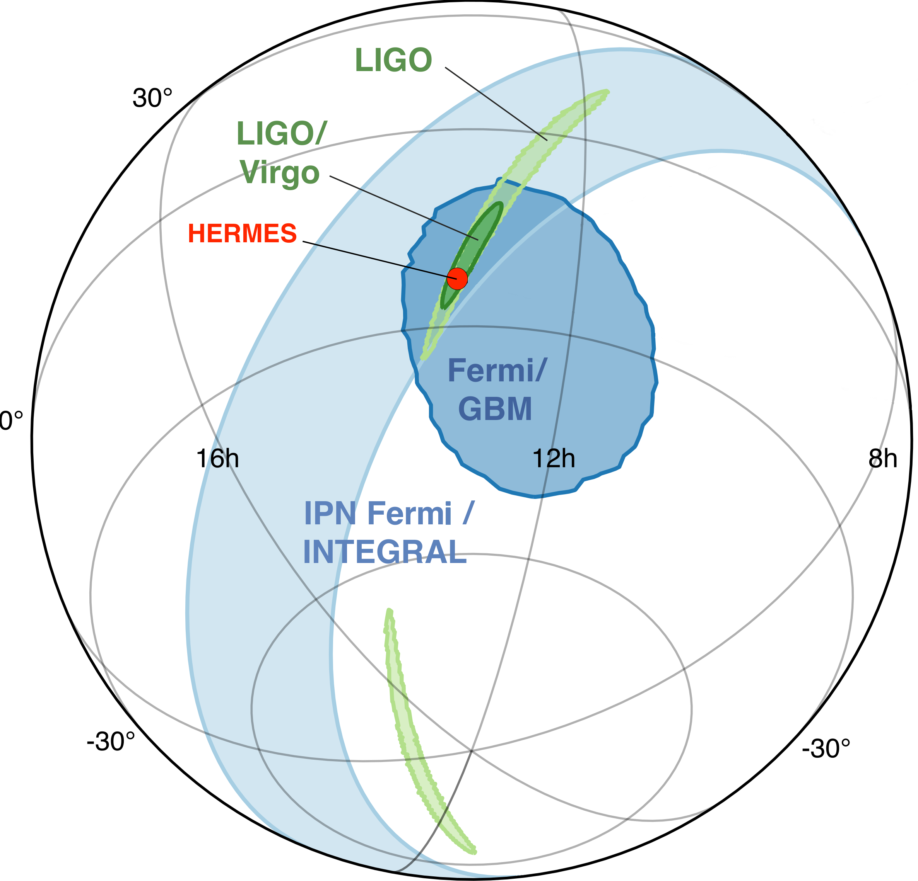
GW Triangulation & EM counterparts
(Fermi GBM, INTEGRAL, HERMES Pathfinder)
Example:
long bright GRB
6.5 phot/s/cm² (source)
3 phot/s/cm² (background)
30 s duration
50-300 keV band
3 satellites each of
effective area: 50 cm²
σ_{ToA} ≈ 1 ms
<baseline> ≈ 6000 km
positional accuracy: 3 deg

Slide 11
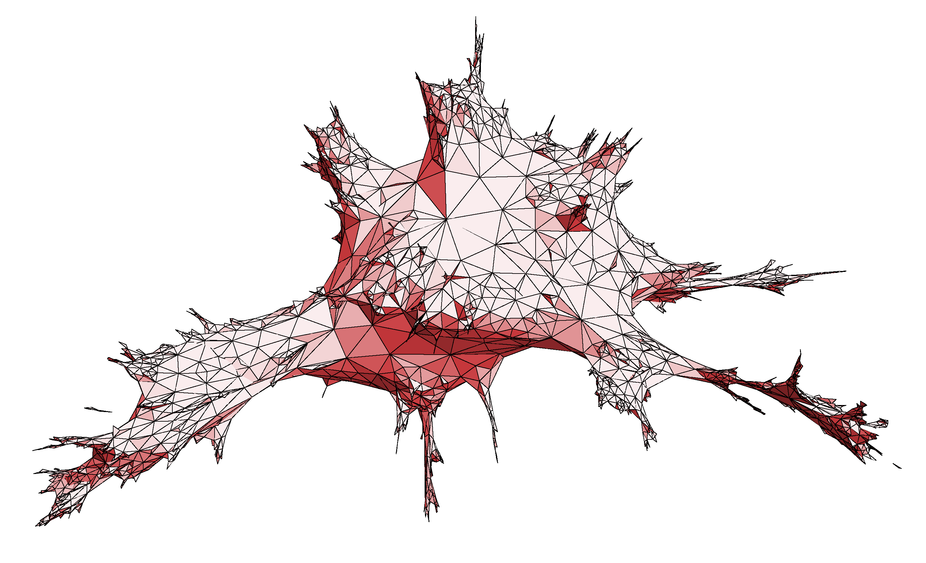
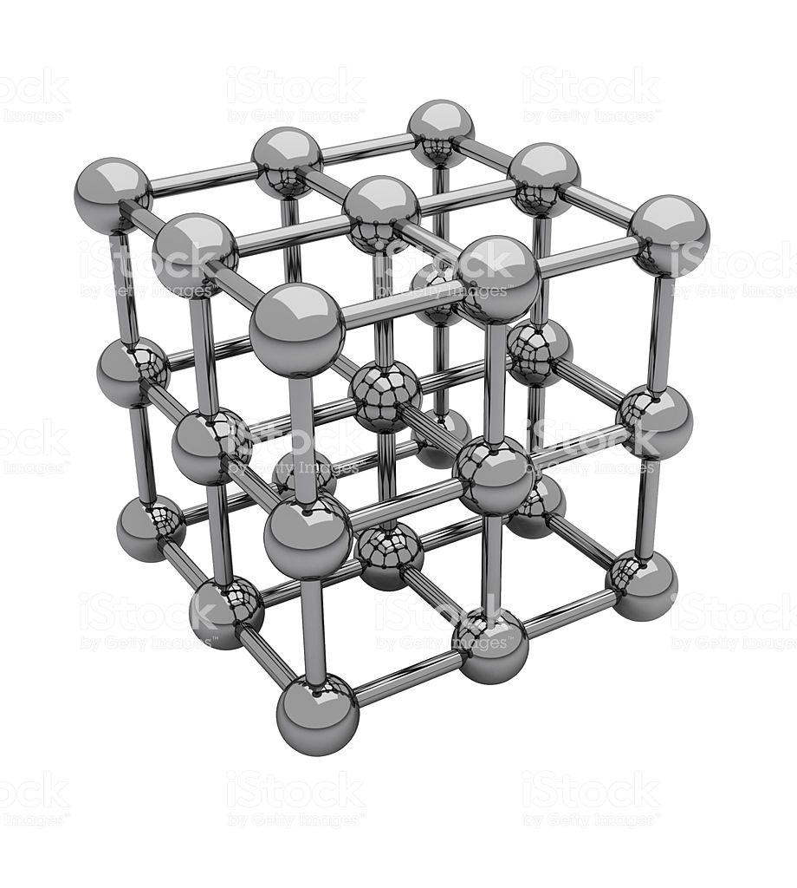
Quantum Gravity
Minimal Length Hypotesis, LIV and Dispersion Relation for photons in vacuo
Existence of a Minimal Length (String theories, etc.)
l_{MIN} ≈ l_{PLANCK} = [Gh/(2πc³)]^{1/2} = 1.6 × 10⁻³³ cm
implies:
Lorentz Invariance Violation (LIV): no further Lorentz contraction
Space has the structure of a crystal lattice and therefore
Existence of a dispersion law for photons in vacuo
|v_{phot}/c − 1| ≈ ξ E_{phot}/(M_{QG} c²)^{n}
ξ ≈ 1
n = 1,2 (first or second order corrections)
M_{QG} = ζ m_{PLANCK} (ζ ≈ 1)
m_{PLANCK} = (hc/2πG)^{½} = 21.8 10⁻⁶ g
l_{MIN} ≈ l_{PLANCK}

Slide 12
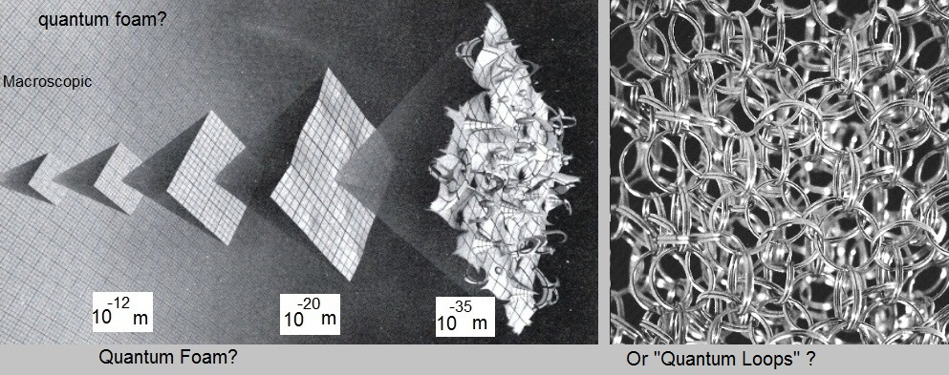
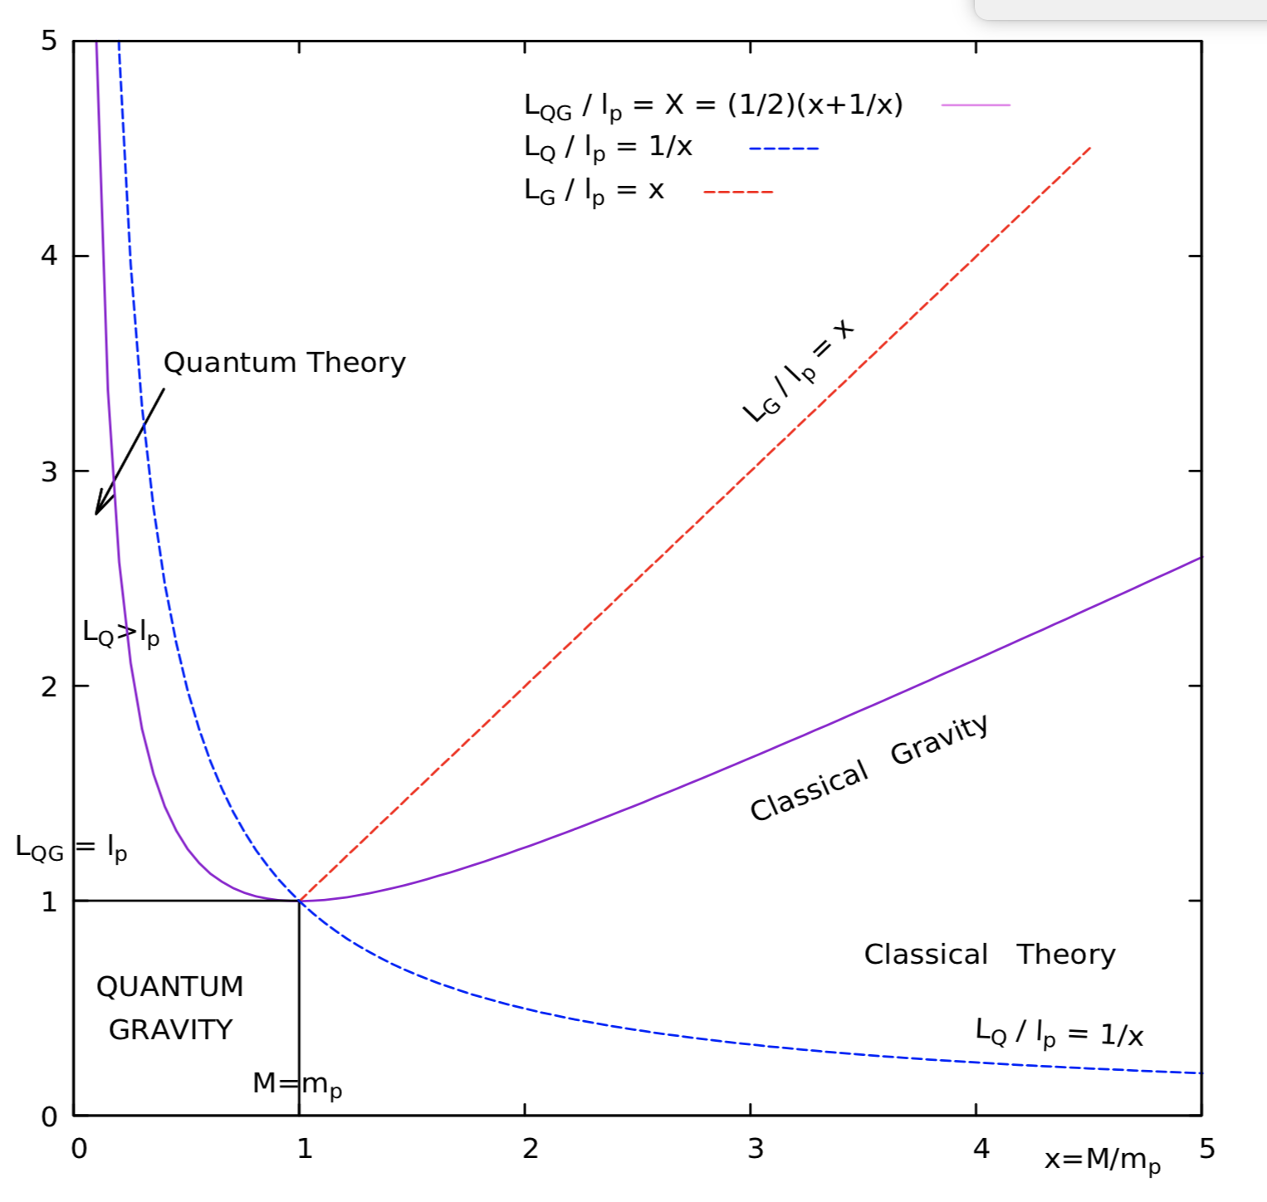
First and second order Dispersion Relation for photons in vacuo
LIV theories
No LIV theories
l_{MIN} ≈ l_{PLANCK}
Burderi, Di Salvo, Iaria (2016)
Space−Time
Uncertainty Relation
Δr Δt > Għ/c⁴
/c⁴
& Sanchez,
2018
Loop Quantum Gravity (Rovelli)
First Order Dispersion Relation
v_{phot}/c ≈ 1 - ξ E_{phot}/(M_{Planck} c²)
Second Order Dispersion Relation
v_{phot}/c ≈ 1 - ξ [E_{phot}/(M_{Planck} c²)]²

Slide 13
Dispersion Relation for photons in vacuo and Delays in travel time
Accumulation of delays in light propagation:
Δt_{MP/LIV} = ξ (D_{TRAV}/c) [ΔE_{phot}/(M_{QG} c²)]^{n}
The distance traveled by photons takes into account the cosmological expansion:
D_{TRAV}(z)=(c/H₀)∫₀^{z} dβ (1+β)/[Ω_{Λ}+(1+β)³ Ω_{M}]^{1/2}
z: cosmological redshift
Ω_{Λ}: ratio between the energy density due to the cosmological constant and the critical (closure) density of the Universe
Ω_{M}: ratio between the energy density due to the matter and the critical (closure) density of the Universe

Slide 14
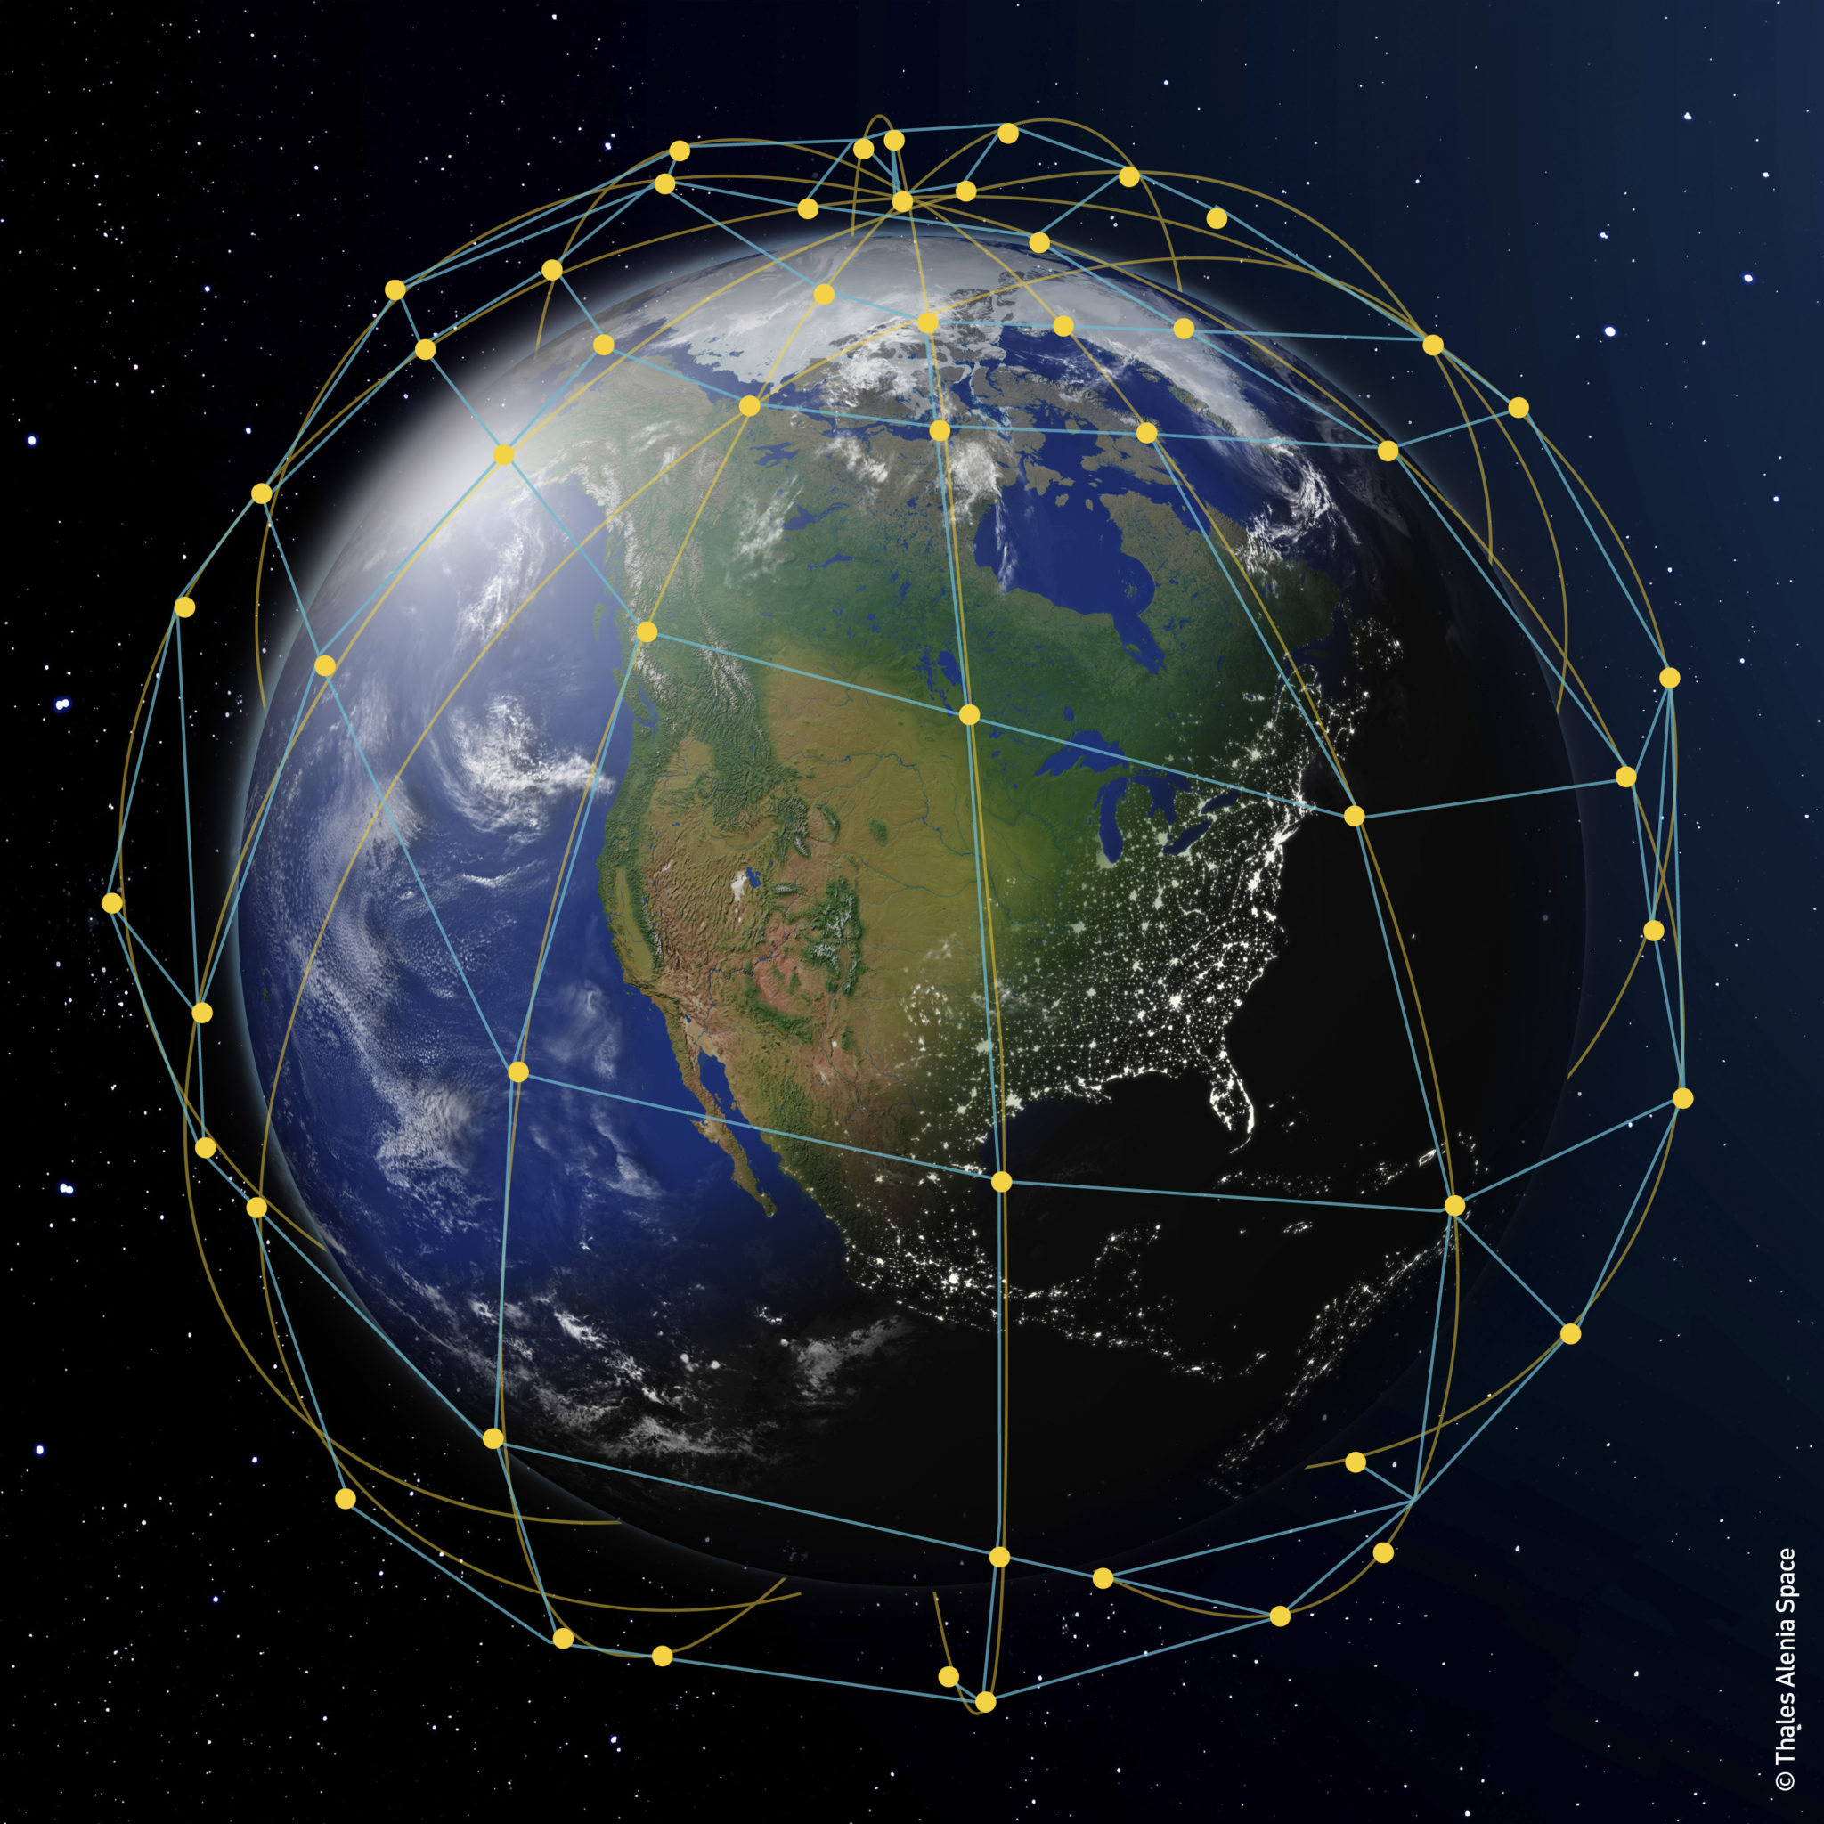
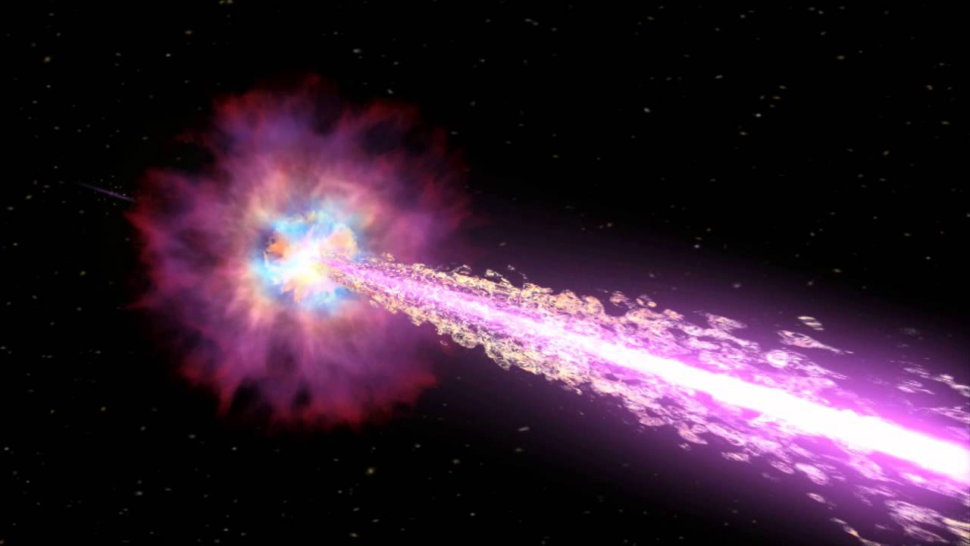
The Energy & Redshift delay
High z
Low z
Time lags caused by Quantum Gravity effects:
  ∝ |E_{phot}(Band II)−E_{phot}(Band I)|
  ∝ D_{GRB}(z_{GRB})
Time lags caused by prompt emission mechanism:
  complex dependence from E_{phot}(Band II) and E_{phot}(Band I)
  independent of D_{GRB}(z_{GRB})

Slide 15
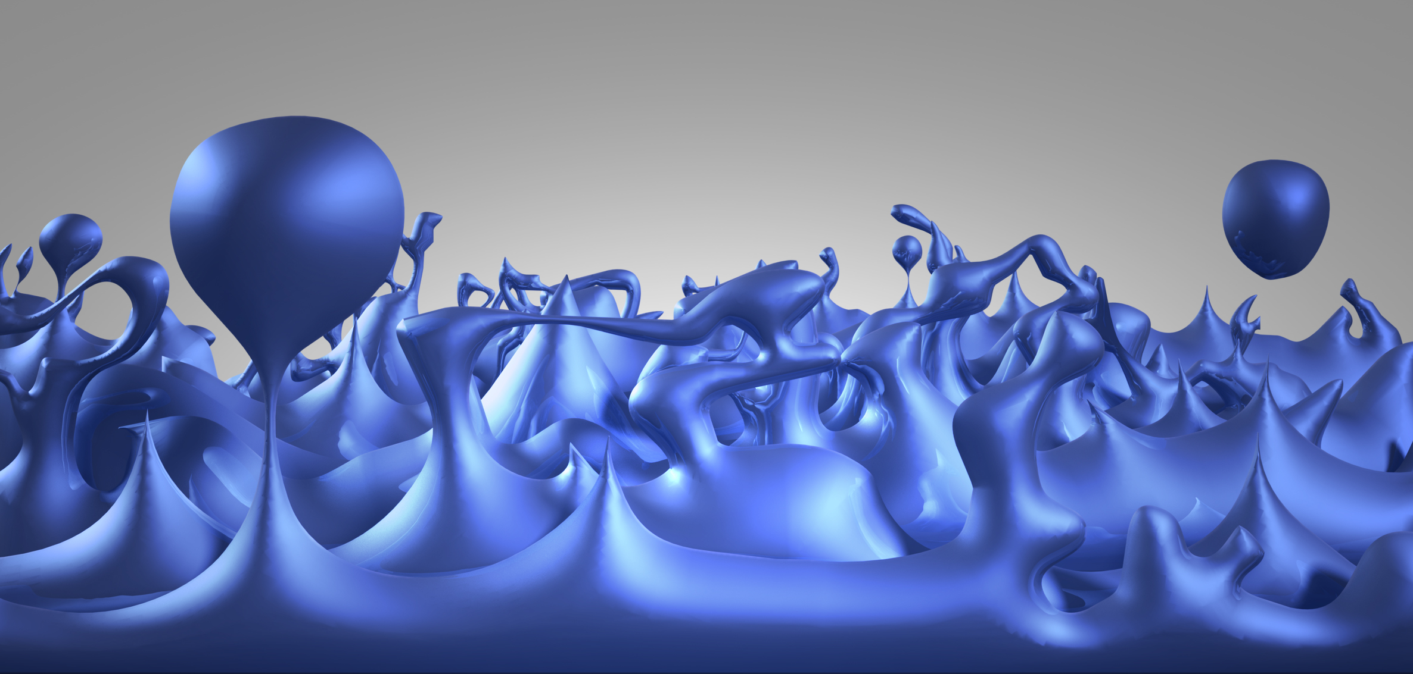
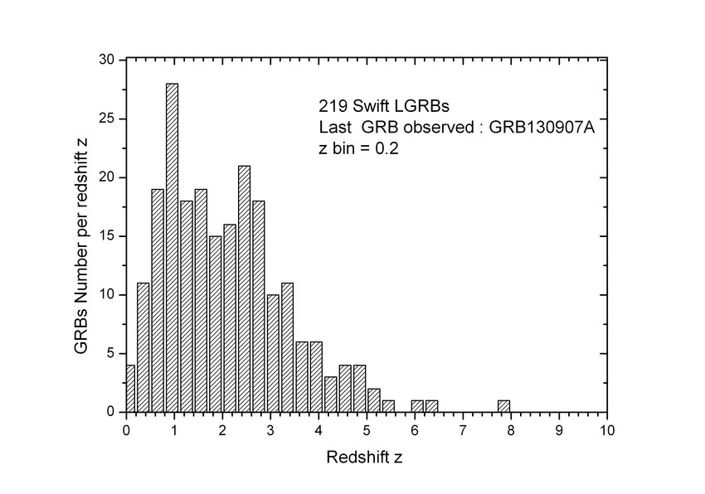
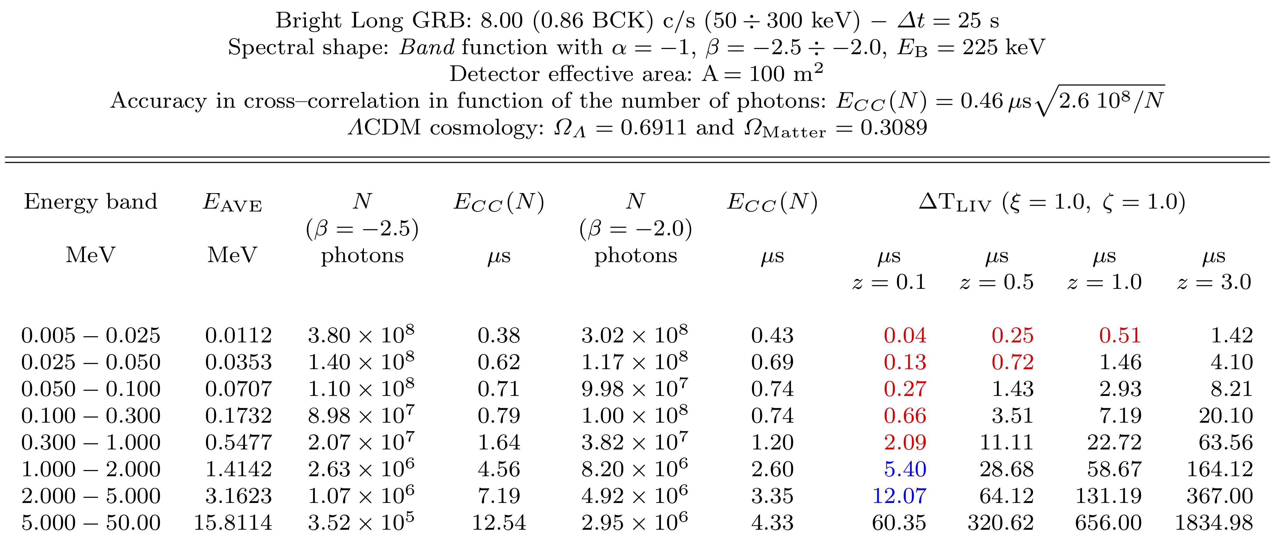
GRBs & Quantum Gravity
σ_{CC} ≈ 0.46 μsec × (2.6 10⁸/N)^{0.5}
Δt_{MP/LIV} = ξ (D_{TRAV}/c) [ΔE_{phot}/(M_{QG} c²)]^{n}
D_{TRAV}(z)=(c/H₀)∫₀^{z} dβ (1+β)/[Ω_{Λ}+(1+β)³ Ω_{M}]^{1/2}

Slide 16
Location of GRBs with fleets of satellites and redshifts
Accuracy in determining delays from Monte-Carlo simulations of 100 pairs of GRBs of fluence 260 (112 BCK) photons/cm² with detectors of different effective areas:
σ_{DELAYS} ≈ σ_{ToA} = 3.3 μs × (A/1 m²)^{−0.58}
Accuracy in determining α and δ with N_{SATELLITES} (N_{IND} = N_{SATELLITES} − 1; N_{PAR}= 2):
σ_{α} ≈ σ_{δ} = c σ_{ToA}/<baseline> × (N_{IND} − N_{PAR})^{−1/2}
Large fleet of small satellites in Low Earth Orbits:
A = 30 × 30 cm ≈ 0.1 m²
σ_{ToA} ≈ 12.5 μs
N_{SATELLITES} ≈ 1000
<baseline> ≈ 6,000 km
σ_{α} ≈ σ_{δ} ≈ 4 arcsec
Three satellites with detectors of 1 m² effective area in Earth−Moon Lagrangian points
MEANS (Moon-Earth Array of Nano Satellites) Project:
A ≈ 1.0 m²
σ_{ToA} ≈ 3.3 μs
N_{SATELLITES} = 3
<baseline> ≈ 400,000 km
σ_{α} ≈ σ_{δ} ≈ 0.5 arcsec
Once the position is known, the redshift of the GRB host galaxy is obtained through pointed observations of large optical telescopes.

Slide 17
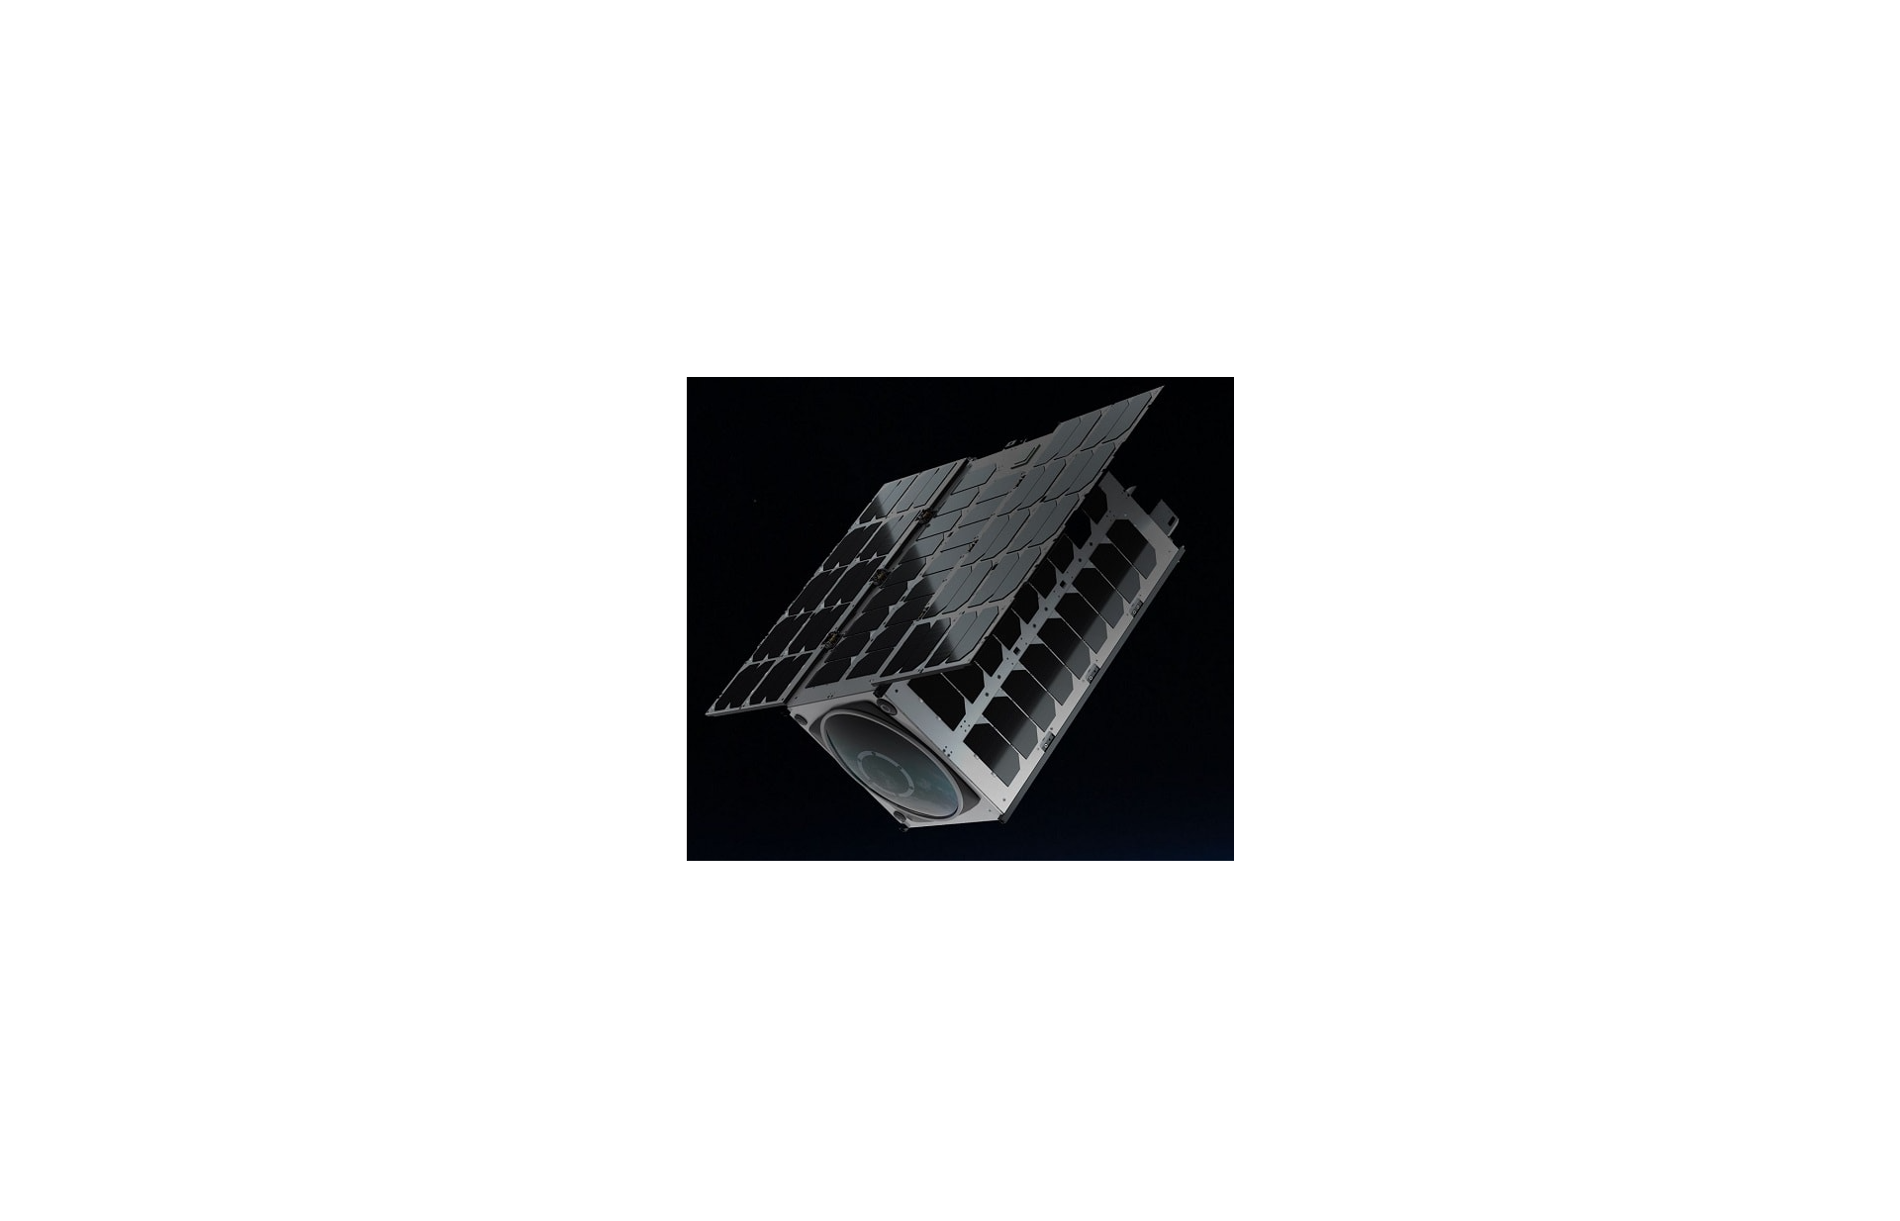
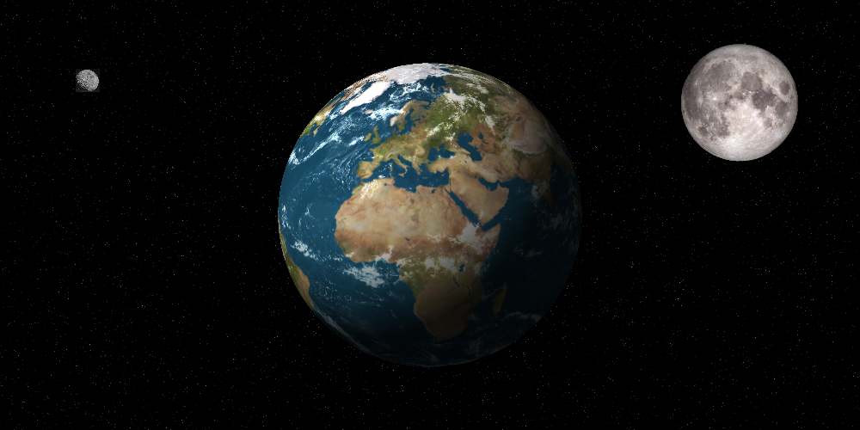
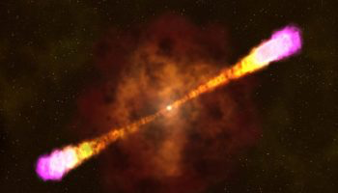
MEANS:
Moon-Earth Array of NanoSats
A ≈ 1.0 m²
σ_{ToA} ≈ 3.3 μs
N_{SATELLITES} = 3
<baseline> ≈ 400,000 km
σ_{α} ≈ σ_{δ} ≈ 0.5 arcsec
MEANS: Phase A/B study (cost 1.18 M€) ASI call 2020
Università di Cagliari, INAF, ARGOTEC,
Politecnico di Milano, Fondazione Bruno Kessler, Università di Palermo

Slide 18
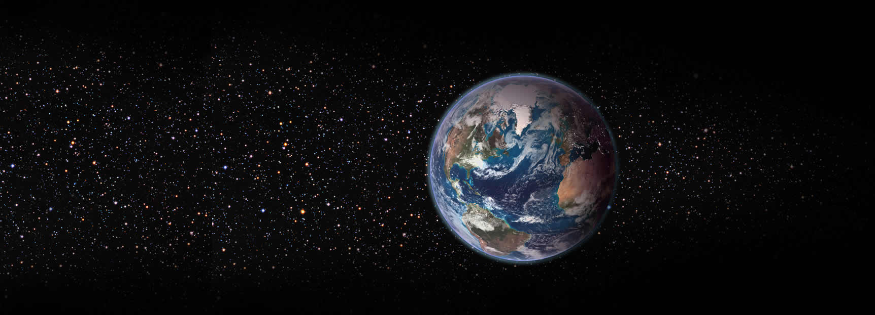
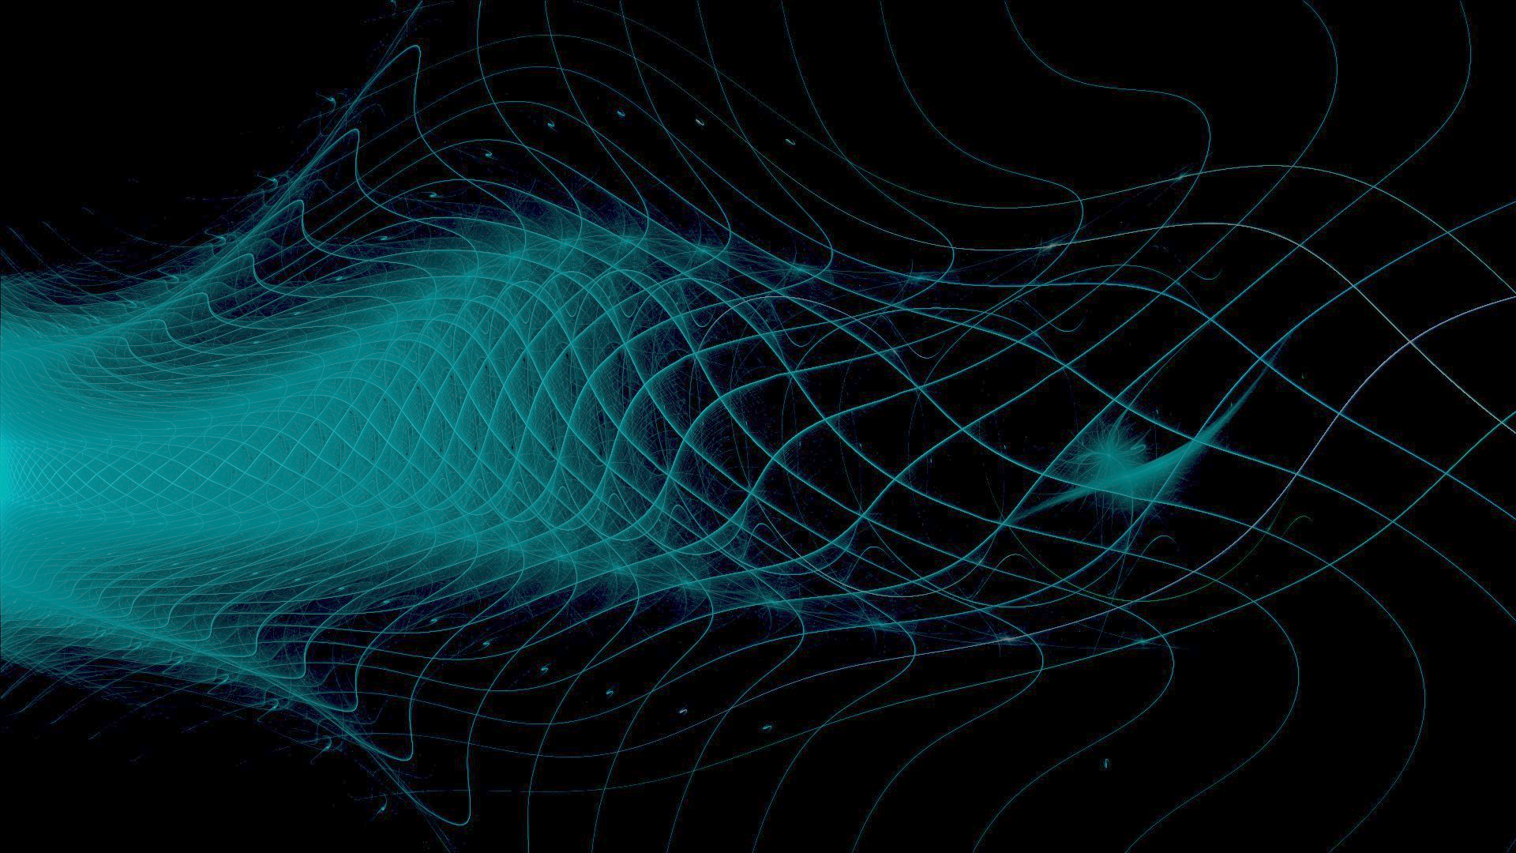
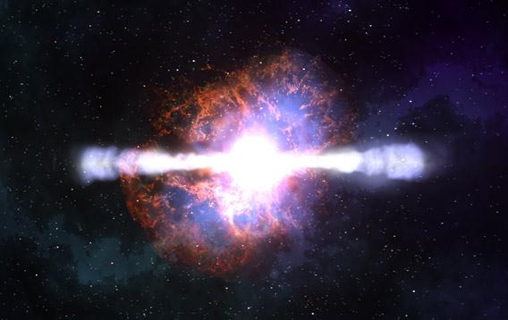
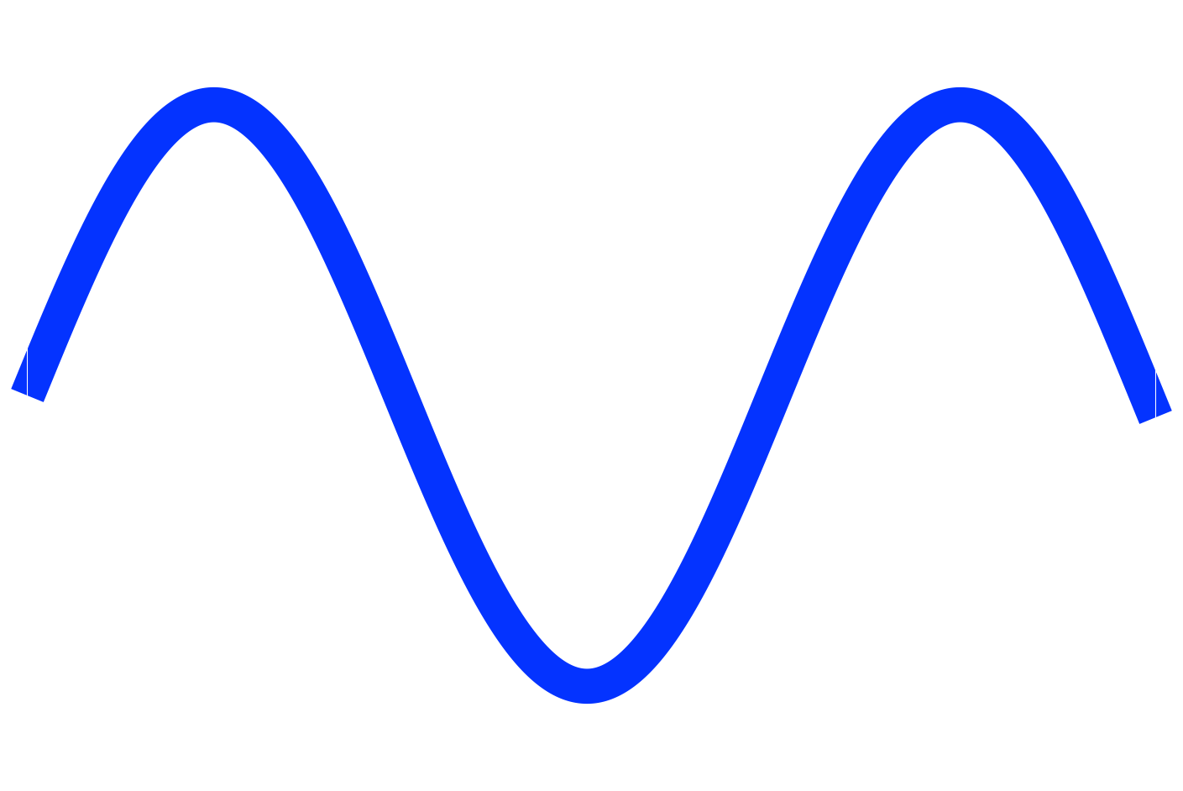
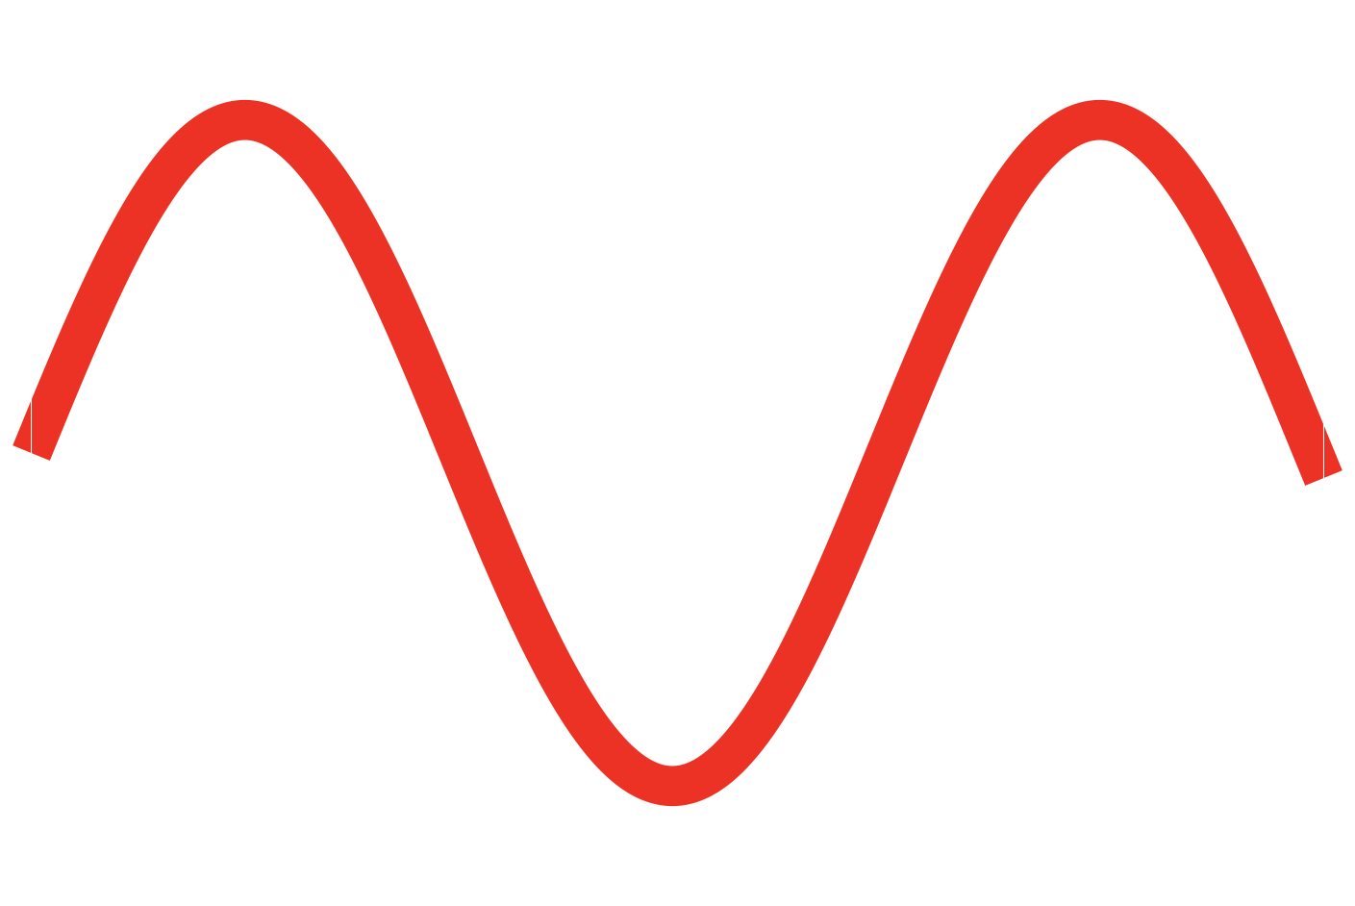
GrailQuest: First Quantum-Gravity dedicated experiment
ΔT~Gyr
Δt~μs
Robust Quantum Gravity Experiment to:
i) Search for a Dispersion law for photons vph/c ~ [1-lP/λph]
ii) Explore Space−Time Granular structure down to lP~10⁻³³ cm
Performed by means of a Constellation of 100÷10000 small sats with: i) Total collecting area: ~100 m²
ii) Energy band: 50 keV − 50 MeV
iii) Time resolution: < 0.1 μs
In a nutshell:

Slide 19
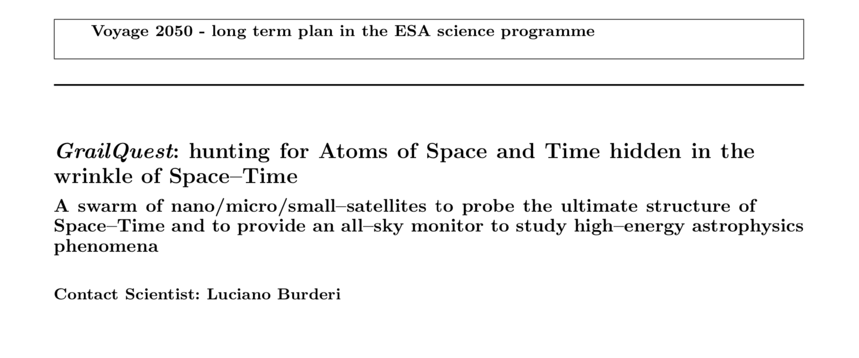
GrailQuest selected for the 2019 Call for White Papers for the Voyage 2050 long term plan in the ESA Science Programme
ΔT~Gyr
Δt~μs
In a nutshell:
Download paper at arXiv:1911.02154v2

Slide 20
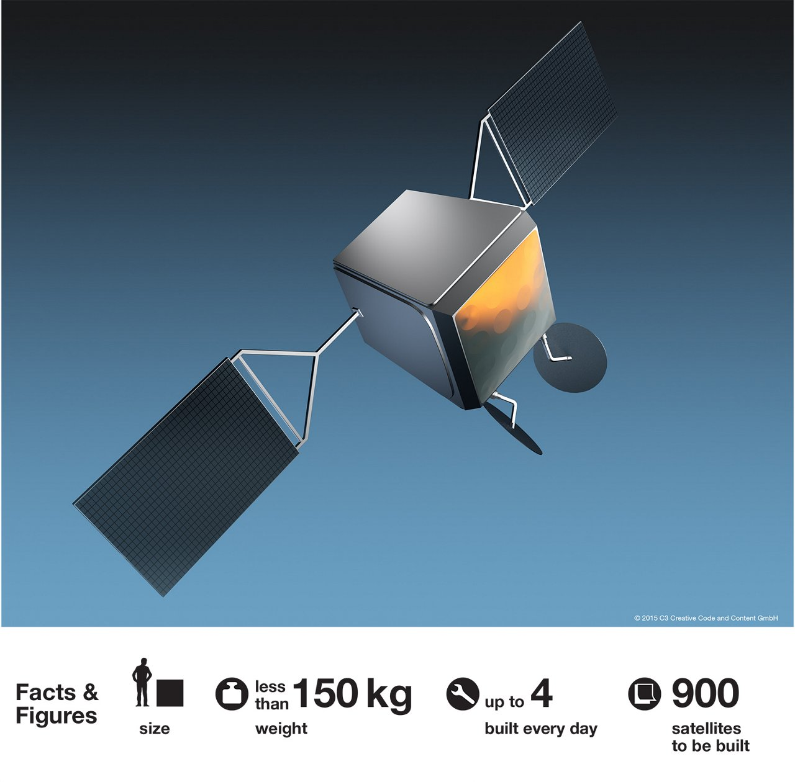
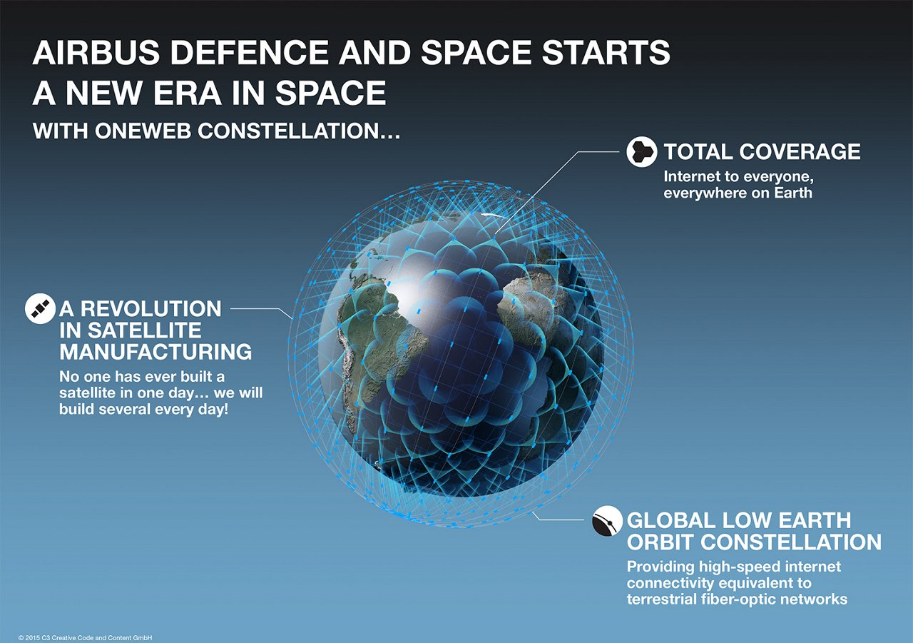
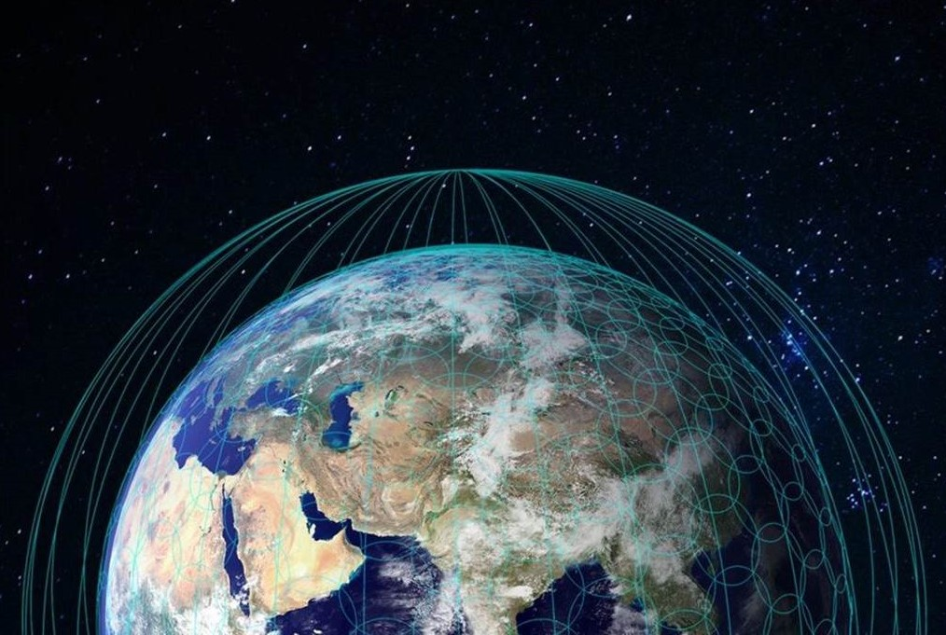
HERMES Next Generation − OneWeb
GrailQuest Next Generation − OneWeb symbiont
OneWeb Constellation 650 sats
Virgin Galactic (Richard Branson) − Arianespace − Airbus Defence and Space
640 @ 1200 km
150 kg satellites (mass production)
110 satellites launched at 18/12/2020
board a 30×30 = 900 cm² effective area detector (e.g. GAGG crystal − SDD photodetector + position sensitive with coded mask?) on each satellite
60 m² effective area All Sky Monitor

Slide 21


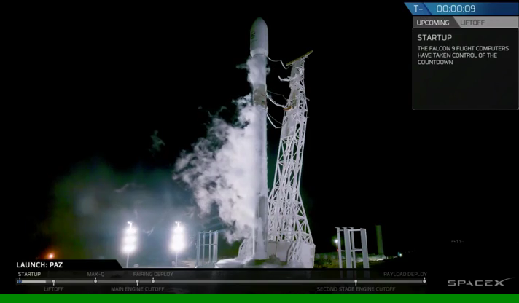
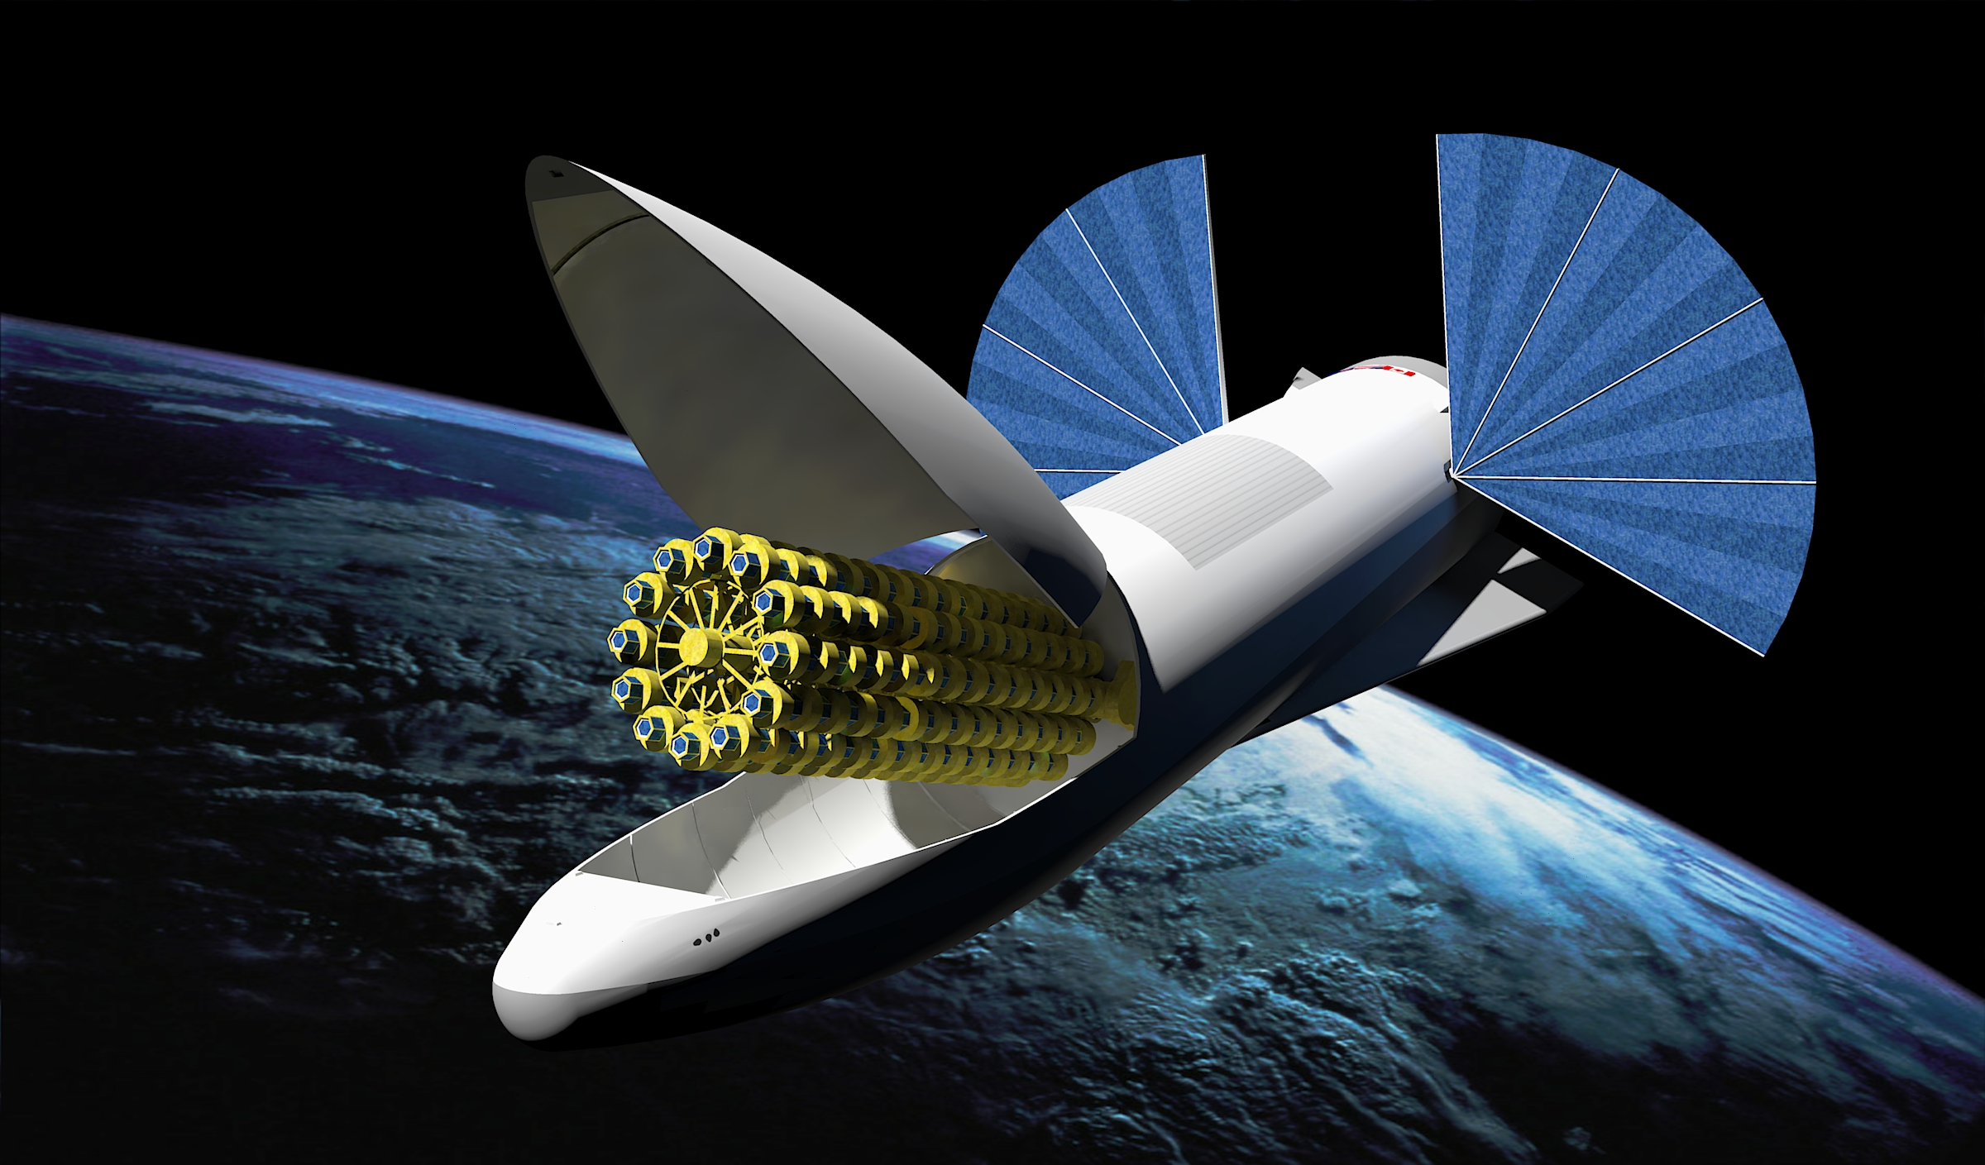
GrailQuest Next Generation − Starlink symbiont
Starlink Constellation 12,000 sats
SpaceX (Elon Musk)
4425 @ 1200 km (completed by 2024)
955 satellites launched at 25/11/2020
7518 @ 340 km
up to 1,000,000 fixed satellite earth stations
optical inter−satellite links
100 ÷ 500 kg satellites (mass production)
board a 10×10 = 100 cm² effective area detector (e.g. GAGG crystal − SDD photodetector + position sensitive with coded mask?) on each satellite
120 m² effective area All Sky Monitor!

Slide 22
GrailQuest Next Generation − Kuiper System symbiont
Amazon’s Kuiper System Satellites 3,236 sats
Amazon & Blue Origin(?) (Jeff Bezos)
April 2019
Philantropy in Astronomy
Hale reflector (5.1 m diameter) in Palomar Observatory funded by Rockfeller Foundation in 1928 proposed by George Ellery Hale
From prototypes to industrial manufacturing
Mass production (cut of costs, great intuition of Henry Ford, inventor of the Assembly Line)

Slide 23
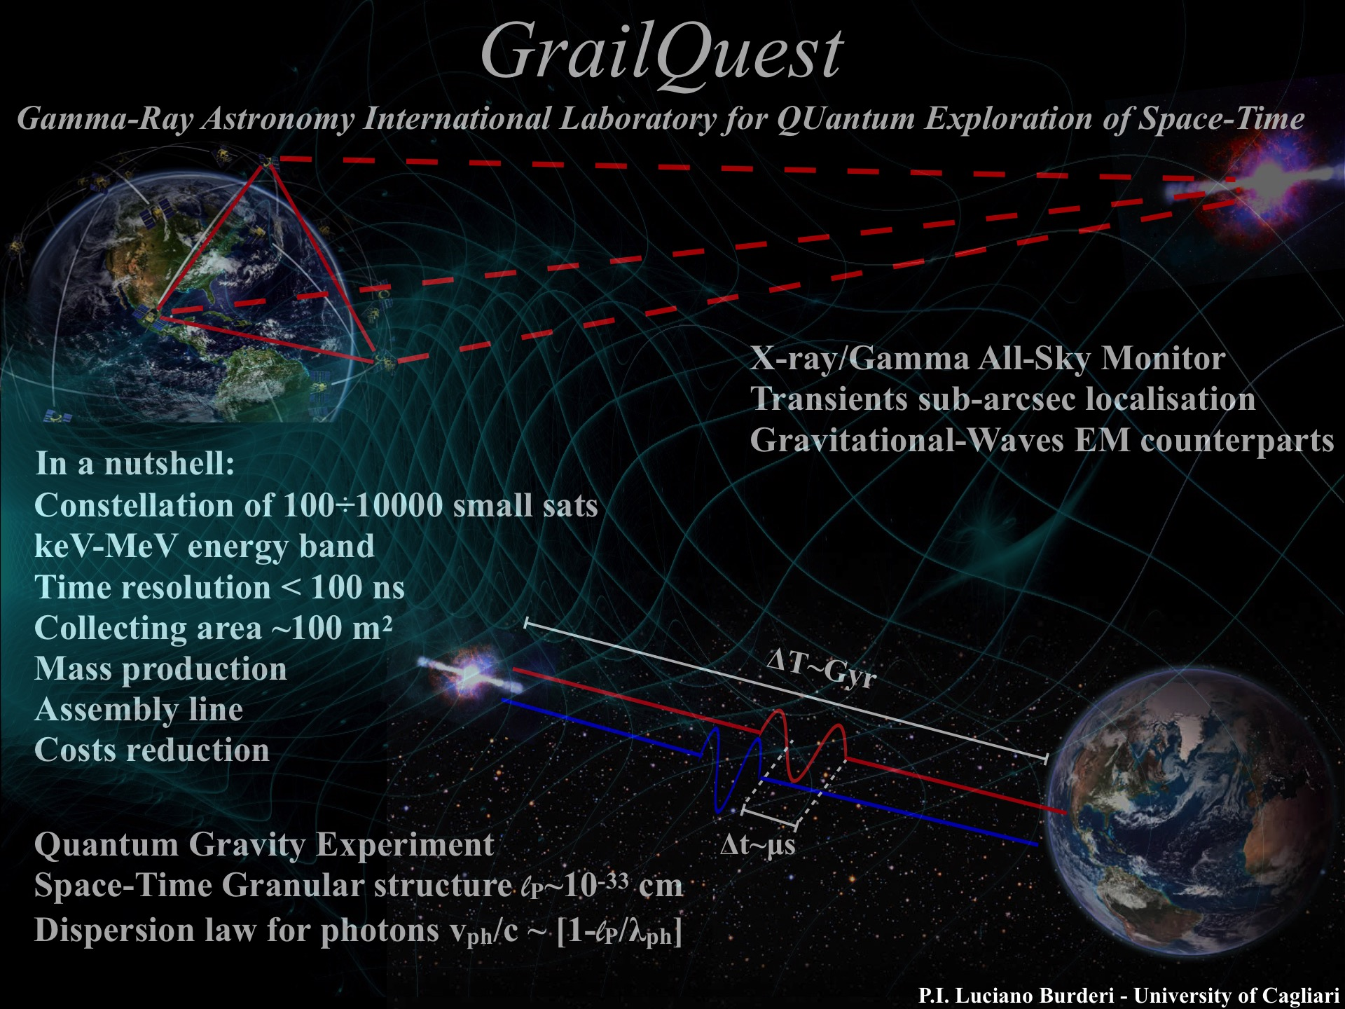
That’s all Folks!
Please, visit our websites:
http://hermes.dsf.unica.it
www.hermes-sp.eu

