Slide 1
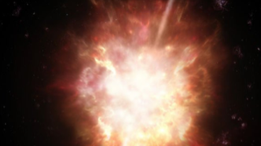

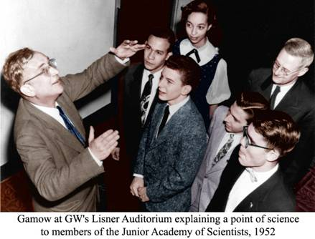
The Gamow Explorer
Nicholas E. White
The George Washington University
October 28, 2020
newhite@gwu.edu
Mission named in honor of George Gamow who was a Professor at GWU from 1934 to 1954
A proposal for MIDEX 2021
Cost cap $290M plus launch
If successful Launch 2028

Slide 2
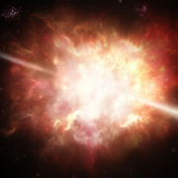





















Gamow Explorer Team Institutions

Slide 3
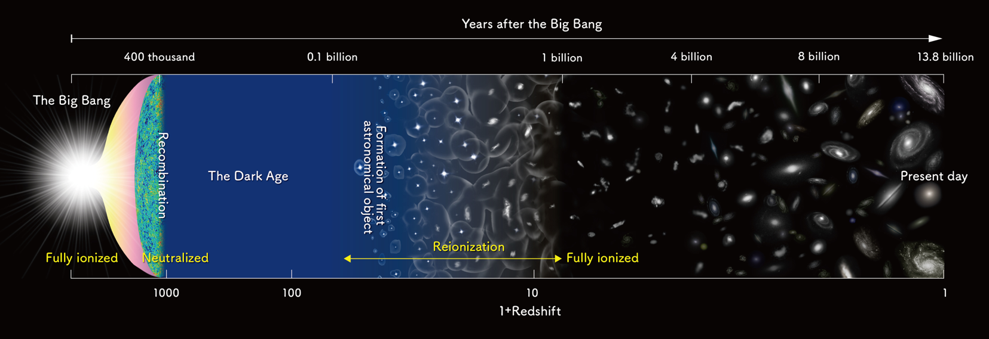
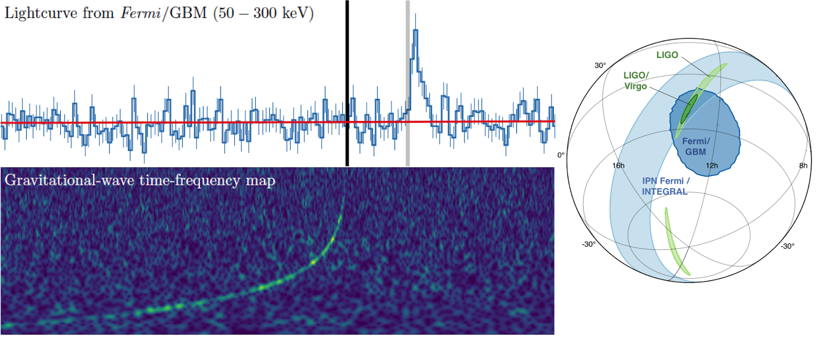
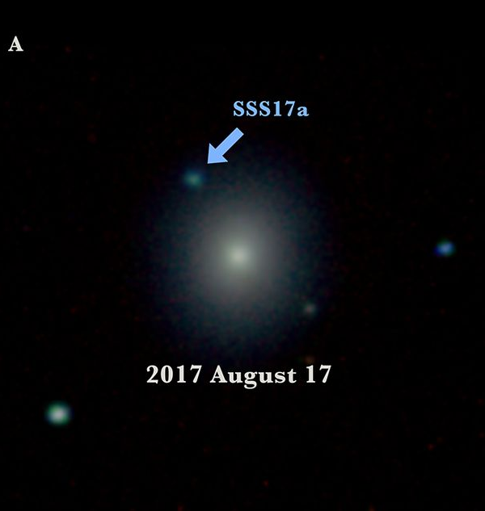
Gamow Explorer Science Goals and Objectives
Goal 1. Use Gamma Ray Bursts to probe the high redshift (z>6) Universe - when the first generations of stars were born, galaxies formed, and Hydrogen was reionized
  a) Test models for GRB production at high redshift
  b) Determine the timeline and sources of reionization
  c) Trace early cosmic chemical enrichment
Gamow Explorer
Goal 2. Multi-Messenger Astrophysics
a) Search for X-ray and Optical-IR EM counterparts for up to 50% of GW events and rapidly provide their location to other telescopes for follow up observations

Slide 4
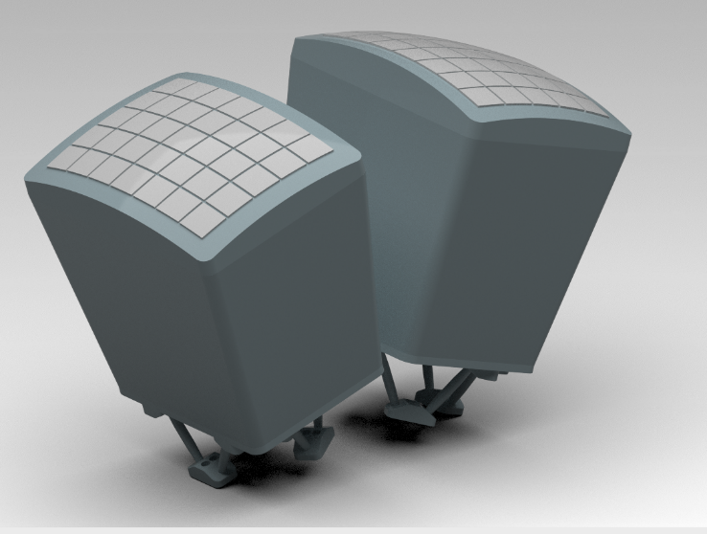
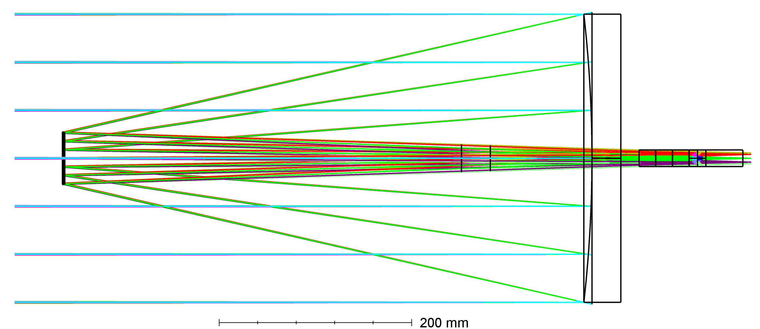
Gamow Explorer Overall Instrument and Mission Design
As pioneered by BepoSAX and the Neil Gehrels Swift Observatory the Gamow Explorer uses two instruments to detect and locate the GRB:
A wide field of view X-ray telescope using Lobster Eye optics to detect the GRB and locate it to to arc minute precision
A narrow field IR telescope to locate it to arc sec precision and make a photo-z measurement to determine whether z > 6
plus, an autonomous rapidly slewing spacecraft: to point the narrow field instrument at the afterglow within ~100s
and, rapid communications:
Promptly (seconds) transmit key information (RA, Dec, Redshift) to the ground for follow up by >8m class observatories while the afterglow is still bright
Rapid on demand uplink to trigger Gamow Explorer observations of Gravitational Wave events to identify electromagnetic counterparts
Lobster Eye X-ray Telescope (LEXT)
FOV >1000 sq deg
0.5-5 keV
Photo-z Infra-Red Telescope (PIRT)
30cm diameter
0.5-2.5 μm in five simultaneous bands

Slide 5

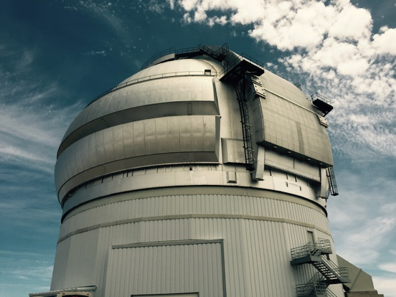
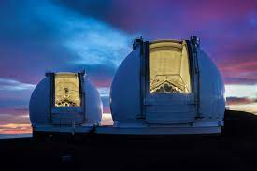
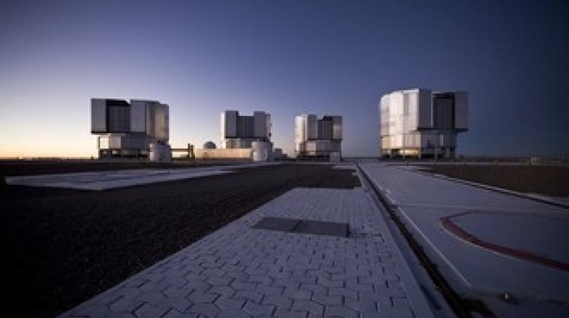
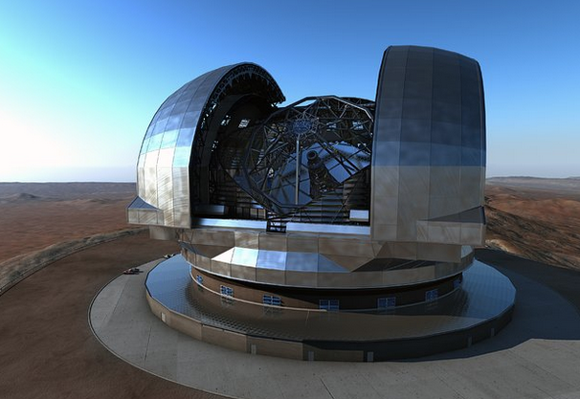
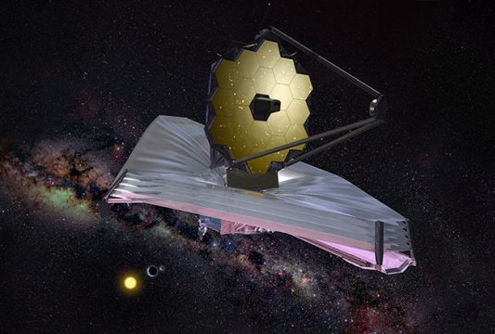
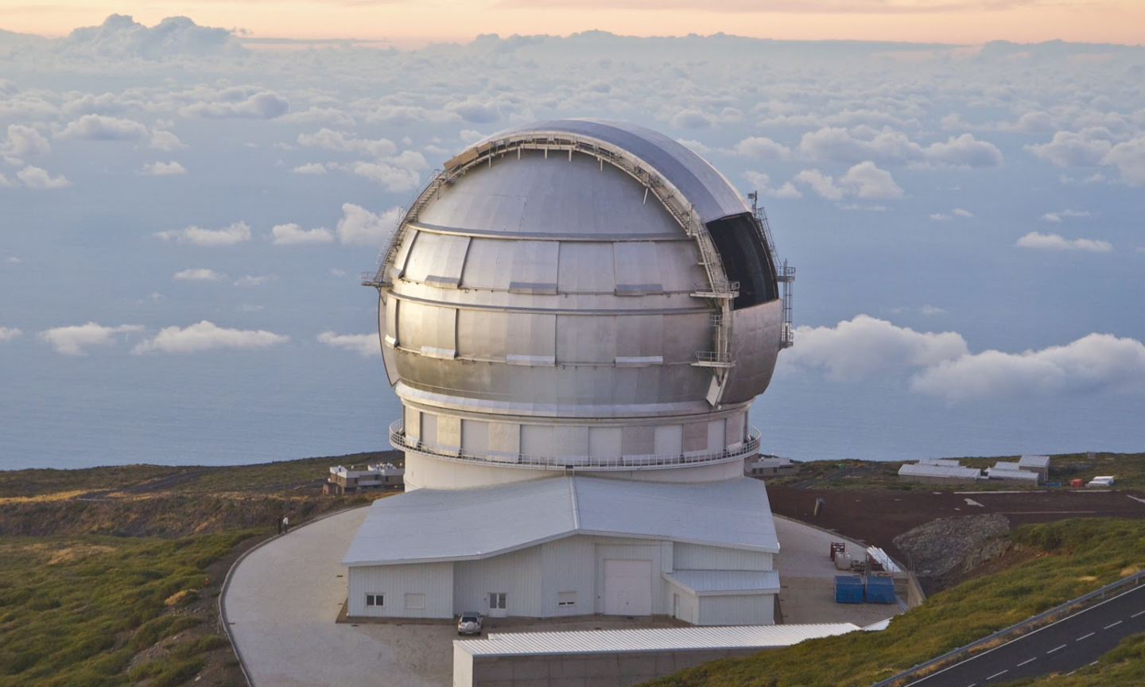
Ground based follow up is built into the DNA of Gamow Explorer
Medium resolution R~3000 IR spectroscopy follow up by large >8m telescopes
Gamow Explorer observation strategy to maximize availability of these large telescopes for rapid follow up when the afterglow is bright
Keck Observatory
Gemini South
Very Large Telescope (VLT)
Gamow Explorer
Gamow team member
Gran Telescopio Canarias
European Extremely Large Telescope (E-ELT)
James Webb Space Telescope

Slide 6

Gamow Optimized Observing Strategy
The search for high redshift GRB is like panning for gold!
High redshift GRBs are rare events with only a few percent predicted to come from z > 6
Large ground and space-based facilities need to know quickly and reliably which are the high value targets to interrupt their planned programs to follow up
Gamow Explorer strategy is optimized to:
Efficiently and rapidly identify rare high z events by autonomously identifying z > 6 GRBs
Observe locations of the sky optimized for JWST and large ground-based telescope follow up
We do not want to throw away any gold nuggets!

Slide 7
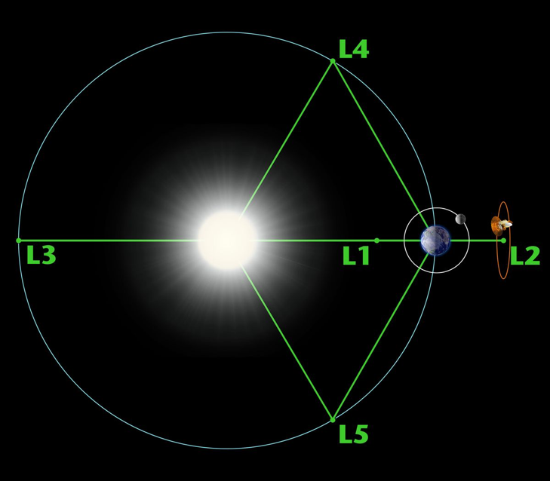
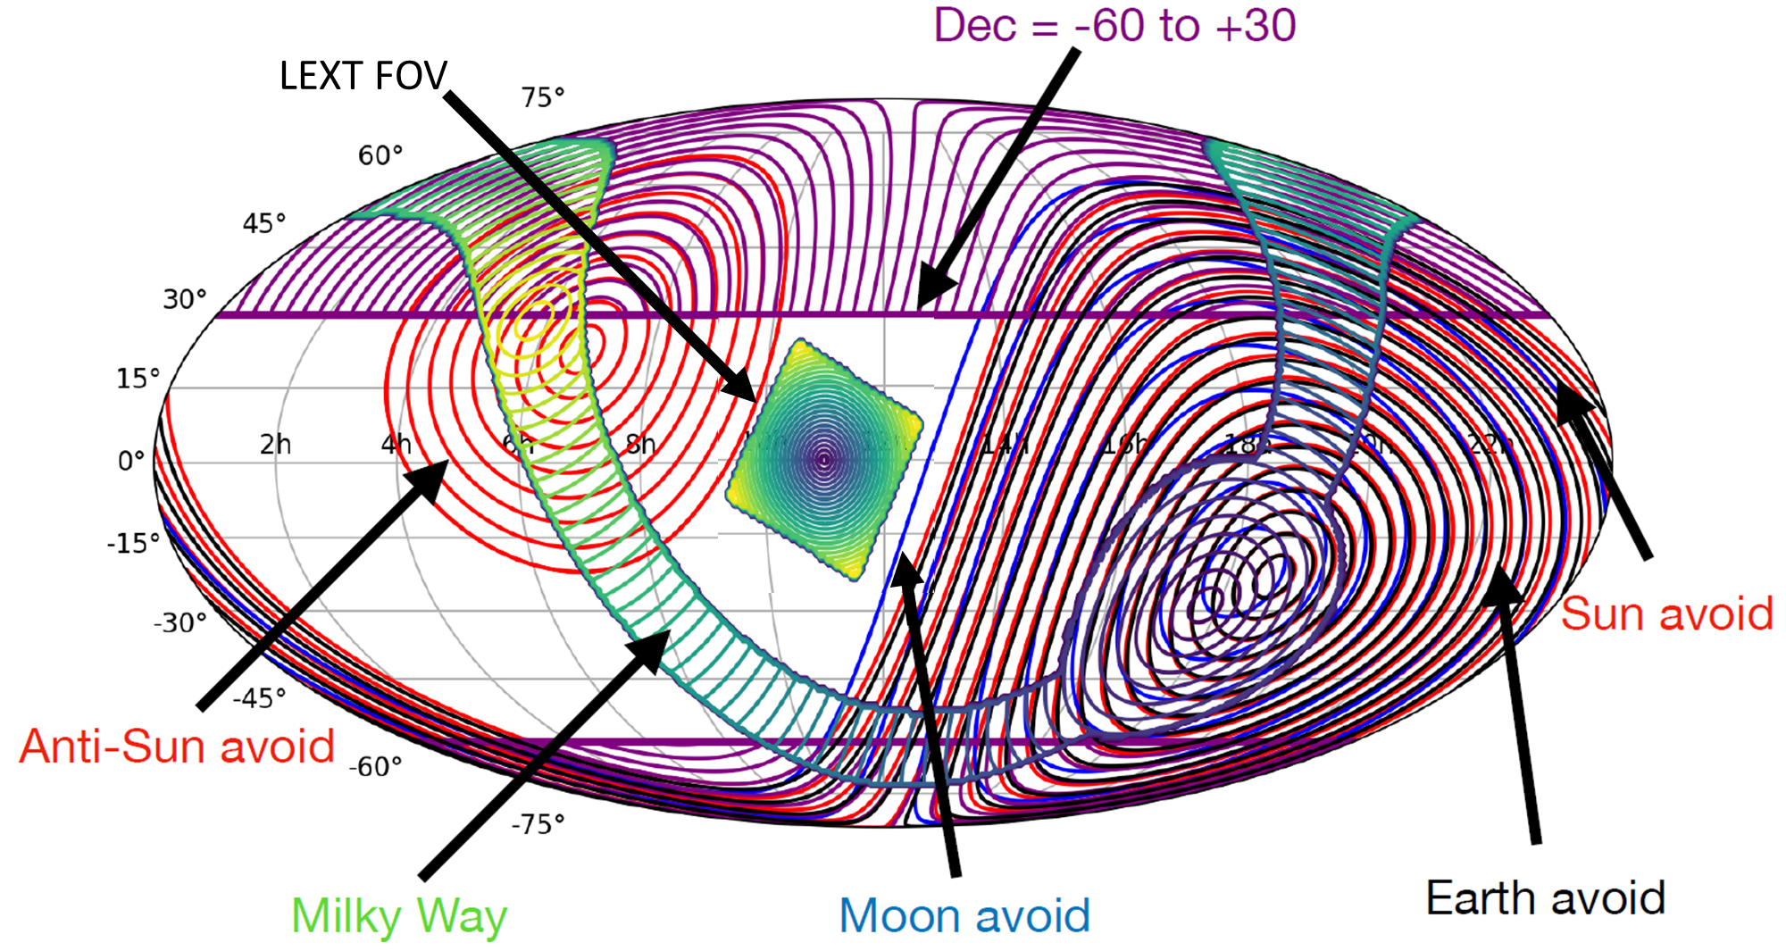
Gamow Explorer L2 Mission Orbit
High observing efficiency (> 95%)
Uninterrupted viewing ideal for finding longer GRBs expected because of cosmological 1+z time stretching
Immediate follow up by IR telescope for photo-z measurement
Passive cooling of IR telescope, IR detector and X-ray CCDs
Observe within the JWST field of regard (sun angle 135-85 deg)
Optimize for ground based follow up between Dec +30 to -60 for telescopes in Hawaii and Chile
Optimize to avoid galactic plane
Low bit rate continuous downlink & uplink via NEN/KSATLite
Rapid response to Multi-messenger events for 50% of the sky
Credit: Jammie Kennea
(>135 deg from sun)
7

Slide 8
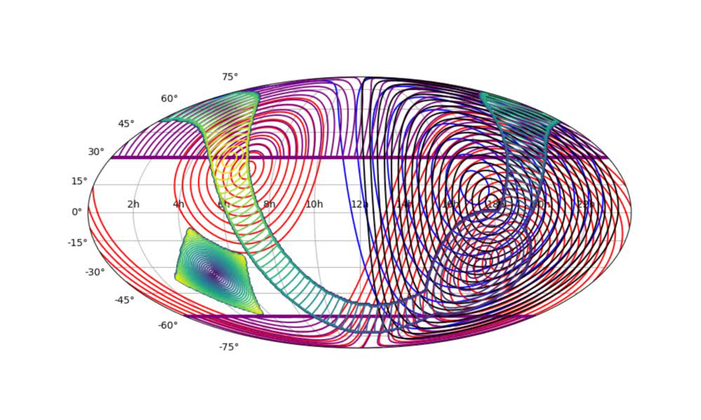
Gamow Explorer L2 Mission Orbit
High observing efficiency (> 95%)
Uninterrupted viewing ideal for finding longer GRBs expected because of cosmological 1+z time stretching
Immediate follow up by IR telescope for photo-z measurement
Passive cooling of IR telescope, IR detector and X-ray CCDs
Observe within the JWST field of regard (sun angle 135-85 deg)
Optimize for ground based follow up between Dec +30 to -60 for telescopes in Hawaii and Chile
Optimize to avoid galactic plane
Low bit rate continuous downlink & uplink via NEN/KSATLite
Rapid response to Multi-messenger events for 50% of the sky
Credit: Jammie Kennea
8

Slide 9
Gamow Explorer GRB rate per year vs. redshift
LGRB Rate (z > 6) = Predicted Rate x Observational Efficiency x Redshift Retrieval (R)
Requirement of >20 GRB with z > 6 to meet the science objectives
Gamow will be > 95% observational efficient in an L2 orbit
Gamow will increase the redshift retrieval rate for z > 6 GRBs from ~30% (Swift) to >80% with an onboard 5 channel photo-z IR telescope
Models predict that Gamow will detect 8 GRB (z > 6) every year (~15 times more than Swift) with ~24 over a 3 yr prime mission
Rate of z > 6 GRB every ~6 weeks consistent with interrupting JWST, Keck Observatory and other large (>8m) ground-based telescopes
Redshift | Swift R = 0.3 LGRB yr⁻¹ | Gamow R = 0.8 LGRB yr⁻¹
z > 0 | 23 | 153
z > 5 | 1 | 13
z > 6 | 0.5 | 8
z > 7 | 0.24 | 5
z > 10 | 0.06 | 1-2
Credit: Giancarlo Ghirlanda and Ruben Salvaterra
Notes:
XCAT thresholds LEXT thresholds
7σ & >50cts, P >1e-10 & >5 counts
bkg=100 cts/s,
2-10 keV

Slide 10
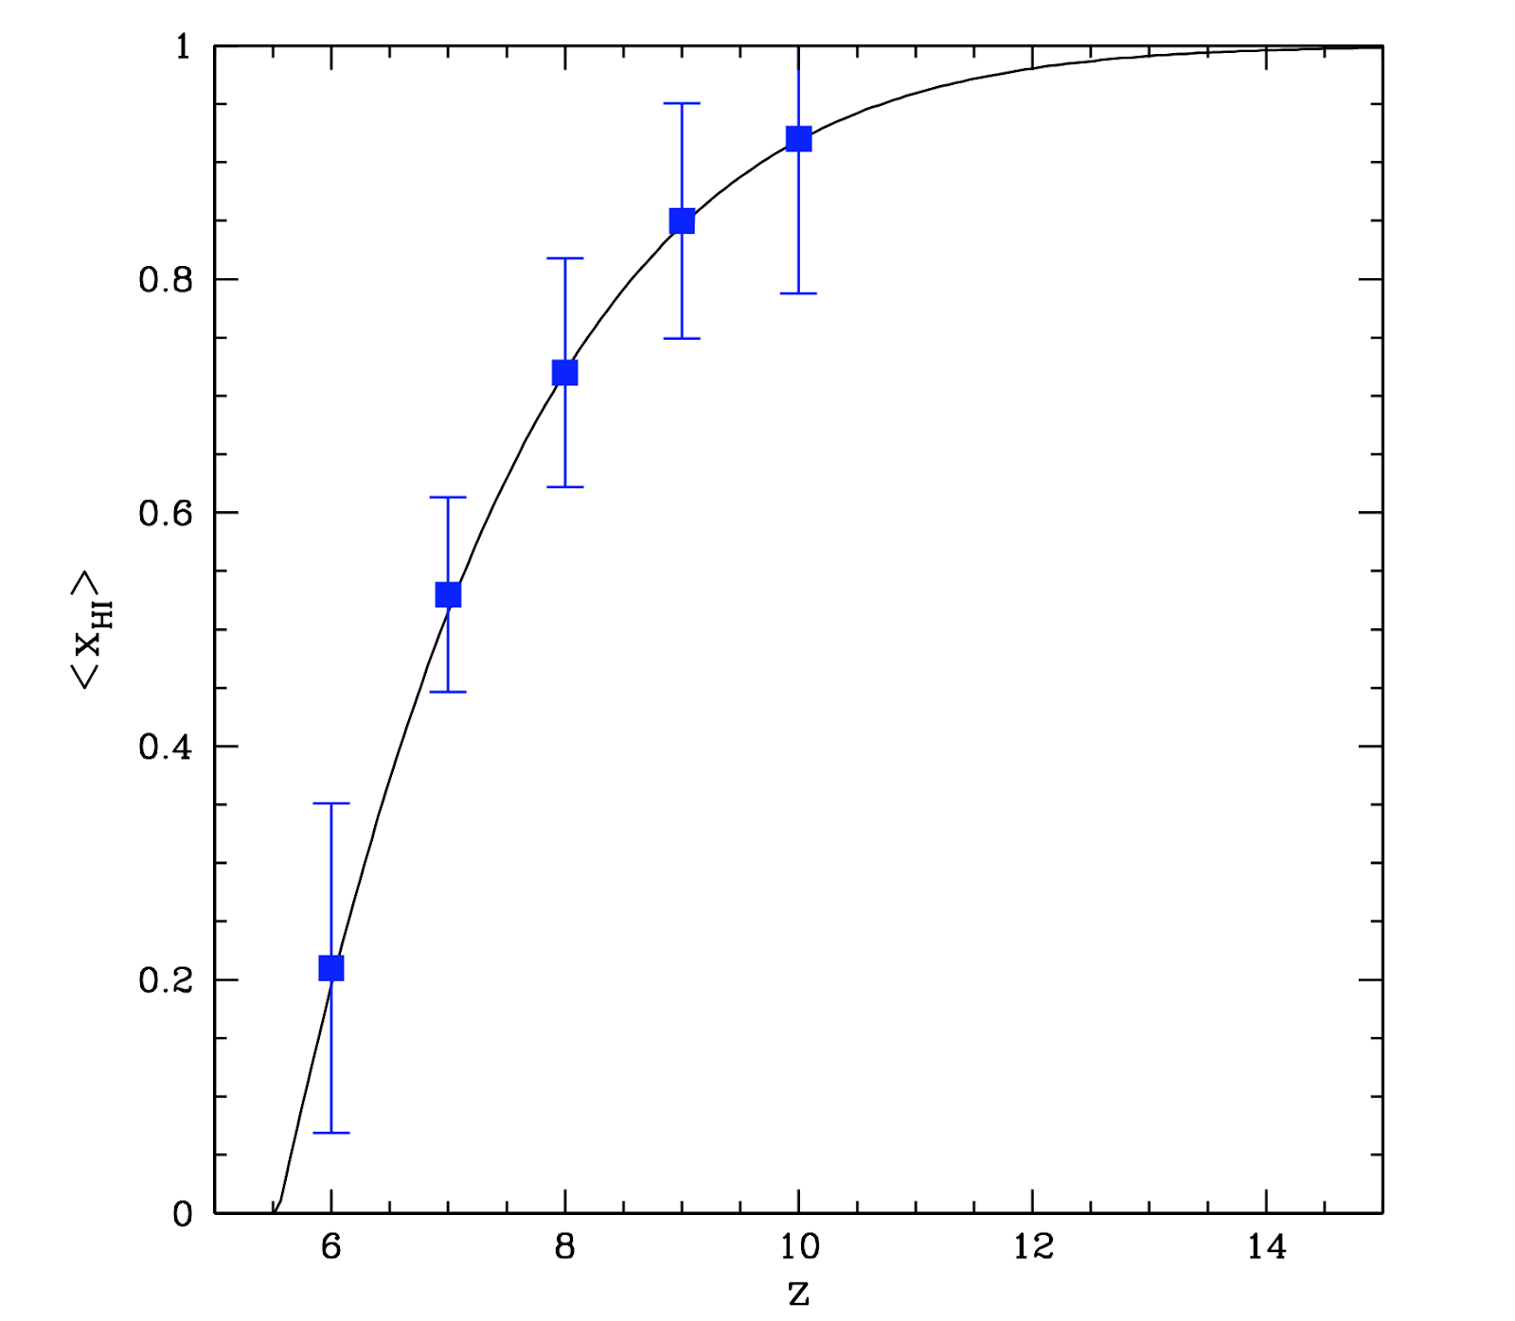
Determine the timeline and sources of reionization
Gamow Explorer together with >8m telescopes (ground and space) will measure the IGM neutral fraction x_{HI} to constrain the timeline of reionization at high redshift
Reionization history Fischer matrix forecasts for 20 GRB z>6 sightlines Incorporate expected GRB redshift distribution dN_{GRB}/dz following SFRD (Lidz et al in preparation)
Includes distribution of ionized bubble sizes L vs. z around GRB hosts from reionization simulations
Distribution of DLA galaxy column density N_{HI} from GRB observations
Spectral signal to noise ratio of spectroscopy of 20 at R=3,000
Error bars on X_{HI} marginalize over degenerate parameters L and N_{HI}
z > 8 is the sweet spot for GRBs (where QSOs are rare)
Preliminary GRB forecast (Lidz, Chang, Hennawi et al)
Notes:
Figure 1. Reionization histories predicted by integrating Equation (24) with a constant emission rate of ionizing photons per hydrogen atom, ⟨n ̇ ion ⟩/⟨nH ⟩ = 2.9 Gyr−1. Left panel: Average neutral fraction (1 − Q) of an IGM that recombines according to Equation (22) (solid curve) or Equation (23) (dashed curve). In
̄ ̄
both models the photon mean free path includes a contribution from the LLSs. The dotted line shows a model without LLSs and with trec = trec,S. The curves
illustrate that the process of reionization is quite extended: even if it completes at redshift 6, the typical location in the IGM is 50% likely to be fully ionized already at z ∼ 8. The data points represent constraints on the ionization state of the IGM from: the Gunn-Peterson optical depth at 5 < z < 6.1 (red open circles, Fan et al. 2006), measurements of the Lyα forest opacity combined with hydrodynamical simulations (green triangles, Bolton & Haehnelt 2007), the dark pixel statistics at z = 5.6 and z = 5.9 (blue squares, McGreer et al. 2015), the gap/peak statistics at z = 6.32 (magenta square, Gallerani et al. 2008), the damping wing absorption profiles in the spectra of quasars at z = 6.3 (orange pentagon, Schroeder et al. 2013) and z = 7.1 (turquoise hexagon, Greig et al. 2017; Mortlock et al. 2011), the redshift-dependent prevalence of LAEs in narrow-band surveys at z = 7 and z = 8 (firebrick stars, Schenker et al. 2014) and their clustering properties at z = 6.6 (gold hexagon, Ouchi et al. 2010). The recent limit on the redshift at which ⟨xHI⟩ = 0.5, extracted from the Planck CMB data (Planck Collaboration et al. 2016), is plotted as the green dot.

Slide 11

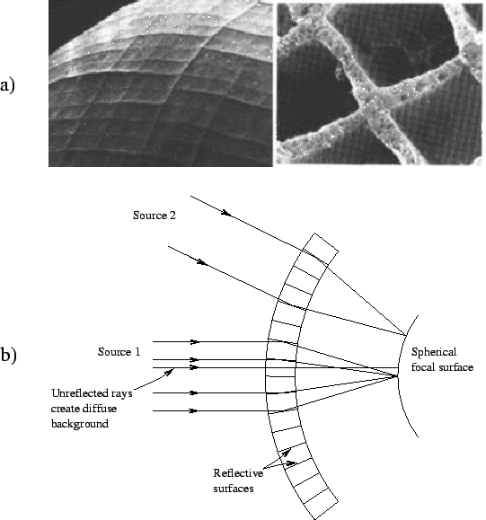
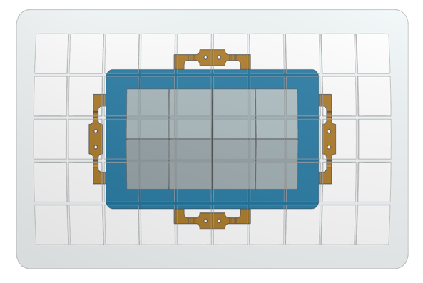
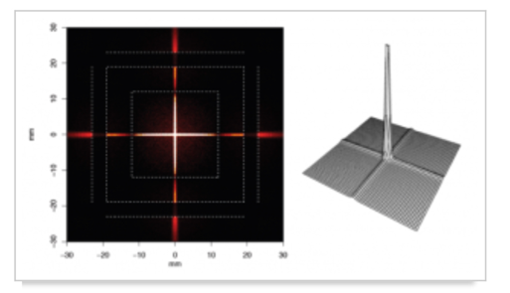
Lobster Eye X-ray Telescope (LEXT)
Optics based on how a Lobster’s eye works (Angel 1979)
Micro channel plate optics on a spherical frame provide wide field of view X-ray telescope
(Wayne Baumgartner, Nick Thomas MSFC, Charly Feldman, Paul O’Brien University of Leicester)
  1358 sq deg in two modules (18.5x36.9 deg each module)
  0.5 to 5 keV
  7 arc minute PSF, localization 1-2 arc min
  Heritage: BepiColombo, SVOM, SMILE
Focal planes are array of CCD chips
(Mark Bautz, Catherine Grant MIT/LL)
  Each detector 5 x 5 cm
  Focal plane for each module is 2 x 4 detectors
  Heritage: ASCA, Chandra, Suzaku, TESS
Cross shaped PSF
Notes:
1 min
Tot: 6 min
XCAT”
Same technique as INTEGRAL IBIS and Swift BAT, but at lower energies.
Covers twice the sky area of Swift (1/3 of all-sky)
Lower-energy range to catch higher- redshift bursts (1–20 keV)
Improved position accuracy (30”)
Triggering software from Swift BAT
team (LANL)

Slide 12
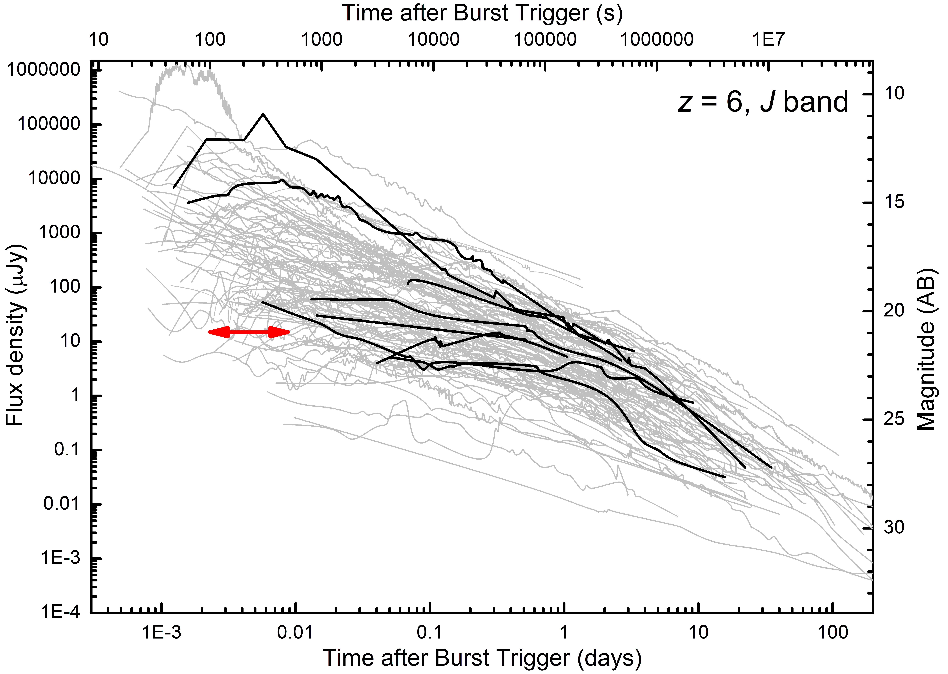
Setting the Gamow IR Sensitivity Requirements
The afterglow lightcurves from ground-based telescopes can be used to set the sensitivity requirements for the Gamow IR telescope – a very diverse sample obtained in various filters and at different redshifts (Cosmological time dilation and luminosity effects are important)
Alex Kann gathered photometry data from a large sample of Swift-era GRBs transforming afterglow lightcurves into a sample of extinction-corrected z=6 J band lightcurves (solid lines are z > 6 GRBs)
Cosmological redshift → longer
Cosmological dimming → fainter
The two effects roughly cancel out!
To detect >80% IR afterglow requires a sensitivity of Apparent AB Mag ~21 (15 μJy) in 500s
JWST NIRSpec
R ~ 1000
10 sigma limit in 10⁴s
Gamow 5 sigma 15 μJy Limit in 500s
Credit: Kann
Notes:
SCORPIO on Gemini will go down to mag 24.4 (0.3 microJy) in imaging (S/N=3) and mag 20.7 (8.4 microJy) in spectroscopy (S/N=10, R~4000) in the J channel in a 30-minute integration; so we should be able to get a nice spectrum (and multi-color light curves) of several afterglows with some 8-10 meter class telescopes, and then go after the host galaxies with the ELTs and JWST

Slide 13
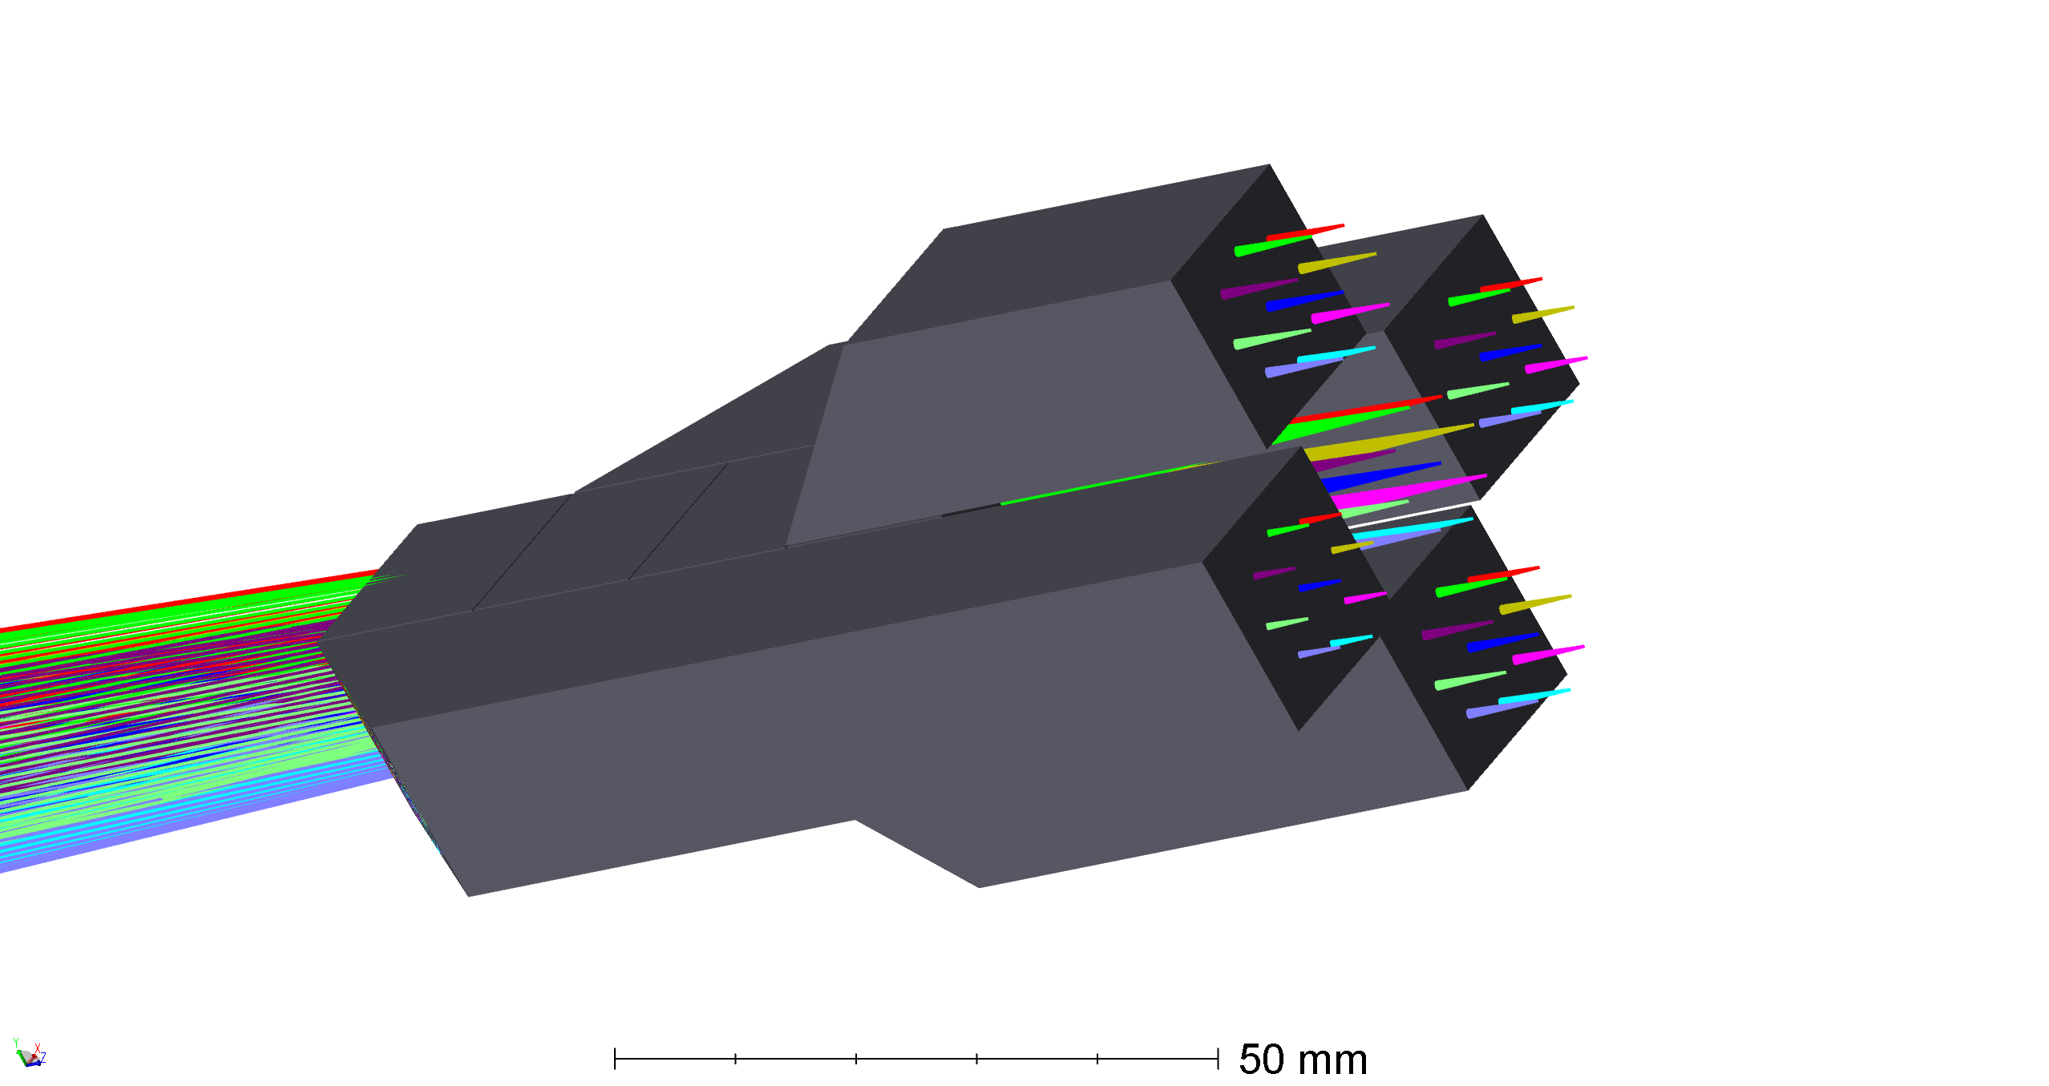
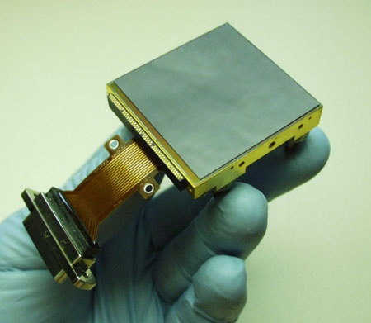
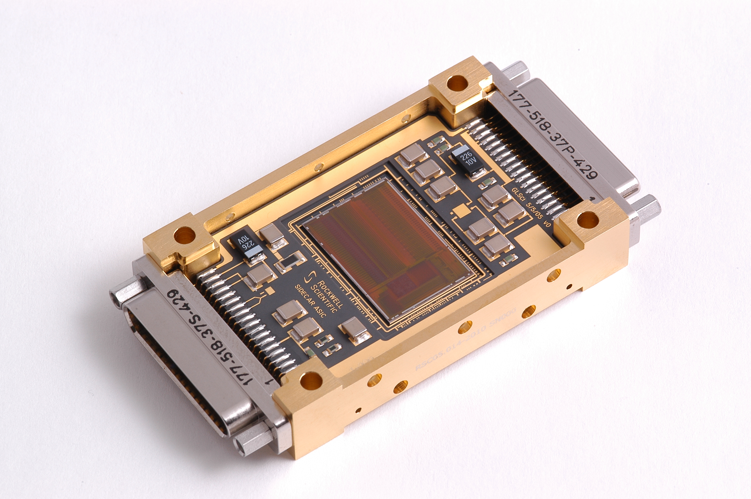
Photo-z Infra-Red Telescope (PIRT) Design
Simultaneous coverage in 5 Bands (0.5-2.5 μm)
Monolithic fused silica epoxy-bonded five-channel dichroic beam splitter
All-aluminum 30 cm telescope passively cooled to =<200K
Using JWST flight spare H2RG detector and SIDECAR ASIC, passively cooled to 100K & 130K respectively
JPL Team: Mike Seiffert, Phil Willems, Mike Rud, Erick Young

Slide 14
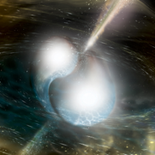
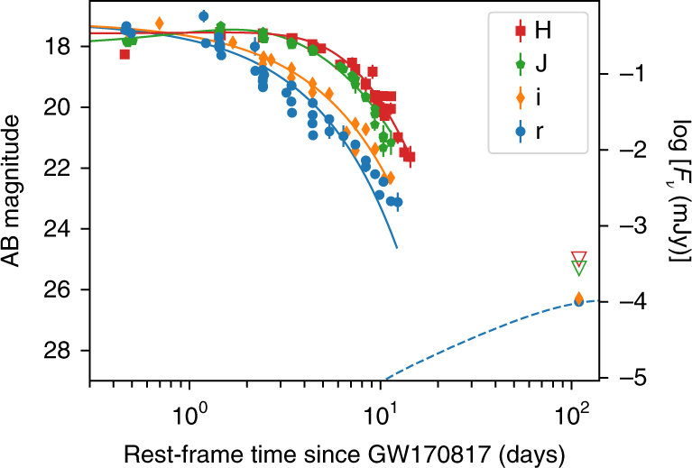
Objective 2A: Search for X-ray and Optical-IR EM counterparts for up to 50% of GW events and rapidly provide their location to other telescopes for follow up observations
Wide Field of View X-ray Optics provide arc min location
Rapidly identify uncatalogued X-ray source associated with gravitational wave merger, requires 1000 sq deg X-ray field of view with arc minute positioning capability during O5(A+) observing runs (currently projected to start in 2026)
External trigger requirement for LEXT to be on target within 100-1000s for 50% of the sky
IR telescope rapid follow up provides arc second position and Kilonova characterization
Horizon of ~200Mpc for LEXT and PIRT in 1000s
This capability will enable other multi-messenger and Time Domain Astronomy science e.g. following up neutrino events
Near-IR telescope provides arc sec location

Slide 15
Gamow Explorer Summary
Use the most luminous cosmic explosions to illuminate the era of reionization
Timely 2028 launch overlaps JWST & A+ gravitational wave facilities era
Key component of Multi-Messenger/Time domain Astrophysics Network
L2 orbit optimizes follow up observations & rapid response
Low risk with high heritage technology
International contributions to the Gamow mission are welcome!
newhite@gwu.edu

