Slide 1
SWG6: Ancillary and Observatory Science
Andrew Blain
26 March 2021
For SWG6 (50 members)
Coordinators: Andrew Blain, Luciano Burderi, Alberto Castro Tirado, Alessandra De Rosa, Victor Doroshenko

Slide 2
Introduction
Sensitive IR/X-ray space telescope is a rare opportunity.
In the era of LSST/Rubin, WFIRST/Roman, likely post-JWST, alongside Athena.
Visit cadence is flexible
Majority of orbit time could be spent on pointed targets
Unblocked by atmosphere for IR spectroscopy of relatively bright objects
SXI performance estimates positive for meeting prime GRB goal
Assists flexibility for observatory and ancillary science.

Slide 3
Opportunities
Many more potential interesting targets that can be accommodated
Solar system objects, comets. Spectroscopic capabilities in ground-blocked windows. Planetary monitoring.
Active stars, XRBs, exoplanet spectroscopy, transit follow-up.
More sensitive than ARIEL.
SN “ToOs” for spectroscopy.
Galaxy samples blocked by atmosphere, redshifted Halpha at z~1
AGN: changing-look, variability, TDEs, year-timescale events

Slide 4
Relative drawbacks
ToO rate, and alert time.
Slitless spectroscopy limits target brightness
Resolution R~3-500 favours “detection level” spectroscopy
IR sensitivity (inevitably) way down on JWST, WFIRST-Roman, ELTs in atmospheric windows.
X-ray sensitivity vs Athena, likewise much lower.
In context of operating eROSITA, and all-sky survey.
Variability of sources on ~8 year timescale
Ongoing monitoring of this excellent background catalogue

Slide 5
Pointing/survey strategy
Potential targets all over sky.
Galactic plane has an excess
Some tension with GRB search
ALTHOUGH SXI field wide enough not to negate Galactic fields.
Sensitivity estimates suggest 50 z>6 GRB target should be comfortably met.
Central IRT field to edge of SXI costs ~2 in factor of time to reach a sensitivity
Sensitivity suggests ~1/2, 1/3 orbit dwell times are reasonable
Little tension with GRB search
Cadence for monitoring, transit observation suitable for large samples. Order of 1000 listed is plausible for regular coverage.
Unusual AGN, known exoplanet systems.

Slide 6
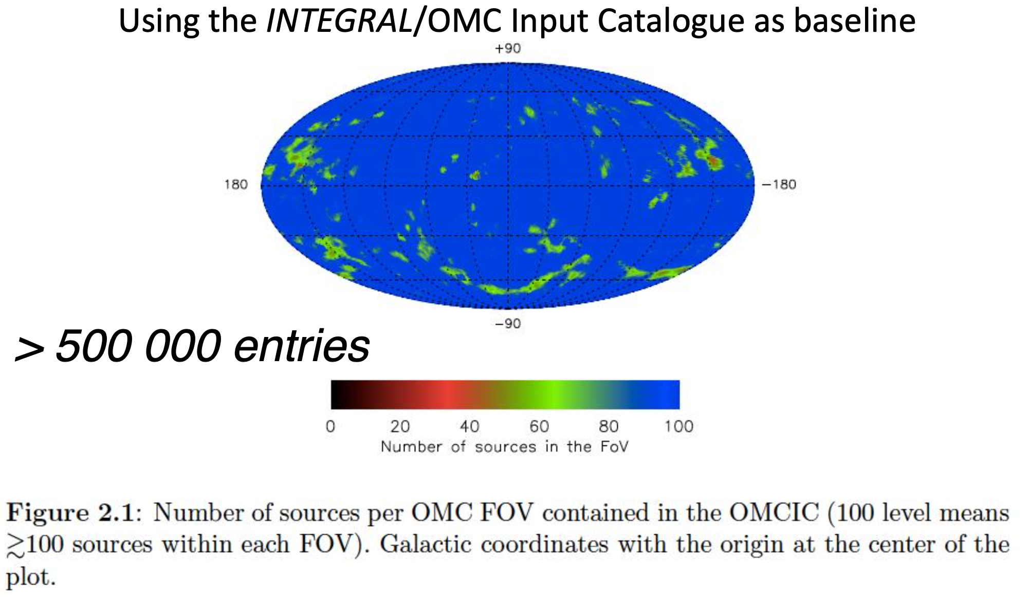
THEIC; Castro-Tirado & Caballero-Garcia
Based on Integral/OMC catalogue.
Will be interesting to compare and revise from eROSITA’s growing catalogue.
Also XMM and Swift and serendipitous catalogues are growing.

Slide 7
Yellow Book coverage of observatory science.
Flexibility of survey-mode pointings crucial for Observatory and Ancillary Science.
Encouraging from study updates to performance,
Ground-segment/downlink capability to compile X/gamma-ray time-series catalogue.
Unique THESEUS features
IR space telescope for spectroscopy. SN, comets
Exoplanet transits, perhaps spectroscopy. 1000s of potential targets
X-ray/IR monitoring of chosen interesting XRBs, AGN
Catalogue size can overfill the mission ~30 sources per day, ~1000 per year. Have at least 10,000 interesting targets.

Slide 8
More information.
Time-domain visits are a THESEUS strength, so observatory science is summarized in the Yellow Book in the Merenghetti chapter.
Significant future capabilities are coming online prior to THESEUS
See SWG5.
JWST, LSST/Rubin, WFIRST/Roman, SKA.
Availability of IR spectroscopy capability over a substantial period.
As prime mission requirement reached, then the availability of observatory time should increase.

