Slide 1
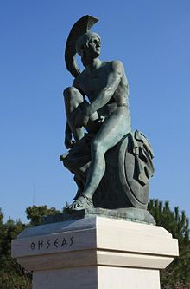
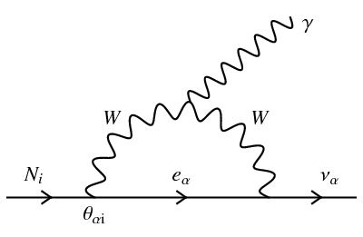
Fundamental physics with THESEUS: the quest for dark matter
Andrea Santangelo IAAT, Kepler Center Tübingen (& Charles Thorpe-Morgan, Denys Malyshev,...)
Notes:
Dear Colleagues, let me thank you for this kind invitation. It’s a pleasure for me to present the capability of THESESUS for dark matter study.

Slide 2
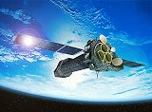
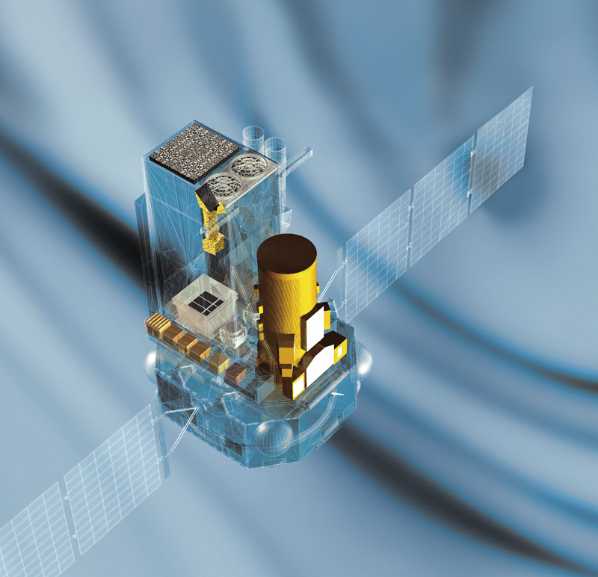
High energy observatories currently in orbit
Launched June 2017
Launched July 2019
XMM-Newton
INTEGRAL
FERMI
This list is not exhaustive (Chandra, Agile, AstroSAT, Swift are not in the list!)

Slide 3
X-ray observatories: a bright future
2021
2031
2032
2021
2027
2021
2022
Arcus is missed, Strobe X is missed, HERD is missed.

Slide 4
Golden Age of High Energy Astrophysics
Accretion physics of galactic compact Objects
Investigating the astrophysics of high magnetic fields
Mapping Galaxies and the entire X-ray sky
Extreme physical conditions around supermassive black holes, determine the contribution of accretion power to the energy budget of the Universe
Physics and cosmic evolution of the hot gas which forms the major baryonic component of the cosmos
Cosmic feedback: connecting black holes to large structures
Complete census of the Gamma-Ray Burst (GRB) population in the first billion years
The physics of high energy transients
The physics of cosmic acceleration
...
Plenty of science expected!

Slide 5
Rationale of the talk
Not only Astrophysics - Topics of fundamental Physics that can be addressed in High energy Astrophysics:
EOS of ultradense matter: NSs studies
Unveiling QED effects
Dynamics of particle in Strong GR fields
Acceleration mechanisms
Dark energy studies
Quantum Gravity
Dark Matter search: Sterile Neutrinos, ALPS, Dark Photons, WIMPS…
Notes:
It is true that I am getting senior, if not old, and therefore I have the privilege not too need many papers, and therefore I have the privilege to select projects that can be risky. In my talk I wish to show you a few example of research that can bring us fundamental physics discoveries with X-ray observatories, or let’s say high energy enterprises.

Slide 6
Evidences for dark matter

Slide 7
Dark matter candidates
Dark Sector
SM→ Standard Model of Particle Physics
Notes:
Several Candidates, of baryonic nature, within the Standard model of particle physics. Of non baryonic nature, but in the frame of the standard model (like neutrinos) do not explain dark matter.

Slide 8
DM particle features
Massive particle (mass depends on the candidate)
Produced in the Early Universe; non-relativistic before CMB decoupling.
Weakly-interacting (to survive cosmological time)
Not charged
Motivated beyond DM (needed for new physics)

Slide 9
A collection of DM particle candidates
Weakly Interacting Massive Particles (WIMPs)
$$m≥1 GeV$$
Axion-like particles (ALPs)
$$m_{a}\sim {10}^{3} eV$$
$$a→γ+γ$$
Sterile (right-handed) neutrinos
Decay models
$$m_{N}≥1 keV$$
$$N→γ+ν$$
To detect decaying dark matter observing the corresponding feature in DM-dominated objects' (photon) spectra.
Dark photons
$$m_{V}<511 keV$$
$$V→3γ$$
Thorpe-Morgan, Malyshev, AS at al., 2020; Aprile et al. arXiv:2006.09721

Slide 10
Key remarks
– In astrophysics there is no way to directly measure the parameters (e.g., mass) of DM particle.
– Then? To deduce these parameters from observations that do not have a reasonable astrophysical explanations.
– The idea? To detect decaying/annihilating dark matter observing the corresponding feature in DM-dominated objects' (photon) spectra.
The signal depends on the DM amount (and spatial distribution in annihilating DM case) in the instrument's FoV

Slide 11
The basics of DM candidates decay
The decay of massive particles with mass m_{DM} with an emission of μ photons in each decay will result in the following spectrum:
$$\frac{dℱ}{dΩ}=\frac{1}{4π}\frac{μJ}{m_{DM}}\frac{dΓ(E)}{dE}$$
J is the dark matter column density
The term Γ represents the radiative decay width. In the observing Field of View (FoV) of an istrument we get:
$$J_{FoV}=\int_{FoV}{\int_{l.o.s}{dldΩ}}$$
$$ℱ_{FoV}=\frac{1}{4π}\frac{μJ_{FoV}}{m_{DM}}\frac{dΓ(E)}{dE}$$
The
Γ is radiative decay width depends on the particle candidate!
Thorpe-Morgan, Malyshev, AS et al., 2020

Slide 12
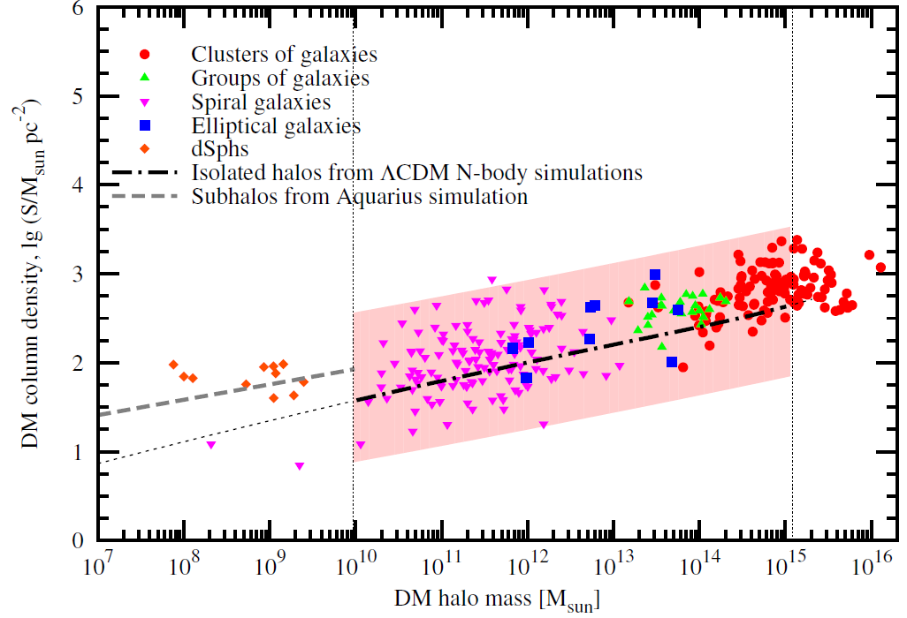
Where to look for DM signals?
Boyarsky et al., 2012
$$J_{FoV}$$
Our Galaxy?
Clusters of Galaxies?
Dwarf spheroidals?
Some other object?
Lower astrophysical background and good knowledge of DM density distribution!
$$J_{FoV}=\int_{FoV}{\int_{l.o.s}{dldΩ}}$$
Consider targets of comparable angular size to the instrument’s FoV!
Michailidis, Thorpe-Morgan, Malyshev and AS, 2021

Slide 13
THESEUS

Slide 14
A brief summary
Several next-generation X-ray missions in the next 10 years
High effective area and/or broad FoV
Well suited for studies of a weak signal originating from the entire FoV

Slide 15
THESEUS DM study: the target
Where to look with THESEUS?
To observe local concentrations of dark matter→ Milky Way halo
The density of DM follows the Navarro-Frenk-White profile
The FoV is assumed to be parallel to the galactic plane and roughly corresponds to the sky area at the border of which the effective area is 50% of the on-axis one…
Parameters of the simulated observations→ Thorpe-Morgan et al.’s paper

Slide 16
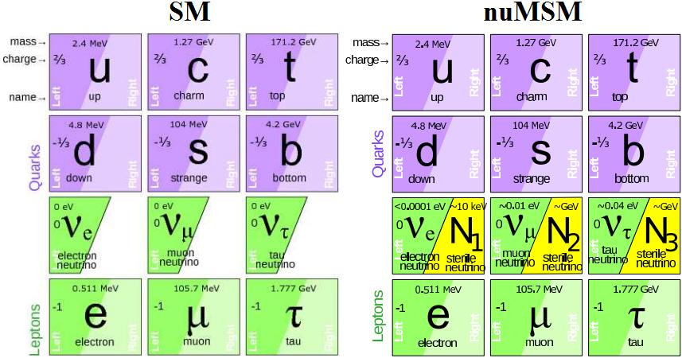
Sterile neutrino DM
SM particles have positive (right- handed) and negative (left-handed) projection of the spin onto their momentum. Standard neutrinos are left-handed only.
νMSM proposes to add right-handed «sterile» companions to the neutrinos.
νMSM:
is a ‘natural’ extension of the SM
can explain low neutrino masses (seesaw mechanism) / neutrino oscillations
gives candidate(s) for the Dark Matter
…
Notes:
– it is a «natural» extension of the SM
– It can explain low neutrino masses (seesaw mechanism) / neutrino oscillations
– it provides a way to explain baryon number generation in the Early Universe
– gives candidate(s) for the Dark Matter
– probably accounts for some observed phenomena (e.g. pulsar kicks)

Slide 17
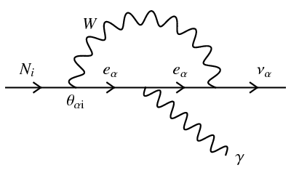
Sterile Neutrinos (2)
Radiative decay channel suggests a narrow line at energy E=m_{N}/2
$$\frac{dΓ(E)}{dE}=\frac{9α_{QED}G_{F}^{2}}{4π^{4}256}\sin^{2}(2θ)m_{N}^{5}δ(E−{m_{N}}/{2)}$$
Parameters to be constrained
θ is the mixing angle
Notes:
it provides a way to explain baryon number generation in the Early Universe

Slide 18
THESEUS and Sterile Neutrinos
1 Msec simulated observations of the Milky Way's DM halo
Control of systematics is needed!

Slide 19
A second candidate: Axions
Axions invented to solve strong CP problem in QCD but a good candidate to be DM, see e.g. Marsh, 2015 for a review.
QCD axion → particle with specific m_{a}- g_{a} relation
More general type of particles - ALPs (axion-like particles)
Massive particles but light (since CP violation is tiny)
Non-relativistic (CDM/WDM)
Produced in the early Universe
Weakly interacting to survive cosmological times
Notes:
– it is a «natural» extension of the SM
– It can explain low neutrino masses (seesaw mechanism) / neutrino oscillations
– it provides a way to explain baryon number generation in the Early Universe
– gives candidate(s) for the Dark Matter
– probably accounts for some observed phenomena (e.g. pulsar kicks)

Slide 20
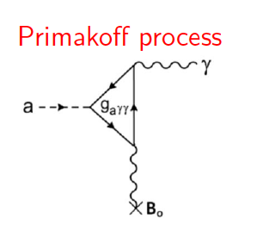
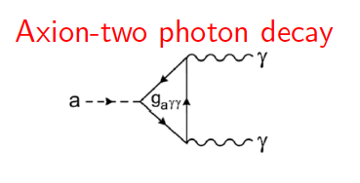
How to detect them?
Axions are coupled to direct observables through:
$$\frac{dΓ(E)}{dE}=\frac{g_{aγγ}^{2}}{64πℏ}m_{a}^{3}$$
In a presence of (electro)-magnetic field axions can be converted to a photon and viceversa: photon-axion oscillations

Slide 21
THESEUS and Axions
Dashed lines→ including systematics

Slide 22
Dark Photons
It is a (conjectured) new gauge bosons, and arises from a symmetry of a hypothetical dark sector
Pospelov et al., 2008; Review by Fabbrichesi, Gabrielli, Lanfranchi, 2020

Slide 23
THESEUS and dark photons
Dashed lines→ including systematics
Very large discovery space!

Slide 24
Conclusions
The next generation of high energy observatories will produce new astrophysics and will have a robust program of fundamental physics. Not discussed here Athena, eXTP.
THESEUS, in addition to its numerous scientific objectives, provides prime potential for the complementary study of the decaying DM’s parameter space.
THESEUS, alongside well controlled systematics, has the potential to either detect decaying dark matter, or to impose some of the strongest constrains on its properties (mass, coupling)

Slide 25
Stay Tuned for surprises!
Thank you.
Contact:
Andrea Santangelo
Abteilung Hochenergieastrophysik
Sand 1, 72076 Tübingen · Germany
Phone: +49 7071 29-76128
Andrea.Santangelo@uni-tuebingen.de

